Slide 1
An operational architecture for privacy-by-design in public service applications
Prashant Agrawal, Anubhutie Singh, Malavika Raghavan, Prof. Subodh Sharma, Prof. Subhashis Banerjee

Slide 2
Agenda
Regulatory context: Digitising public services & citizens’ rights
Failure of consent and “privacy self-management”
Need for a technical operational standard for data protection regulation
Deep dive into operationalization using trusted executables & regulatory architecture for:
Electronic health records
Direct benefit transfers
Contact tracing

Slide 3
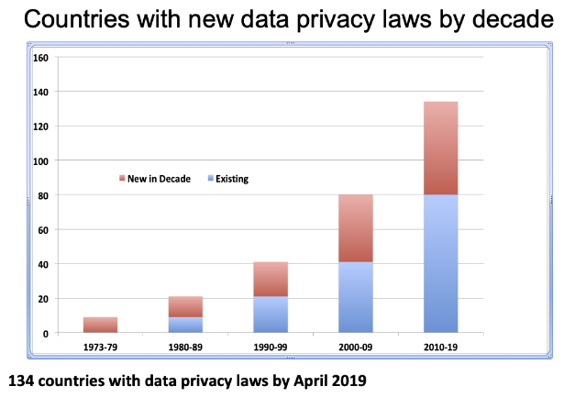
Source: (Greenleaf ’19) (link)

Slide 4
Regulatory Context
Move to accountability-led approaches in data protection law
Identify grounds of processing, PRIOR to processing data (Art 6 GDPR, Ch III & s. 11 PDP Bill) (subj to exceptions/ exemptions)
process data for specified purpose with safeguards (Art 5(1) (b) GDPR, s. 4 PDP Bill, with data minimisation)
process personal data “fairly” throughout life cycle of processing (Art 5(1)(a) GDPR, s. 5(a) PDP Bill)
Larger focus on organizational data practices (Ch. IV GDPR, Ch. VI PDP Bill)
heightened accountability of data-processing entities TO regulator and FOR regulators to monitor and supervise. (Ch. VI GDPR, Ch IX PDP Bill)

Slide 5
Failure of consent and privacy self-management
Asking for “consent” for data-sharing is widely recognised as meaningless or a false choice.
Many cognitive biases operate on users making decisions about sharing their personal information (Solove, 2013; Acquisti & Grossklags, 2006) .
High degree of information asymmetry about how providers will use and share personal data.
The threat of denial of service makes “taking consent” a false choice (Acquisti, 2004).

Slide 6
Framing the “Privacy Paradox” against this reality
The paradoxical observation where people state that they value their informational privacy yet reveal their personal information for smaller benefits (Kokolakis, 2015).

Slide 7
Privacy in India: Puttaswamy & the PDP Bill
Justice K.S.Puttaswamy (Retd.) vs Union of India –
Informational privacy as
“…an interest in preventing information about one-self from being collected and in controlling information about one-self that others have legitimate access to” (Koops et. al, ‘17)
PDP Bill and “data fiduciaries”
a fundamental expectation of trust is the basis of which people share personal data with companies and the State
This (should) operate irrespective of consent

Slide 8
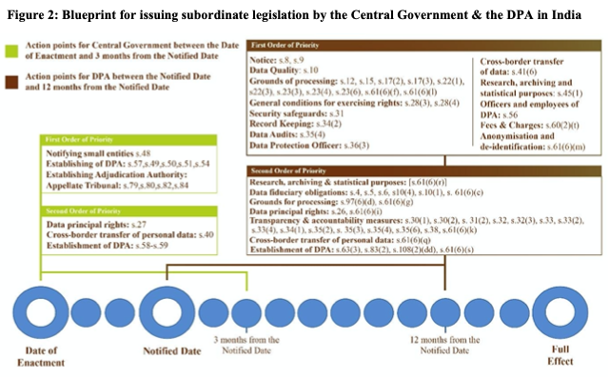
Operationalising “privacy” guarantees

Slide 9
Operationalising “privacy” guarantees
Need for a technical operational standard for data protection regulation
Enforcement & Subordinate Regulation detailing
Deep dive into operationalization using trusted executables & regulatory architecture for:
Electronic health records
Direct benefit transfers
Contact tracing

Slide 10
References
Greenleaf, Graham, Countries with Data Privacy Laws – By Year 1973-2019 (May 10, 2019). Available at SSRN: https://ssrn.com/abstract=3386510 or http://dx.doi.org/10.2139/ssrn.3386510
General Data Protection Regulation available here: https://eur-lex.europa.eu/legal-content/EN/TXT/?uri=CELEX:02016R0679-20160504
Personal Data Protection Bill 2019 (as of December 2019) available here: http://164.100.47.4/BillsTexts/LSBillTexts/Asintroduced/373_2019_LS_Eng.pdf
Solove, D. J. (2012). Privacy self-management and the consent dilemma. Retrieved from https://papers.ssrn.com/sol3/papers.cfm?abstract_id=2171018
Acquisti, Alessandro and Grossklags, Jens. (2007), What can Behavioural Economics teach us about Privacy? Digital Privacy: Theory, Technologies and Practices. Taylor and Francis Group. Available here: https://www.heinz.cmu.edu/~acquisti/papers/Acquisti-Grossklags-Chapter-Etrics.pdf
Acquisti, A. (2004). Privacy in Electronic Commerce and the Economics of Immediate Gratification. Proceedings of the 5th ACM Conference on Electronic Commerce, 21-29. Available here: https://dl.acm.org/doi/10.1145/988772.988777
Kokolakis, S. (2015). Privacy attitudes and privacy behaviour: A review of current research on the privacy paradox phenomenon (July 2015). Available at ResearchGate: https://www.researchgate.net/publication/280244291_Privacy_attitudes_and_privacy_behaviour_A_review_of_current_research_on_the_privacy_paradox_phenomenon
K.S.Puttaswamy v. Union of India (2017). Available here: https://main.sci.gov.in/supremecourt/2012/35071/35071_2012_Judgement_24-Aug-2017.pdf
Koops, B.-J. (2017). A Typology of Privacy. University of Pennsylvania Journal of International Law, 484-575. Retrieved from: https://pdfs.semanticscholar.org/fe72/a06daf70f03ba5713b529f60c900d5f2564c.pdf.

