Slide 1

Chapter 4:
The Issue, Execute, and
Commit Stages

Slide 2


Background Required to Understand this Chapter
In-Order Pipelines
Precise Exceptions
OOO Pipelines: Basic idea
http://www.cse.iitd.ac.in/~srsarangi/archbooksoft.html

Slide 3

Contents
1.
Instruction Renaming
2.
Instruction Dispatch, Wakeup, Select
3.
The Load-Store Queue (LSQ)
4.
Instruction Commit

Slide 4

Renaming (architectural registers → physical registers)
Consider a 4-issue processor
  4 instructions need to be renamed each cycle
  4 instructions have 8 read operands, and 4 write operands
Each read operand, needs to read its value from a physical register
Each write operand needs to be assigned a new physical register
Dependences between the instructions need to be taken care of
There are two main approaches
  Renaming with a physical register file
  Renaming with reservation stations

Slide 5
Renaming with a physical register file
Every ISA has a set of registers that are visible to software
    These are called architectural registers
    x86 has 8
    x86-64 has 16
    ARM has 16
    MIPS has 32
To ensure precise exceptions, the architectural registers should appear to be updated in-order
However, inside the processor we need to do renaming to eliminate output and anti dependences

Slide 6

Physical Register File and the Process of Renaming
R1
R2
R16
Architectural register file
Physical register file

Slide 7


Physical Register File
Consider a system with16 architectural registers and128 physical registers
In this case, architectural registers exist in principle. There is no separate architectural register file.
Each architectural register is mapped to one and only one physical register at any point in time.
112 physical registers are unmapped. They either are empty or contain a value that will be overwritten by a later instruction
Why are 112 registers unmapped?

Slide 8
Example
mov r1, 1
add r1, r2, r3
add r4, r1, 1
mov r2, 5
add r6, r2, r8
mov r1, 8
add r9, r1, r2
mov p11, 1
add p12, p2, p3
add p41, p12, 1
mov p21, 5
add p61, p21, p8
mov p13, 8
add p91, p13, p21
r series → architecture, p series → physical
At the beginning ri is mapped to pi
With time, the mapping changes
p12 contains the value of r1 till the value is overwritten. p13 contains the new value. At this point, p12 contains an interim value

Slide 9
Example - II
We need 16 physical registers to contain the latest values of architectural registers
112 physical registers can possibly contain interim values that might be required by instructions in the OOO pipeline (also called in-flight instructions like p12)
More is the number of physical registers → higher is the number of instructions that can simultaneously be in flight → more is the ILP
Renaming: convert architectural register id → physical register id

Slide 10
Rename Stage
Three Structures
  Register Alias Table (RAT) → Translate architectural register id to physical register id
  Dependence Check Logic (DCL) → Take care of dependences between instructions renamed in the same cycle
  Free List or Free Queue → Maintain a list of unmapped physical registers

Slide 11
Register Alias Table
RAT table
Architectural
register ids
Physical
register ids
Rename multiple instructions at once
We get a stream of physical register ids
  Eliminates WAW and WAR hazards

Slide 12
Operation of the RAT Table
Free list
28
32
add r1, r2, r3
r1
14
r2
29
add p32, p29, p34
r3
34
mov r3, r1
RAT table
mov p28, p32

Slide 13
Free List
It is a queue of unmapped physical register file ids
An entry is dequeued from it when we need to assign it to an architectural register id
When is an entry added to it? LATER
Update the RAT with the new mapping
Free list
Physical register id

Slide 14
Dependence Check Logic
add r1, r2, r3
add r4, r1, 1
Let us say r1 is mapped to p11
The second instruction needs to read the mapping of r1 as p11
What if both instructions are sent to the RAT together?

Slide 15
Dependence Check Logic - II
Mappings from the free list
r1 → px
r4 → py
r3 → pz
from RAT
px
inst 2
All mappings from the RAT
from RAT
1) add r1, r2, r3
2) add r4, r1, 1
3) add r3, r4, r6
px
py
inst 3

Slide 16
Available bit in the rename table entry
We need some more information in each entry
  An available bit (avlbl)
  It indicates whether the result can be found in the physical register file and the rest of the pipeline or not.
    If not, the instruction has to wait in the instruction window.
rename table entry
physical register id
avlbl bit

Slide 17
Contents
1.
Instruction Renaming
2.
Instruction Dispatch, Wakeup, Select
3.
The Load-Store Queue (LSQ)
4.
Instruction Commit

Slide 18
Dispatch
Till the rename stage, instructions proceed in-order.
Dispatch → Send the instruction to the instruction window (IW)
Instruction Window
Rename

Slide 19
Instruction Window
Status of an instruction in the window
opcode → type of operation: add, subtract, multiply
tag → physical register id
ready bit → does the physical register file contain the corresponding value
valid
opcode
src tag 1
ready
bit 1
src tag 2
ready
bit 2
dest tag
imm1
imm2

Slide 20
At any point in the instruction window
Instructions waiting for an operand to be ready
Instructions whose operands are ready

Slide 21
Select and Execute
Instruction
Window
Select unit
Register File Read
Execution Unit 1
Execution Unit 2
Execution Unit 3
Execution Unit 4

Slide 22

Wakeup
How does an instruction in the IW know that its operands are ready?
The producer instructions need to let it know
Once a producer finishes executing
  Broadcasts the tag (destination physical register id) to the entries of the IW
  Each entry marks its corresponding source operand as ready if the tag matches
  This is called wakeup

Slide 23
Instruction Window
Tag bus

Slide 24
Instruction Window - II
tag
tag
src tag 1
src tag 2
Ready bit 1
Ready bit 2

Slide 25
Broadcast multiple tags at once
Tag bus 1
src 1
ready 1
src 2
ready 2
Tag bus 2

Slide 26
Instruction Select

Slide 27
Select Unit
Instruction window (IW)
request
grant
Select unit
Once an IW entry has all its operands ready, it is marked as
ready.
It asserts its attached grant line
The select unit chooses one among the ready instructions

Slide 28
Tree Structured Select Unit: Each node is a choice box
requests
requests
requests
Request
Root Node
Granted Request
Request Granted

Slide 29
Select Unit for Multiple Resources
What if we have 2 adders, 2 multipliers, and 1 divider?
Solution:
  Have a separate select unit for each class of instructions
  For a select unit that caters to multiple FUs (functional units)
  Three options: Option 1 → chain select units
request
grant
grant
Select
Unit 1
XOR
Select
Unit 2
request
grant

Slide 30
Option 2: Multiple request signals
Send multiple request signals (up to n)
Every level sends at most n requests to the root
The root selects at most n requests, and issues grant signals
This circuit is more complicated than serial select circuits
  The choice boxes need more elaborate logic

Slide 31
Option 3: Asymmetric Select Units
Have two select units with different policies.
Select unit 1:
  Each choice box gives priority to its left input
Select unit 2:
  Each choice box gives priority to its right input

Slide 32

Select Policies
The select policy has an important implication on performance. We should select those instructions that are the most performance critical.
Random
Oldest First
Type of opcode
  Load instructions typically have higher priority than
  stores.
  Other priorities can also be learnt based on
  execution patterns.

Slide 33
Tag Broadcast

Slide 34
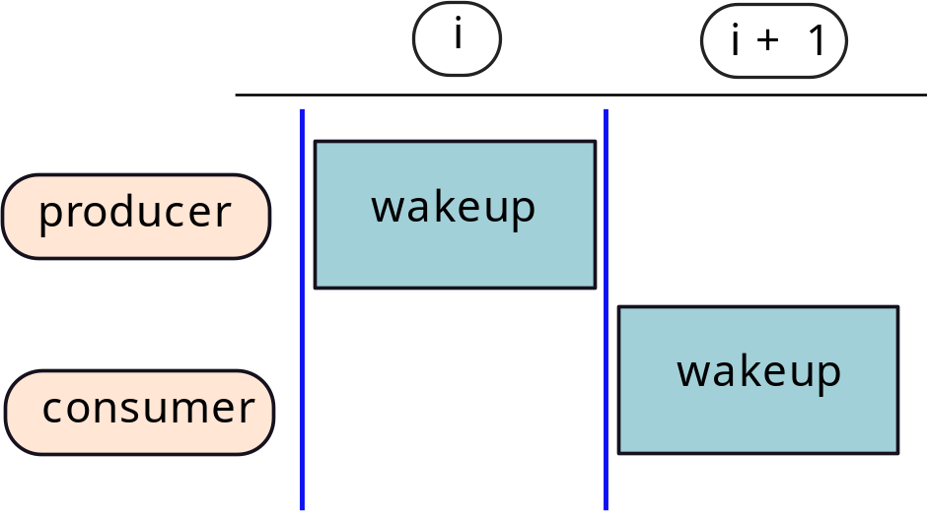
RAW Dependences in our Pipeline
Consider consecutive instructions with RAW dependences
add r1, r2, r3
add r4, r1, r5
We want back-to-back execution – Execution in
consecutive cycles.

Slide 35
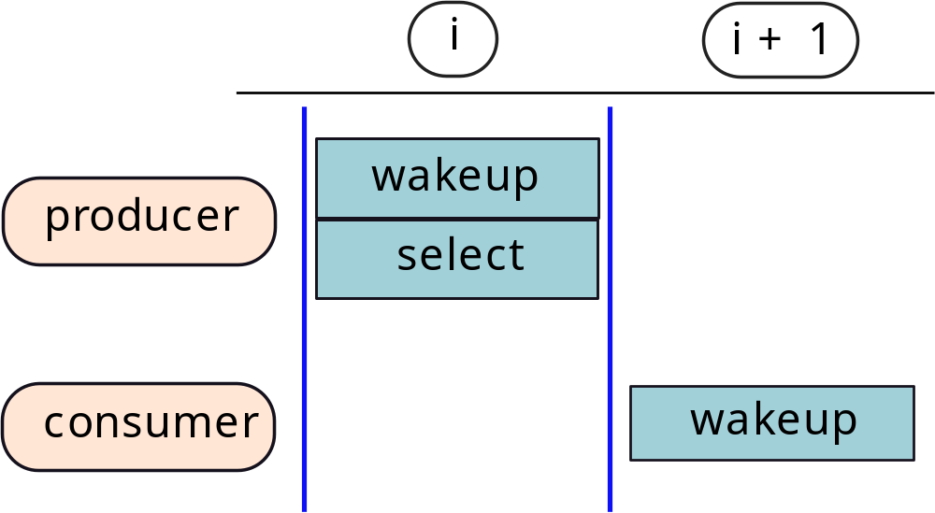

What does this imply?
Assume we have slightly optimized our pipeline to have
wakeup and select in the same cycle.

Slide 36
When should we broadcast the tag?
Reg. Write/
Broadcast
Rename
Dispatch
Wakeup/Select
Reg. Read
Execute
Option 1
(2)
(1)
Option 2
(2)
(1)
Option 3
(2)
(1)

Slide 37
Let us consider Option 3 – Early Broadcast
Allows back-to-back (in consecutive cycles) execution
What needs to be done:
  When (1) is in the Reg. read stage, (2) needs to be in the select stage
  This is possible if we broadcast the tag for (1) when it is in the reg-read stage
  (2) picks up the tag, wakes up, and gets selected for the next cycle

Slide 38
Classic Example of Forwarding in an OOO Pipeline
Rename
Dispatch
Wakeup
Reg. Read
Execute
Reg. Write
Rename
Dispatch
Reg. Read
Execute
Reg. Write
(1)
Select
Broadcast
Tag
Broadcast
Tag
Forward
Rename
Dispatch
Wakeup
Reg. Read
Execute
Reg. Write
Rename
Dispatch
Select
Reg. Read
Execute
(2)
Select
Broadcast
Tag
Wakeup

Slide 39
2-cycle latency for producer: Load-use Hazard
Rename
Dispatch
Wakeup
Reg. Read
Execute
Execute
Reg. Write
(1)
Select
Broadcast
Tag
Forward
Rename
Dispatch
Wait
Wakeup
Reg. Read
Execute
(2)
Select

Slide 40
Structure of the Pipeline
Rename
Dispatch
Wakeup
Reg. Read
Execute
Reg. Write
Select
Broadcast
Tag
For different instructions, we broadcast the tags at
different points of time.
If the execution requires k cycles, we broadcast the tag k cycles after getting selected.

Slide 41
Forwarding Logic in the Execution Unit
Also called bypass paths
Functional Unit
from the
Register File

Slide 42

When should we mark the avlbl bit?
Option 1: Along with the register write
Rename
Dispatch
Select/ Wakeup
Reg. Read/
Broadcast
Execute
Reg. Write
Some instructions that have
arrived after the broadcast might wait forever

Slide 43
When should we mark the available bit?
Option 2: Along with the broadcast
Rename
Dispatch
Select/ Wakeup
Reg. Read/
Broadcast
Execute
Reg. Write
The instructions being written to the IW will miss the broadcast and the update of the avlbl bit

Slide 44

What to do?
Let us fix solutions 1 and 2
Basic features of a new solution:
  Realization: Instructions being written to the IW will miss the broadcast
  These instructions would have also read the avlbl bit as 0
  As a result: they will wait forever
What does the teacher do if some students in the class are sleeping?
  ANSWER: Take one more class
What is the solution here:
  Double broadcast

Slide 45
Double Broadcast
Both solutions 1 and 2 can be fixed, if two broadcast messages are sent
Let us look at one solution
  Set the avlbl bit to 1 along with sending the Broadcast message
  There might be some instructions that miss the broadcast
  Log the Broadcasted tags in a temporary structure
  Also record all the instructions that are being dispatched in a separate structure called the dispatch buffer
In the next cycle
  Match the tags with entries in the dispatch buffer.
  If there is a match, update the corresponding IW entry
  Clear the entries for the last cycle in the dispatch buffer

Slide 46
Register Read and Execute

Slide 47

Read operands from the register file and Issue to the execution units
Instruction
Window
Select unit
Register File Read
Execution Unit 1
Execution Unit 2
Execution Unit 3
Execution Unit 4

Slide 48
Execute
Instruction
Window
Select unit
Register File Read
Execution Unit 1
Execution Unit 2
Execution Unit 3
Execution Unit 4

Slide 49
Contents
1.
Instruction Renaming
2.
Instruction Dispatch, Wakeup, Select
3.
The Load-Store Queue (LSQ)
4.
Instruction Commit

Slide 50

Case of Load and Store Instructions
ld r1, 4[r3]
st r2, 10[r5]
First, the instructions are sent to the adder to compute the effective address. In this case: 4 + (contents of r3), 10 + (contents of r5)
Next, they are sent to a load-store unit
  Sends the loads and stores to the data cache
  Loads can execute immediately
  Stores update the processor’s state (remember precise exceptions)
  We cannot afford to write the value of stores on the wrong path
    Hence, for stores we wait.

Slide 51
Requirements: Loads and Stores
Stores wait
They need some storage space
Loads first check this dedicated space
Loads cannot directly be sent to the cache
There might be stores before them that are unresolved
Unresolved stores might be to the same address

Slide 52
Key requirements
Stores have to be sent to the memory system in
program order. This is needed for precise exceptions.
We need dedicated storage space → store queue
Stores can only be sent when they are guaranteed
to be on the correct path. A store needs to be the earliest
instruction in the pipeline when it is sent.
Loads first check the store queue. The store queue is
like a cache.
Loads cannot be sent to the memory system until all the
stores before it are resolved and do not write to the same
address.

Slide 53
Load-Store Queue (LSQ)
Time
Load
Store
Allocate an entry at decode time (allocated in order)
Don’t ask when to deallocate an entry (ask later)
When the effective address is computed, update the entry

Slide 54


Resolved and Unresolved Eentries
Load
Store
Unresolved – address not computed
Resolved – address computed

Slide 55
Compute Address of a Store – Case I
Scan later entries
1. Resolve
2. Forward
3. Stop
A
A’
A
A
Load
Store
Unresolved – address not computed
Resolved – address computed

Slide 56
Compute Address of a Store – Case II
Scan later entries
1. Resolve
2. Forward
3. Stop
A
A’
A
A
Load
Store
Unresolved – address not computed
Resolved – address computed

Slide 57
Compute Address of a Load – Case I
Scan earlier entries
2. Stop
1. Resolve
A
A’
A
A
Load
Store
Unresolved – address not computed
Resolved – address computed

Slide 58
Compute Address of a Load – Case II
Scan earlier entries
2. Forward
1. Resolve
A
A’
A
A’’
A
Load
Store
Unresolved – address not computed
Resolved – address computed

Slide 59
Summary of the Discussion
Type | Search direction | Action: Condition
Loads | Search all the stores before it | Terminate and forward value: Store to the same address Terminate: Store with an unresolved address Go to d-cache: Conditions (1) and (2) not met
Stores | Search all the loads and stores after it | Terminate: Store to the same address Terminate: Store with an unresolved address Forward value: Load from the same address

Slide 60
Actual Implementation
LSQ
Load queue
Store queue
New load entry
New store entry
For the purpose of efficiency, have two queues:
  One load queue
  One store queue

Slide 61
Both are arranged as a circular queue
Consume
head
Entries
tail
Produce

Slide 62
Organization
Load queue
Store queue
tail
tail
head
head
Load queue entry
Store queue entry
Load address
Index of the tail ptr in the store queue when the entry was added
Memory address and value
Index of the tail ptr in the load queue when the entry was added

Slide 63
Basic Search Operations
Search all the stores before a load
Search all the stores after a store
Search all the loads after a store
Represent locations as a bit vector. If a queue has N entries, we have N bits:
one bit per each entry.
Create a bit vector called prec – all the locations before a given location after
set to 1.

Slide 64

Implementation of functions: before
Compute quickly in HW
$$j ≥head$$
$$before(j)=\overline{prec(head)}∧prec(j) be$$
head
j
tail
prec(head)
1
1
0
0
0
0
0
0
prec(j)
1
1
1
1
0
0
0
0
before(j)
0
0
1
1
0
0
0
0
Entries before j
in the queue

Slide 65




Expressions for other cases
$$j<head$$
Wraparound
$$before\left(j\right)= \overline{prec\left(head\right)}∨prec\left(j\right)$$
j
tail
head

Slide 66


after function
$$j ≤tail$$
$$after(j)=\overline{prec(j)}∧\overline{map(j)}∧(prec(tail)∨map(tail))$$
head
j
tail
$$j>tail$$
Wraparound
$$after(j)=(\overline{prec(j)}∨prec(tail)∨map(tail))∧\overline{map(j)}$$
tail
head
j

Slide 67
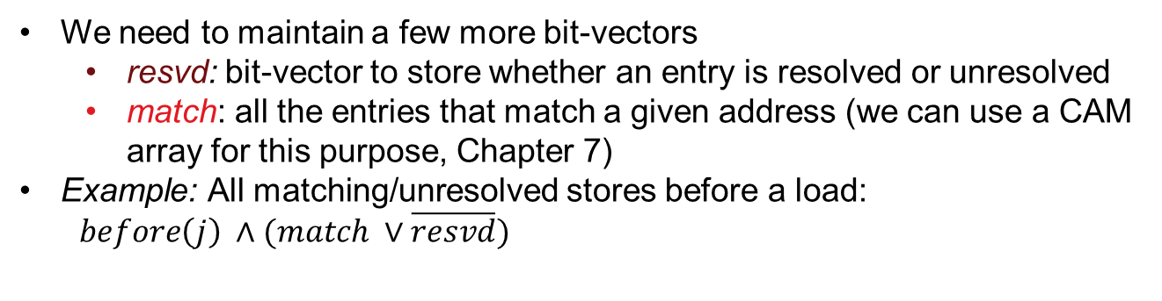
Operation of the LSQ
Type | Search direction | Action: Condition
Loads | Search all the stores before it | Terminate and forward value: Store to the same address Terminate: Store with an unresolved address Go to d-cache: Conditions (1) and (2) not met
Stores | Search all the loads and stores after it | Terminate: Store to the same address Terminate: Store with an unresolved address Forward value: Load from the same address
We need to maintain a few more bit-vectors
  resvd: bit-vector to store whether an entry is resolved or unresolved
  match: all the entries that match a given address (we can use a CAM array for this purpose, Chapter 7)
Example: All matching/unresolved stores before a load:
$before\left(j\right) ∧(match ∨\overline{resvd})$

Slide 68
Wrap-up
We can compute various functions and find a set of locations of interest.
We need to find either the first or last location.
How do we do this quickly in hardware?
Can we use a select unit?

Slide 69
Contents
1.
Instruction Renaming
2.
Instruction Dispatch, Wakeup, Select
3.
The Load-Store Queue (LSQ)
4.
Instruction Commit

Slide 70
Precise Exceptions
Instructions in order
Processor
Instructions in order
For an external observer
  Instructions need to appear to execute in order
  At any point of time, the instruction flow can be paused, and resumed later.

Slide 71
New Structure: Reorder Buffer (ROB)
Reorder Buffer (entry)
  Contains 1 entry for every instruction that has been fetched
  After decoding an instruction, we enter it in the ROB
  If there are no free entries, the OOO pipeline stalls
  Instructions are entered into the ROB in program order
  The ROB is essentially an in-order queue
Updating an entry
  Whenever an instruction finishes its execution, we update the entry of the ROB
  Mark it ready
Removing an entry
It is called retiring or committing
This happens in program order (keep reading ... )

Slide 72
Removing Entries from the ROB (Commit/Retire)
Commit
Every processor has a commit width
  Number of instructions to commit per cycle
  Let the commit width be W
  2, 4, or 6 (typical values)
  Start from the top of the ROB and access the next W entries
  Stop at the first entry, which is not ready or continue till we reach the W^{th} entry
  Commit all the entries that we find to be ready
Create
entry
Fetch
and
Execute
ROB
Update
entry

Slide 73


What does it mean to commit an entry?
Remove it from the ROB
AND
Depends on the type of instruction
Consider instructions with a register destination
  Inst J: r1 ⬅ r2 + r3
  Assume that r1 is mapped to py
  Before this instruction, r1 was mapped to px
When can we free px?
  After J commits, there are no instructions earlier than J in the pipeline
  There is no instruction that requires the value in px
  px can be reclaimed, and added to the free list

Slide 74
Updates to renaming
Whenever we see an instruction of the form:
  Instruction J: r1 ← ...
  Remember the previous mapping of r1 by reading the rename table
  Assume that r1 was mapped to px
  Save this mapping in the ROB entry for instruction J
  When J is committed, unmap px, and return it to the free list
This can be done for all instructions that have a destination operand as a register: ALU instructions, load instruction

Slide 75
Load and Store Instructions
When should a store be written to memory?
  ANS: When we are sure that it is not in the wrong path of a branch, or no interrupt will come before it
  Only possible at commit time.
  Solution: Send stores to memory at commit time.
  At the same time remove them from the store queue
When should a load be removed from the LSQ?
At commit time ☺

Slide 76
What do we in the case of an interrupt?
Let us treat interrupts, exceptions, and branch mispredictions in the same category
We will clearly have some instructions in the pipeline that are on the wrong path. They should not be committed
Use the ROB:
  Mark the instruction that has had an exception, or suffered from a misprediction, in the ROB
  In the case of an interrupt mark the topmost entry in the ROB
  Wait till the marked instruction retires
  Initiate the recovery sequence
  More on the next slide →

Slide 77
Flushing the Pipeline
Flush the ROB, LSQ, IW
and all pipeline registers
Insts
Rest of the Pipeline
Fetch
Branch misprediction
ROB

Slide 78
Recovery Sequence
  Flush the pipeline
  Remove the entries from the IW, LSQ, and ROB
  Remove entries from all pipeline registers and other temporary structures (not the rename table or register file though)
Restore the state
  Architectural register state for the last committed instruction and the PC
  The contents in the rest of the physical registers does not matter

Slide 79
Approach 1: Retirement Register File (RRF)
RRF → Maintain the state of all architectural registers at commit time
Each entry of the ROB gets augmented with the value of the destination register
Write the value of the destination register at commit time.
The RRF maintains a checkpoint at commit time
PRF
ROB
RRF

Slide 80
Approach 2: Retirement RAT (RRAT)
Why do we need to write the values into
the RRF?
Aren’t just the mappings sufficient.
Maintain a copy of the mapping of the
destination register in the ROB entry
  Eg: r1 ← r2 + r3, r1 gets mapped to py
  Maintain r1 ←→ py in the ROB entry
  Update the RRAT with this mapping
At the time of recovery
  Transfer the mappings in the RRAT to the RAT
RAT
ROB
RRAT
Prove that this can be done.

Slide 81
Approach 3: RAT Checkpointing (SRAM based)
Consider the following design
At every branch let us maintain a checkpoint
Set of 16, 7-bit ids
In each entry of the RAT, have a shift register, where each entry of the shift register is 7 bits wide
To create a checkpoint, shift the entries in each row.
The last entries of each shift register represent the current architectural state
Remove the last entries once the corresponding instructions commit
7 bit (1 out of 128 phys. regs)
16 entries

Slide 82
RAT
Latest mapping
Architectural state
Arch reg. id

Slide 83
Approach 4: RAT Checkpointing (CAM based)
A CAM (content addressable memory) is like a hash table
  You address each element not by an index, but by a subset of its content
  It is slower than a structure that is addressed by an index
SRAM and CAM: Refer to Chapter 6 of the reference: Computer Organisation and Architecture
[Sarangi, McGrawHill, ’15]
CAM based RAT
arch. reg id
7-bit physical reg id
128 entries
4 bit arch. reg id, valid bit, 7 bit phys. reg id,

Slide 84
CAM based RAT
At any point of time, 16 bits are set to 1. They contain the current mapping (latest state)
The architectural state is also a set of 16 entries in the RAT table.
We can save a checkpoint by saving the set of valid bits in a 128 bit vector.
For every branch, we can take a snapshot of the valid bits.
The best way to achieve this is to have a shift register in each row of the RAT table, where each entry is 1 bit wide
Use the same idea as the SRAM based RAT

Slide 85
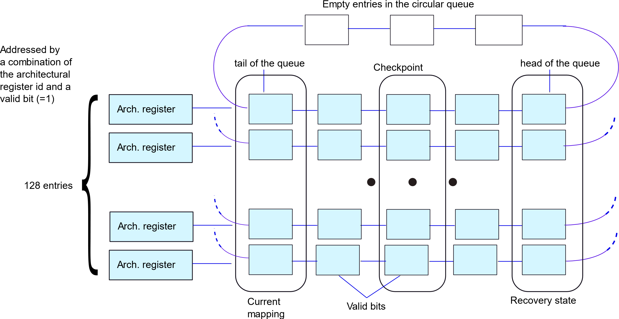
CAM based checkpointing, one 1 bit per row

Slide 86
Pros and Cons
RRF
+ point → Simple to implement. Transferring the checkpoint is easy
- point → Extra register writes every cycle. More power
RRAT
+ point → Requires less space in the ROB than the RRF
SRAM based
+ point → Activity only on a branch. Shift operation.
CAM
- point → Need to save the value in the ROB. More space.
- point →Has activity every cycle.
- point → Each row of the RAT is wider. Cannot resume from non-branch points.
+ point → Shift operations are easy. Shift only 1 bit.
- point → The CAM per se is a slower structure than an SRAM.

Slide 87
Conclusion
Renaming is done using the RAT table that stores a
mapping between an arch. register and a physical reg.
We additionally need a free list and dependence check logic.
The scheduler comprises the wakeup, select, and broadcast
logic. We often perform an early broadcast to avoid stalls.
The LSQ manages the dependences between loads and
stores. It forwards data between in-flight loads and stores.
The ROB is used to keep track of in-flight instructions.
Instructions are committed when they complete.

Slide 88
The End

