Slide 1
Writing Parallel Program-4

Slide 2
Recap
Synchronization (barrier, critical)
Data race

Slide 3
Recap: Barrier
A program point where all active threads will stop until all threads have arrived at that point.
#pragma omp parallel {
int i = omp_get_thread_num();
a[i] = i;
#pragma omp barrier
b[i] = i;
}
a
b

Slide 4
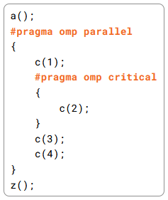
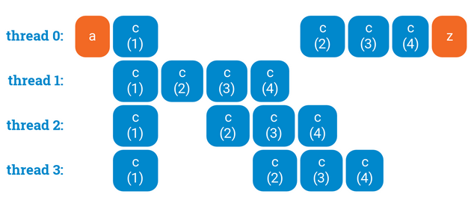
Recap: Critical Section
Only one thread execute a critical section at a time.
Provides mutual exclusion.
Ref: https://ppc.cs.aalto.fi/ch3/

Slide 5
Recap: Data Race
Multiple parallel threads access one shared memory location where
at least one of these accesses is a write.
The read or written value is undefined
Example
#pragma omp parallel for
for(int i=0;i<N;i++) {
sum = sum + f(a[i]);
}

Slide 6
Reduction
Reducing an expression to a value.
sum = a[0] + a[1] + … + a[N-1]
Can we can reduce the following loop?
for(int i=0;i<N;i++) {
sum = sum + a[i];
}
Issues:
- Data race

Slide 7
Reduction
Reducing an expression to a value.
sum = a[0] + a[1] + … + a[N-1]
Can we can reduce the following loop?
for(int i=0;i<N;i++) {
sum = sum + a[i];
}
Issues:
- Data race
- dependencies across iterations

Slide 8
Parallel For Reduction
Can we can reduce the following loop?
#pragma omp parallel for shared(sum, a) reduction(+: sum)
for(int i=0;i<N;i++) {
sum = sum + a[i];
}
Supported reduction operators: +, -, *, &, |, ^, &&, ||

Slide 9
Handling Parallel For Reduction
#pragma omp parallel for shared(sum, a) reduction(+: sum)
for(int i=0;i<N;i++) {
sum = sum + a[i];
}
Reduction forks a number of threads
Iterations are assigned to threads
Partial sum values are computed.
Final value is computed by accumulating the partial sum values

Slide 10
When should we NOT parallelize a loop?
Answer: If there are data dependencies across iterations
Example:
for(int i=0;i<N;i++)
sum = sum + a[i];
The definition of `sum’ in iteration i is used in iteration (i+1)

Slide 11
Data Dependence: general Definition
There is a data dependence from statement S1 to
statement S2 (statement S2 depends on statement S1) if and only if
1) both statements access the same memory location and at least
one of them is a write and
2) there is a feasible run-time execution path from S1 to S2.

Slide 12
Data Dependency
True dependence: written data is read later
X = a; …; b = X;
// X is not redefined between S1 and S2
Anti-dependence: read data is written later
b = X; …; X = a;
Output dependence: two statements write on the same location
X=a; …; X=b;

Slide 13
Data Dependency Across Iterations in a Loop
Example 3:
for(int i=0;i<N;i++){
t = a[i];
b[i] = t;
a[i] = b[i];
}
Example 1:
for(int i=0;i<N;i++)
sum = sum + a[i];
t = a[i];
b[i] = t;
a[i] = b[i];
t = a[i+1];
b[i+1] = t;
a[i+1] = b[i];
Example 2:
for(int i=0;i<N;i++)
a[0] = i;

Slide 14
Data Dependency Across Iterations in a Loop
Read-Write: Data is written in one iteration and read in another iteration
Example:
for(int i=0;i<N;i++)
sum = sum + a[i];
Write-Write: two iterations writing on the same location
Example:
for(int i=0;i<N;i++)
a[0] = i;

Slide 15
Loop index based dependencies
Example 1:
for(int i=0;i<N;i++)
a[i+1] = a[i];
a[0] -> a[1] -> a[2] -> … -> a[N-1]

Slide 16
Loop index based dependencies
Example 1:
for(int i=0;i<N;i++)
a[i+1] = a[i];
a[0] -> a[1] -> a[2] -> … -> a[N-1]
Example 2:
for(int i=0;i<N;i++)
a[i+2] = a[i];
a[0] -> a[2] -> a[4] -> …
a[1] -> a[3] -> a[5] -> …

Slide 17
Loop index based dependencies
Example 1:
for(int i=0;i<N;i++)
a[i+1] = a[i];
a[0] -> a[1] -> a[2] -> … -> a[N-1]
Example 2:
for(int i=0;i<N;i++)
a[i+2] = a[i];
a[0] -> a[2] -> a[4] -> …
a[1] -> a[3] -> a[5] -> …
Example 3:
for(int i=0;i<N;i+=2)
a[i+1] = a[i];
a[0] -> a[1]
a[2] -> a[3]
a[4] -> a[5]

Slide 18
Data Dependency Across Iterations in a Loop
Example 1:
for(int i=0;i<N;i++)
sum = sum + a[i];
Example 3:
for(int i=0;i<N;i++){
int t = a[i];
b[i] = t;
a[i] = b[i];
}
Example 2:
for(int i=0;i<N;i++)
a[0] = i;
Can we parallelize these loops?

Slide 19
References
OpenMP Specification.
https://www.openmp.org/spec-html/5.0/openmp.html
Chapter 2.2.1, 2.2.2
Optimizing compilers for modern architectures
a dependence-based approach
by Randy Allen, Ken Kennedy

