Slide 1
Performance Analysis

Slide 2
Recap
Concurrency, Parallelism, Distributed computing
Two parallelization approaches for summation computation

Slide 3
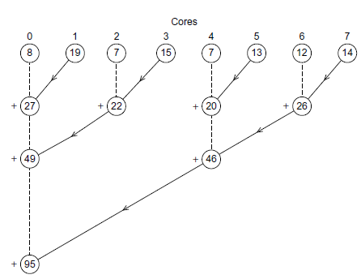
Comparing two Attempts
Parallel computation
(1) Compute partial sum of n/p elements.
Serial computation
(2) accumulate results of partial sum
Step (2) of the first approach is serialized

Slide 4
Analyzing Performance
Remember the example
What if we have 4 processors?

Slide 5
Speedup
T_{serial}: Execution time of the serial program
T_{parallel}: Execution time of the parallel program
Speedup S = T_{serial} / T_{parallel}

Slide 6
Linear Speedup
Suppose we have p processors
If (T_{parallel} == T_{serial} / p) then the speedup is linear
In case of linear speedup
S = T_{serial} / T_{parallel} = p
Linear speedup is ideal but unusual.

Slide 7
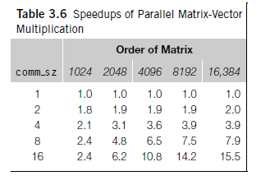
Speedup Example
Observation: speedup vs p vs problem size

Slide 8
Efficiency
efficiency: E = S / p i.e. speedup per processor
E = (T_{serial} / T_{parallel} ) / p
E = T_{serial} / (p * T_{parallel} )

Slide 9
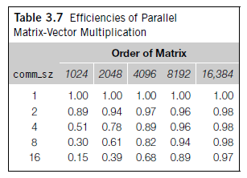
Efficiency Example

Slide 10
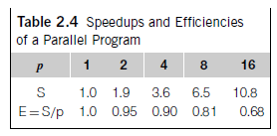
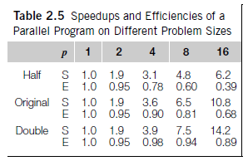
Speedup vs Efficiency
Speedup and efficiency increase with problem size

Slide 11
Amdahl’s Law
Unless the entire serial program is parallelized, the possible speedup is going to be limited regardless of the number of processors by the sequential component(unparallelized fraction) of a program.
f: parallelized fraction of a program
1-f: sequential component(unparallelized fraction) of a program
T_{parallel} = f * (T_{serial} / p) + (1-f) * T_{serial}
Speedup S = T_{serial} / T_{parallel} = T_{serial} / (f * (T_{serial} / p) + (1-f) * T_{serial})

Slide 12
Example
Let T_{serial} =20, f = 0.9, and
p = 2 =>
T_{parallel} = f * (T_{serial} / p) + (1-f) * T_{serial} = 0.9 * 20/2 + 0.1 * 20 = 9 + 2 = 11

Slide 13
Example
Let T_{serial} =20, f = 0.9, and
p = 2 =>
T_{parallel} = f * (T_{serial} / p) + (1-f) * T_{serial} = 0.9 * 20/2 + 0.1 * 20 = 9 + 2 = 11
p = 4 =>
T_{parallel} = f * (T_{serial} / p) + (1-f) * T_{serial} = 0.9 * 20/4 + 0.1 * 20 = 4.5+ 2 = 6.5

Slide 14
Example
Let T_{serial} =20, f = 0.9, and
p = 2 =>
T_{parallel} = f * (T_{serial} / p) + (1-f) * T_{serial} = 0.9 * 20/2 + 0.1 * 20 = 9 + 2 = 11
p = 4 =>
T_{parallel} = f * (T_{serial} / p) + (1-f) * T_{serial} = 0.9 * 20/4 + 0.1 * 20 = 4.5+ 2 = 6.5
p = 10 =>
T_{parallel} = f * (T_{serial} / p) + (1-f) * T_{serial} = 0.9 * 20/10 + 0.1 * 20 = 1.8+2 = 3.8

Slide 15
Example
Let T_{serial} =20, f = 0.9, and
p = 2 =>
T_{parallel} = f * (T_{serial} / p) + (1-f) * T_{serial} = 0.9 * 20/2 + 0.1 * 20 = 9 + 2 = 11
p = 4 =>
T_{parallel} = f * (T_{serial} / p) + (1-f) * T_{serial} = 0.9 * 20/4 + 0.1 * 20 = 4.5+ 2 = 6.5
p = 10 =>
T_{parallel} = f * (T_{serial} / p) + (1-f) * T_{serial} = 0.9 * 20/10 + 0.1 * 20 = 1.8+2 = 3.8
p = 20 =>
T_{parallel} = f * (T_{serial} / p) + (1-f) * T_{serial} = 0.9 * 20/20 + 0.1 * 20 = 0.8+2 = 2.8

Slide 16
Amdahl’s Law
unless the entire serial program is parallelized, the possible speedup is going to be very limited regardless of the number of processors.
S = T_{serial} / T_{parallel} = T_{serial} / (f * (T_{serial} / p) + (1-f) * T_{serial})
S ≈ T_{serial} / ( (1-f) * T_{serial}) for a large value of p
Also S ≤ T_{serial} / ( (1-f) * T_{serial})
Therefore S ≤ 10 where T_{serial} =20 and f=0.9
Speedup is decided by the sequential/unparallelized version

Slide 17
Gustafson-Barsis Law
Time is constant and the problem size increases with the number of processors.
Note: T_{serial} = T_{sequential} + T_{parallelizable}
_{T_parallel >=} T_{sequential} + _{T_parallelizable / p}
Speedup S ≤ (T_{sequential} + T_{parallelizable}) / (T_{sequential} + T_{parallelizable}/p)
Let r = T_{sequential} / (T_{sequential} + T_{parallelizable}/p) and
1-r = (T_{parallelizable} /p) / (T_{sequential} + T_{parallelizable}/p)
Hence T_{sequential} = r*(T_{sequential} + T_{parallelizable}/p) and
T_{parallelizable} = (T_{sequential} + T_{parallelizable}/p) *p * (1-r)

Slide 18
Gustafson-Barsis Law
Time is constant and the problem size increases with the number of processors.
We replace the values of T_{sequential} and T_{parallelizable} in the following formula
Speedup S ≤ (T_{sequential} + T_{parallelizable}) / (T_{sequential} + T_{parallelizable}/p)
S ≤ (r*(T_{sequential} + T_{parallelizable}/p) + (T_{sequential} + T_{parallelizable}/p) *p * (1-r))
/ (T_{sequential} + T_{parallelizable}/p)
S ≤ ((T_{sequential} + T_{parallelizable}/p) * (r + (1-r)*p) / (T_{sequential} + T_{parallelizable}/p)
S ≤ r +(1– r)*p => S ≤ p +(1– r)*p

Slide 19
Gustafson-Barsis Law
Given a parallel program solving a problem using p processors,
let r be the fraction of total execution time spent in sequential code.
The maximum speedup achievable in this program is S ≤ p +(1-p)*r

Slide 20
Limitations of Amdahl’s and Gustafson-Barsis Law
Overhead in Parallelism is not considered.
Parallelism incurs overhead due to communication, mutual exclusion, locks etc
T_{parallel} = (T_{serial} / p) + T_{overhead}
S = T_{serial} / ((T_{serial} / p) + T_{overhead})
E = S/p = T_{serial} / (p*((T_{serial} / p) + T_{overhead}))

Slide 21
References
Chapter 2.6
An Introduction to Parallel Programming
by Peter Pacheco.
Chapter 17
Parallel programming in C with MPI and OpenMP
by Michael J. Quinn.

