Slide 1
Parallelism in Hardware

Slide 2
So Far…
Parallel programming using OpenMP constructs
Dependence analyses to identify parallelism
Question: How does hardware support parallelism?

Slide 3
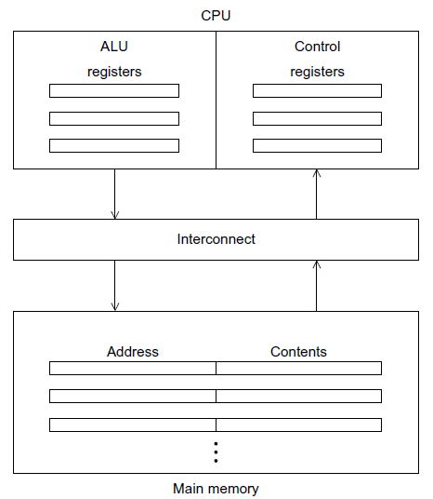
von Neumann architecture

Slide 4
Improvements on von Neumann architecture
Major Improvements:
Cache memory
Virtual memory
Low level parallelism

Slide 5
Cache Memory
An intermediate small, faster memory between CPU and main memory.
CPU can access cache memory significantly faster than main memory.
CPU
Cache
Main Memory

Slide 6
Principle of Locality
Cache memory improve temporal and spatial locality.
Temporal locality. After accessing one memory location (for instruction or data)
computation will access the same location in near future.
Spatial locality. After accessing one memory location (for instruction or data)
computation will consecutively access a nearby location.
Example:
int a[1000];
. . .
sum = 0;
for (i = 0; i < 1000; i++)
sum += a[i];

Slide 7
Accessing Cache Memory
Cache Hit and Miss
When a cache is checked for information and the information is available, it’s a cache hit.
Otherwise, it’s a cache miss.
Cache Block and Cache Lines
Based on principles of locality a memory access will effectively operate on a blocks of memory instead of an individual location.

Slide 8
Write-through and Write-back Cache
Write-through cache
writes the data back to memory as soon as it is written to the cache.
Write-back cache
The data isn’t written immediately.
Mark the updated data in the cache as dirty.
(2) When the cache line is replaced by a new cache line from memory,
the dirty line is written to memory.

Slide 9
Cache mappings
Decided by cache associativity
Fully associative cache: a new line can be placed at any location in the cache.
Direct-mapped cache. each cache line has a unique location in the cache
to which it will be assigned.
n-way set associative (Intermediate schemes). each cache line can be placed in one of n different locations in the cache.

Slide 10
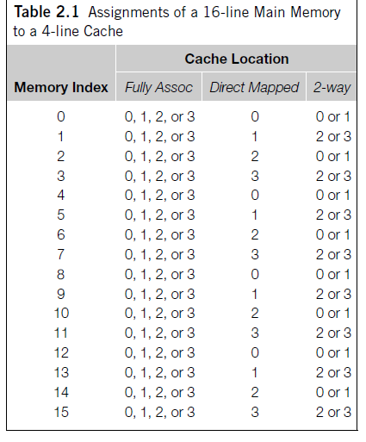
Example
Cache associativity Tradeoff:
Direct mapped cache:
good best-case time but unpredictable in worst case
Fully associative cache:
the best miss rates, but practical only for a small number of entries
Different cache replacement policies
for n-way associative caches

Slide 11
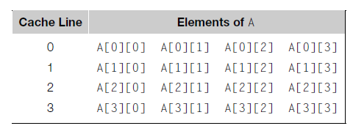
Effect of Cache Memory on Programs
double A[MAX][MAX], x[MAX], y[MAX];
. . .
/* Initialize A and x, assign y = 0 */
. . .
/* First pair of loops */
for (i = 0; i < MAX; i++)
for (j = 0; j < MAX; j++)
y[i] += A[i][j] * x[j];
. . .
/* Assign y = 0 */
/* Second pair of loops */
for (j = 0; j < MAX; j++)
for (i = 0; i < MAX; i++)
y[i] += A[i][j] * x[j];
C stores two-dimensional arrays in
“row-major” order.
MAX=4
First pair of loops: 4 cache misses
Second pair of loops: 16 cache misses
Result: the first pair of loops are faster

Slide 12
Virtual Memory
Main memory may not suffice to store:
- a large program,
- a program with large data size,
multiple programs and data in multitasking OS
Solution: Virtual memory.
- main memory functions as a cache for secondary storage
- main memory access is order of thousands times faster than secondary memory
- virtual memory abstracts the physical addresses of the secondary storage

Slide 13
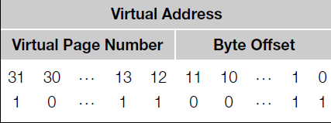
Page
virtual memory operates on pages (blocks of data and instructions)
pages are of a fixed page size (4 to 16 KB)
pages contain virtual addresses, not physical addresses of secondary storage
Page table translates virtual addresses to physical addresses
virtual address = virtual page number + byte offset in the page
Let a virtual address is of 32 bit and page size is 4 KB = 4096 bytes.
Each byte in the page is identified
with 12 bits, since 2^12 = 4096

Slide 14
Virtual Memory and TLB
Virtual memory tradeoff:
Virtual memory to physical memory computation increases the runtime
Solution: translation-lookaside buffer or TLB (similar to cache memory)
TLB caches a few entries from the page table in very fast memory.
Principle of spatial and temporal locality is applicable
Improves the page table access speed significantly
Page fault: the page is not in main memory, it is in secondary storage. Similar to cache miss.

Slide 15
References
Chapter 2
An Introduction to Parallel Programming
by Peter Pacheco.

