Slide 1
Writing Parallel Program-2

Slide 2
Recap
Process
Thread
Parallel program

Slide 3
Writing a Parallel Program
Sequential Program
int t=0;
for(i=0;i<N;i++) {
t= a[i] + b[i];
c[i] = t;
}
Parallel program
#pragma omp parallel for
for(i=0;i<N;i++) {
t= a[i] + b[i];
c[i] = t;
}

Slide 4
Private and Shared
Shared variable: single instance is shared among all threads
Private variable: each thread has its own local copy
Example
int x = 5;
#pragma omp parallel {
int a = x+1;
}

Slide 5
Private and Shared
Shared variable: single instance is shared among all threads
Private variable: each thread has its own local copy
Example
int x = 5;
#pragma omp parallel {
int a = x+1;
}
Example
int x = 5;
#pragma omp parallel private(x){
int x = x+1; // bad programming
}

Slide 6
Rules to Specify Private and Shared Variables
Loop iteration variable is private
int a[N]; int i=0;
:
#pragma omp parallel for
for(i=0;i<N;i++) a[i] = i;
int a[N];
:
#pragma omp parallel for
for(int i=0;i<N;i++) a[i] = i;
Better programming practice

Slide 7
Rules to Specify Private and Shared Variables
Explicit specification of shared and private variables
int n; int a; int b;
:
#pragma omp parallel for shared(n, a) private(b)
for (int i = 0; i < n; i++) {
int t = b;
// b = a + i;
}
Values of a private variable is undefined at the entry and exit of a parallel region.

Slide 8
Static Schedule
int nthreads=10
#pragma omp parallel for shared(a,b,c) private(i) schedule(static)
parallel for(i=0;i<N;i++) c[i] = a[i] + b[i];
Distribute the chunk of iterations to threads
thread 1 : iteration 0…(N/10)-1
thread 2: iteration (N/10)…2*(N/10)-1
:
thread 10: iteration 9*(N/10)…N-1

Slide 9
Another Static Schedule
#pragma omp parallel for shared(a,b,c) private(i)
schedule(static,size of the chunk=4)
parallel for(i=0;i<64;i++) c[i] = a[i] + b[i];
Distribute the chunk of iterations to threads
thread 1 : iteration {0,1,2,3}, {16,17,18,19}, …
thread 2: iteration {4,5,6,7}, {20,21,22,23}, …
thread 3 : iteration {8,9,10,11}, {24,25,26,27}, …
thread 4: iteration {12,13,14,15}, {28,29,30,31}, …

Slide 10
Dynamic Schedule
schedule(dynamic, n): Default value of n=1
Each thread
executes a chunk of n iterations
requests another chunk
No particular order of chunk assignments to threads

Slide 11
Static vs Dynamic Schedule
Dynamic scheduling is preferred when the iterations are of different computational size
Dynamic scheduling incurs runtime overhead unlike static scheduling
as distribution is performed during execution

Slide 12
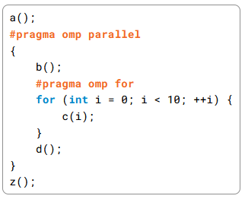
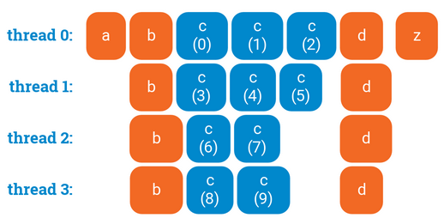
Waiting in `parallel for’
No synchronization at the beginning of a parallel for loop.
Threads synchronize at the end of a parallel for loop.
Ref: https://ppc.cs.aalto.fi/ch3/nowait/

Slide 13
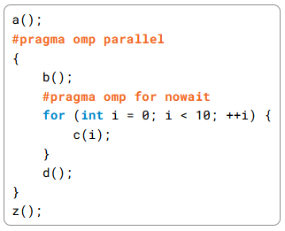
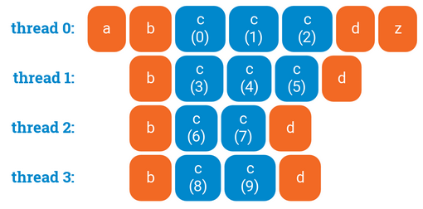
Waiting in `parallel for’
`nowait’ removes the synchronization
Ref: https://ppc.cs.aalto.fi/ch3/nowait/

