Slide 1
Writing Parallel Program

Slide 2
Recap
Speedup
Efficiency
Amdahl’s Law
Gustafson-Barsis Law
Question: Is speedup < 1 possible?

Slide 3
Process
An instance of a computer program that is being executed.
The executable program.
A block of memory for
executable code,
call stack of active functions,
memory heap for dynamic memory allocations
Additional details
resources e.g. file descriptors
process state
:

Slide 4
Multiprocessing
(1)
A multiprocessor system may execute multiple processes in parallel on different processors
(2)
Multiple processes may run on single processor in interleaved fashion.
Operating system assigns multiple processes to an available processor
Each process get a time slice to execute on the processor

Slide 5
Thread
Contained in a process
A process may contain multiple threads
Lightweight than process
Threads in a program share same executable
Each thread has its own program counter
Each thread has its own call stack
Thread fork and thread join happen inside a process

Slide 6
Thread
Threads may run in parallel on different processors
Multiple threads may execute on a single processor in time-slices
Threads have local memory and multiple threads share memory (unlike processes)

Slide 7
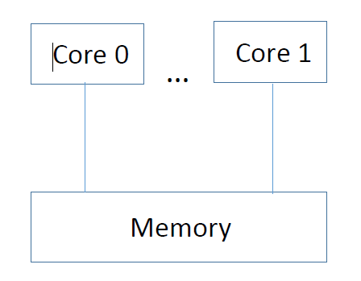
Assigning Threads to Cores
thread 1
thread 2
X

Slide 8
Writing a Parallel Program
Sequential Program
for(i=0;i<N;i++) c[i] = a[i] + b[i];
The iterations are independent and may execute in parallel
Each thread may execute one or multiple iterations

Slide 9
Writing a Parallel Program
Sequential Program
for(i=0;i<N;i++) c[i] = a[i] + b[i];
The iterations are independent and may execute in parallel.
Parallel Program
parallel for(i=0;i<N;i++) c[i] = a[i] + b[i];
May executes the iterations in parallel

Slide 10
Demonstration
Use OpenMP parallel for
Execution time of the serial and parallel program
Effects of different parameters on execution time
Study speedup and efficiency

