Slide 1
COL380: Introduction to Parallel & Distributed Programming

Slide 2
We will Study …
Concurrency
Parallelism
Distributed computing

Slide 3
Evaluation
Assignments 40%,
Minor-1 15%,
Minor-2 15%,
Major 30%
Plagiarism is unacceptable. Offenders will be penalized by a failing grade.

Slide 4
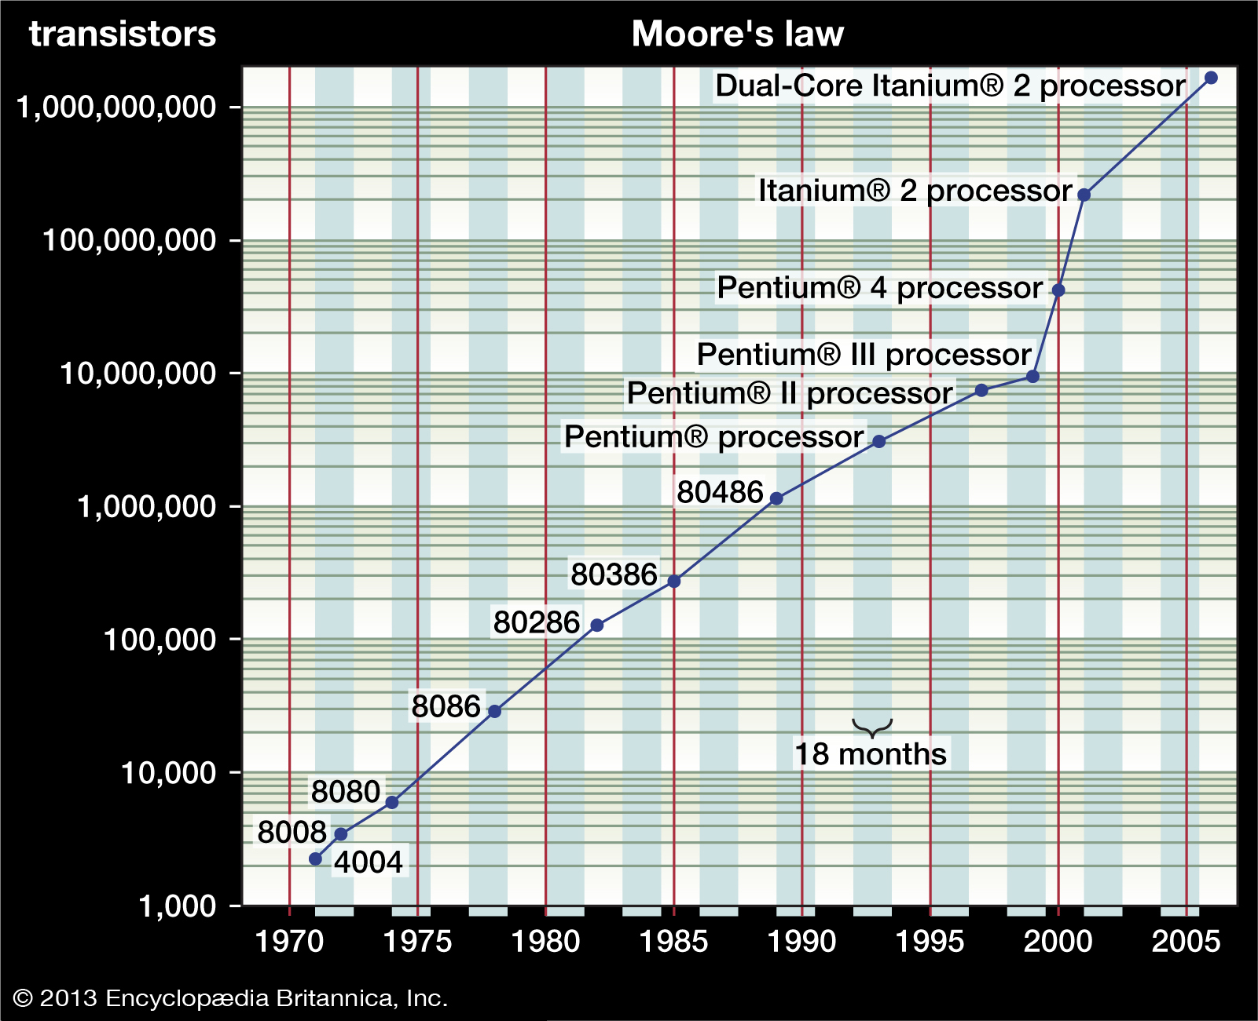
Moore’s Law
the number of transistors in a dense integrated circuit (IC) doubles about every two years.
Ref: https://www.britannica.com/
technology/Moores-law

Slide 5
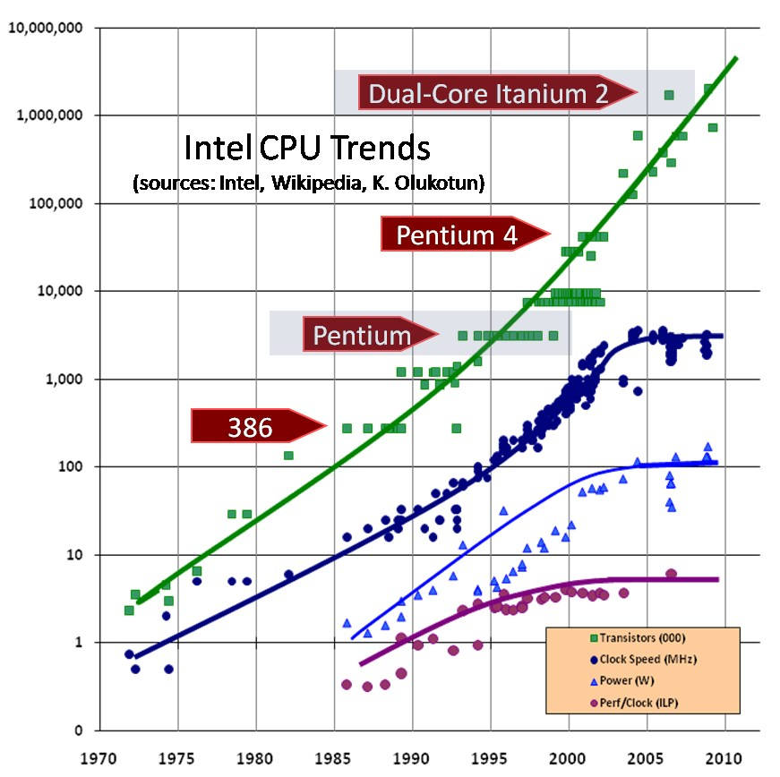
CPU Trends

Slide 6
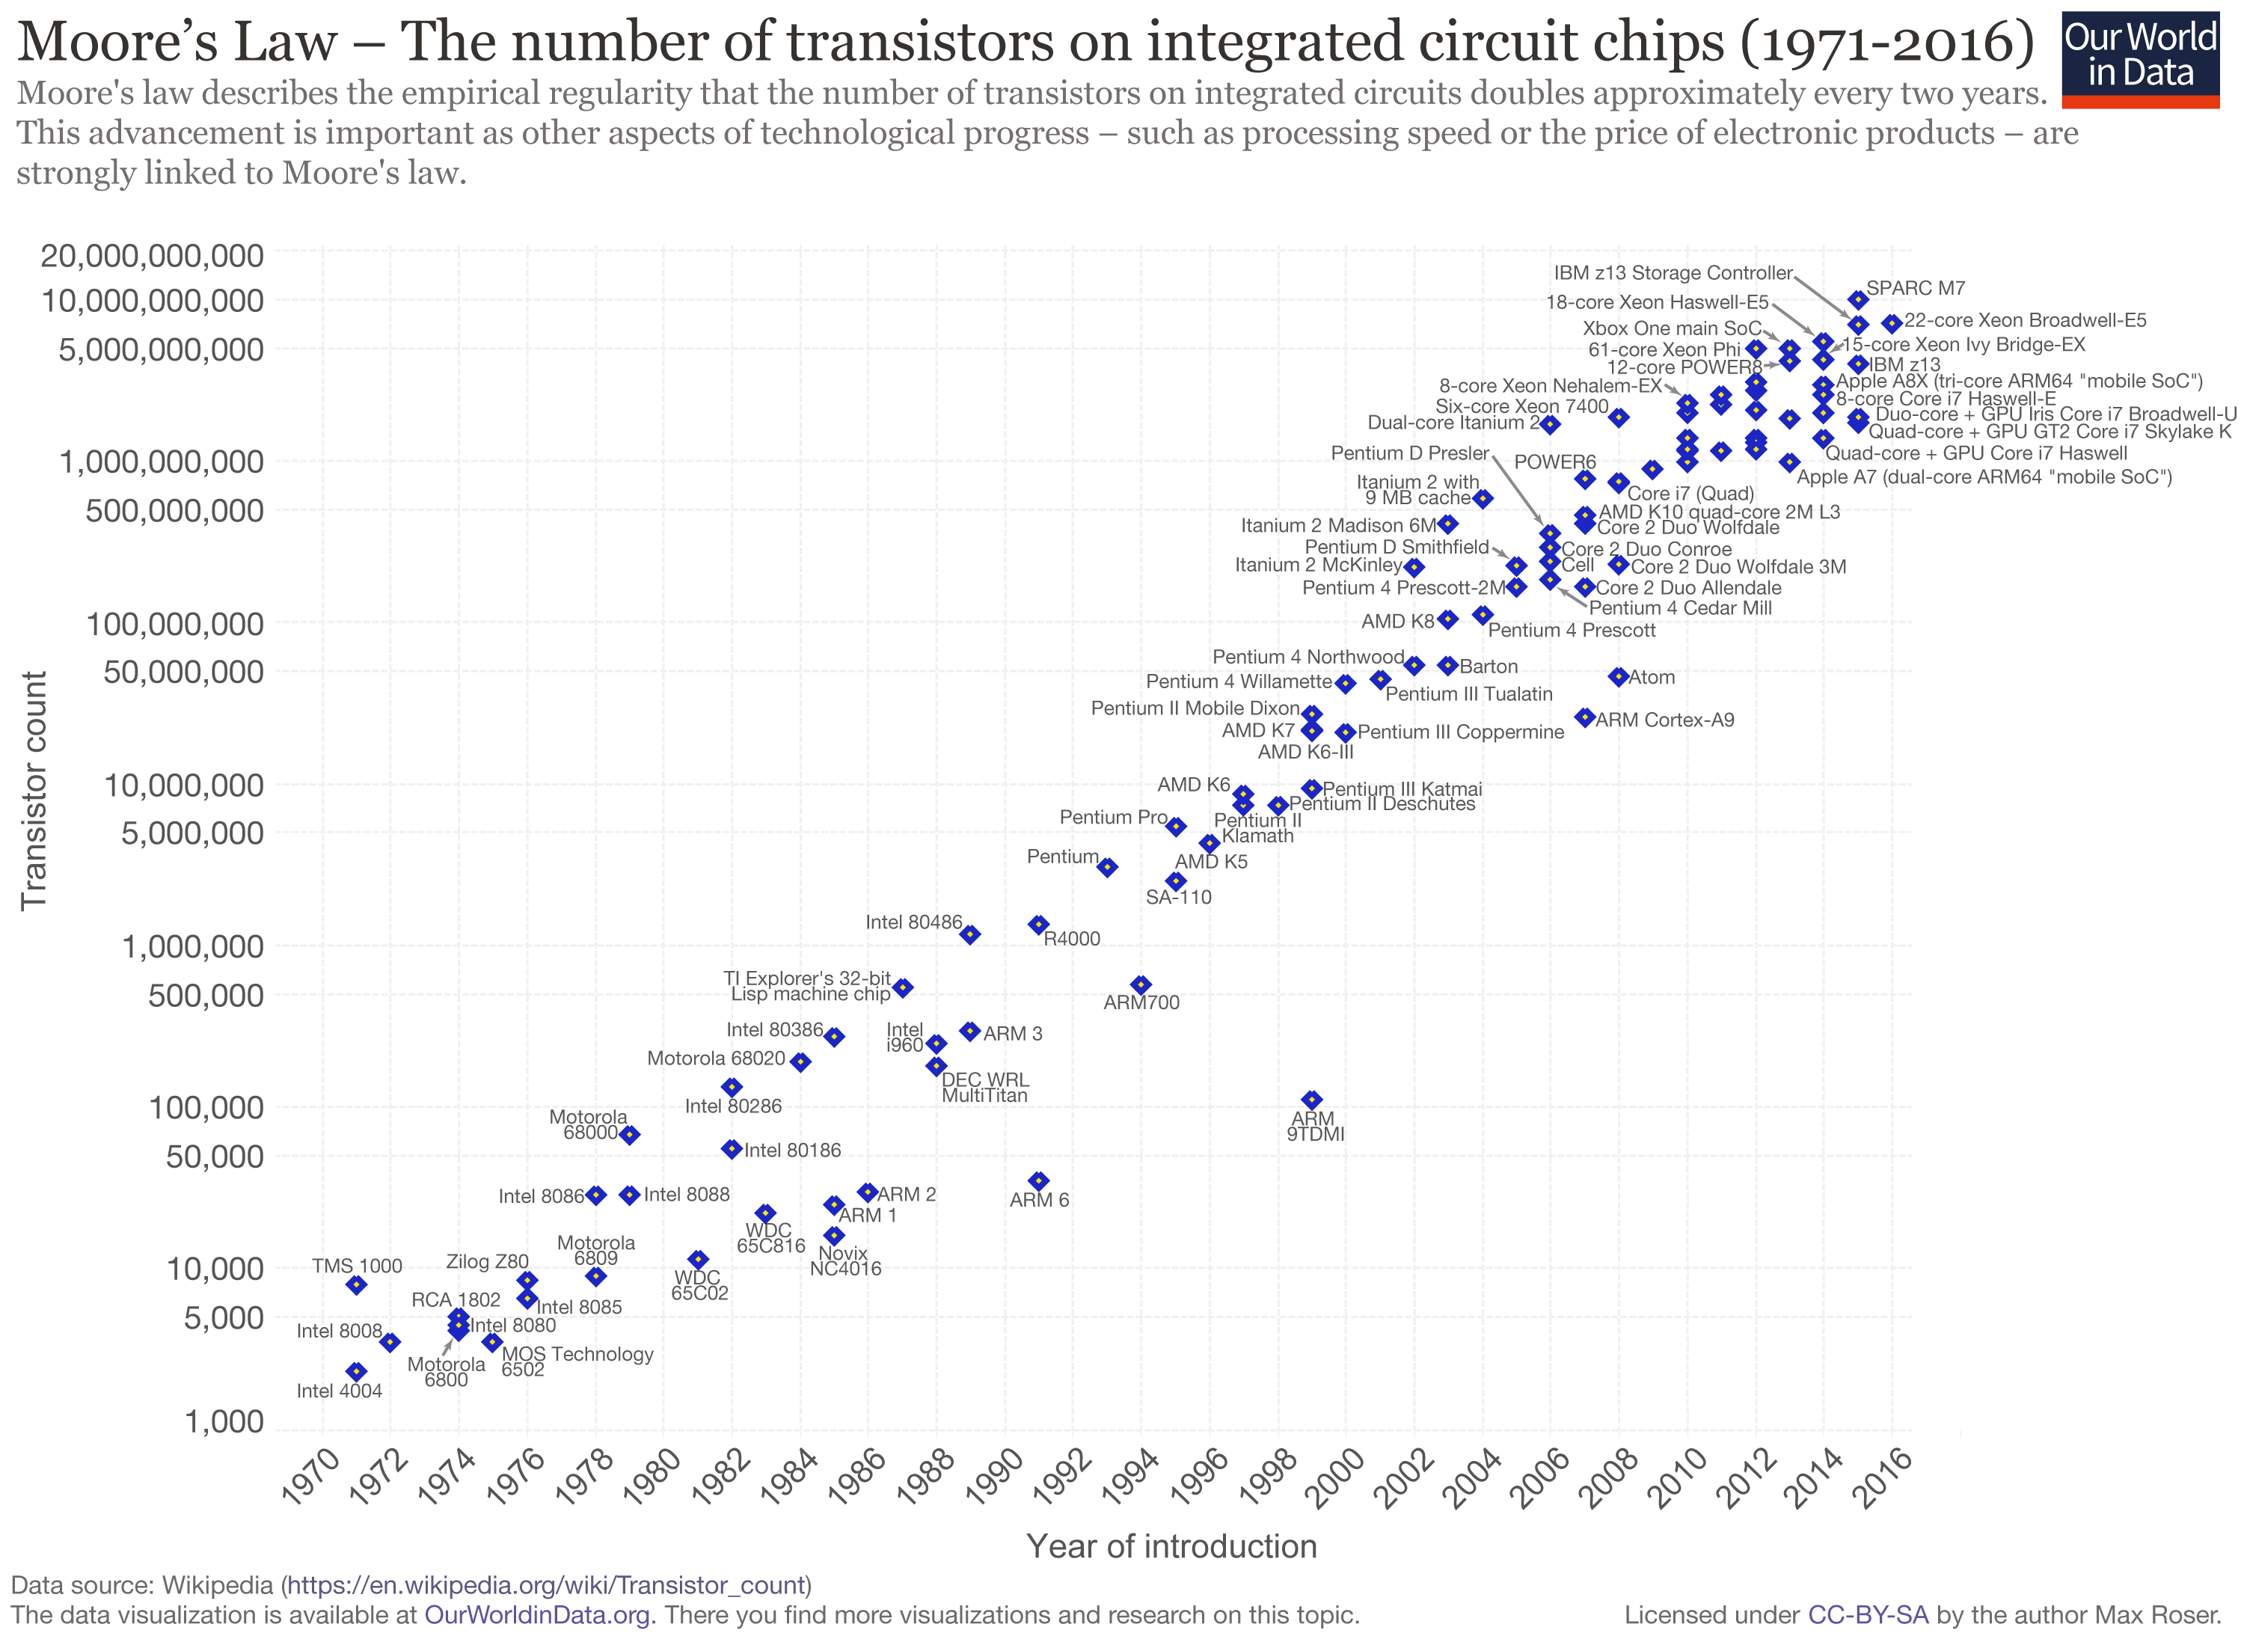
CPU Trends

Slide 7
Sequential Computation
Bottleneck of Sequential Computation
Single processor performance increases with the as transistor density increases.
Increase in transistor density increases power consumption and result in heating problem.
Heating problem results in unreliable computation.
Additional technique to improve performance: Parallelism

Slide 8
Benefits
Parallelism increase computation power
Many important applications
Climate modeling
Protein folding
Drug discovery
Data analysis
…

Slide 9
Parallelism and Parallel Computing
Can a system automatically parallelize a sequential program?
Specific cases
Automatic parallelization by compiler
Instruction level parallelism in architecture
Cannot exploit all possible opportunities
Parallel Programming: Device parallel algorithm and program that solves a problem in more efficient manner

Slide 10
Example
Problem: Compute n values and sum them together.
Sequential Program
int sum = 0;
for (i = 0; i < n; i++) {
x = f(i);
sum = sum+x;
}

Slide 11
Parallel Program: Compute Partial Sum
Assumption: p processors where p << n
my_sum = 0;
my_first i = . . . ;
my_last i = . . . ;
for (my_i = my_first i; my_i < p_last_i; my_i++) {
my_x = f(i);
my_sum += my_x;
}

Slide 12
Parallel Program: Accumulate Partial Sum
if (I’m the master core) {
sum = my_sum;
for (each core other than myself) {
receive value from core;
sum += value;
}
} else { send my_sum to the master; }
8+19+7+15+7+13+12+14=95

Slide 13
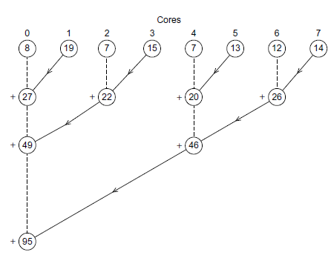
Parallel Program: Second Attempt
No constraint on the number of available processors

Slide 14
Comparing two Attempts
(1) Compute partial sum of n/p elements.
(2) accumulate results of partial sum
Both approaches have same number of addition operations

Slide 15
Comparing two Attempts
Parallel computation
(1) Compute partial sum of n/p elements.
Serial computation
(2) accumulate results of partial sum
Step (2) of the first approach is serialized

Slide 16
Comparing two Attempts
(1) Compute partial sum of n/p elements.
(2) accumulate results of partial sum
First approach is closer to the sequential sum program

Slide 17
Additional Concerns
Communication
- shared memory, message passing, …
Coordination
- synchronization
Job distribution
- load balancing

Slide 18
Different Models of Computation
Concurrency
Parallelism
Distributed computing
Shared memory programs: OpenMP
Message passing:
MPI
….

Slide 19
Memory & Communication Play a Significant Role
Core 0
Core 1
Core 0
Core 1
…
…
Memory
Memory
Memory
Network

Slide 20
References
Chapter 1
An Introduction to Parallel Programming
by Peter Pacheco.
Introduction to Parallel Computing, Second Edition
by Ananth Grama, Anshul Gupta, George Karypis, Vipin Kumar

