Slide 1

Application Virtualization
Gautam Shroff – TCS Innovation Lab - Delhi

Slide 2
Virtualization

Slide 3
Multi-Tenancy
Usually meant for hosted Software as a Service applications
Multi-tenancy - single code base; multiple customers
  software development economies of scale driving down costs
  rapid and invisible upgrades

Slide 4
Example: Multi-Tenancy using Multiple Schemas

Slide 5
Application Virtualization: Model Driven Interpreters
Virtualize a class of applications:
  e.g. Forms-based workflow applications
  … but there are others – Facebook Apps are an example
MDI:
  interprets model at runtime instead of generating code
  does this efficiently
MDI platforms also:
  allow manipulation of the model while the system is running
  manage this efficiently and correctly
In addition some MDI platforms:
  allow manipulation of models and immediately render – WYSIWIG
  are [somewhat] meta-circular

Slide 6
Motivation for Application Virtualization / MDI
Cloud is about Infrastructure
What about Development Costs: “No Silver Bullet”
“There is no single development, in either technology or or management technique, which by itself promises even one order-of of-magnitude improvement within a decade in productivity, reliability, or simplicity.”
Fred Brooks, 1975
However –
Computer hardware has progressed a lot
  No other technology since civilization began has seen seven orders of magnitude price-performance gain in 50 years
The Internet happened
Cloud Computing is promising another revolution.
It has been 3 decades since !

Slide 7
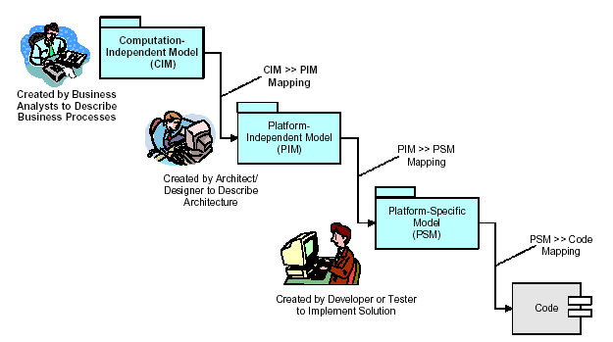
Model Driven Architecture:

Slide 8
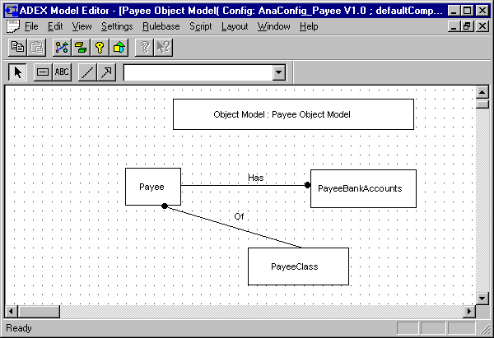
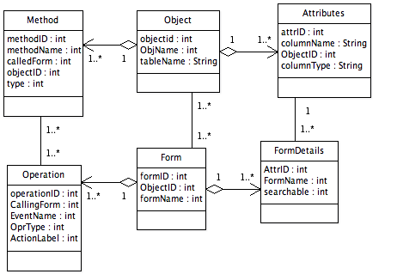
How MDA Works:
Visual Modeling
Describes
Meta Model
Application Model
Attributes
Attribute Name | Object Name | Column Name
PID | PropertyObj | PropertyID
Address | PropertyObj | Address
Owner | PropertyObj | Owner
Code Generator
Templates
Application Code
Class <ObjectName>:
<Attributes>
….
Class PropertyObj:
PID
Address
Owner

Slide 9
Lessons from our MDA experience
    Technology Proofing
      critical for redeployment to different architectures, databases, languages…
    Developing into complex high-performance software architectures
      critical for enforcing standards and uniformity required for performance
    However
Steep learning curve & complex environment
Poor turn-around time for changes
  Incremental generation and testing difficult
End-to-end savings was not significant
Even if code is generated from model elements
– one change – say a field addition, or size change can affect upto 100 lines of code, and cause re-generation of over 1000 lines across many files – all needs to be deployed, tested …
MDA works best for large, complex ‘product-line’ systems
Not for small light-weight applications

Slide 10
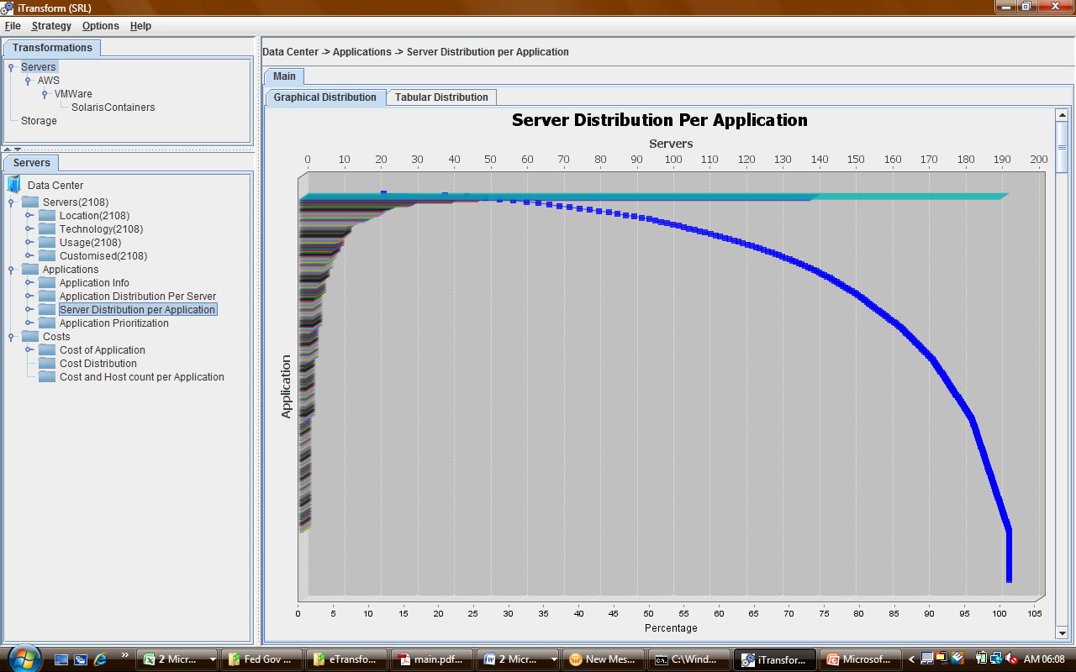
Long Tail of Enterprise Applications
Small number of large,
Business-critical applications
Moderate number of
midsize applications
Large number of small,
situational applications
candidates for Dev 2.0 and public cloud

Slide 11
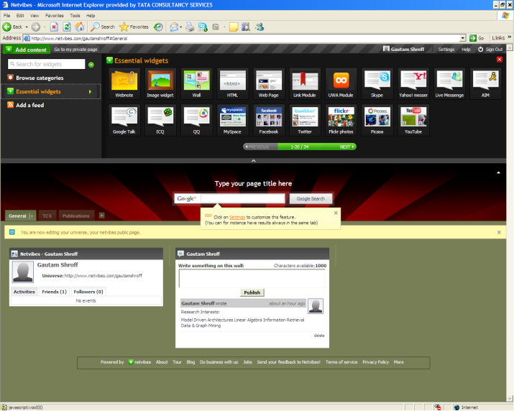
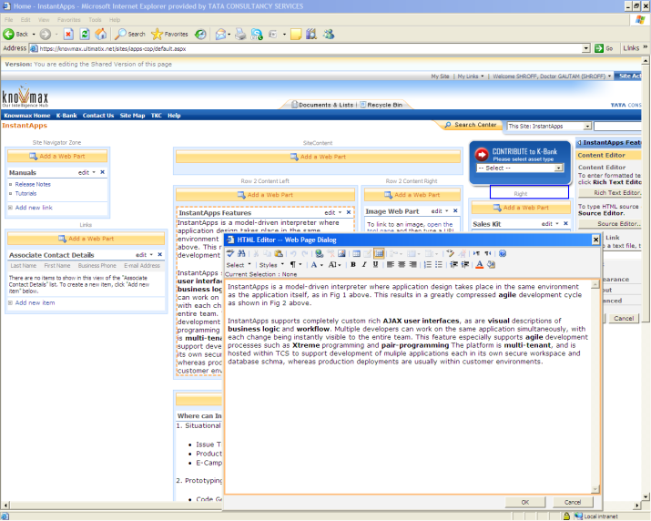
Lessons from the Web
Web 1.0: Publishers and Readers
Web 2.0:
  “Do it yourself” writing – blogs, wikis
  “Do it yourself” publishing:
Netvibes
Sharepoint
Sampa, Ning …

Slide 12
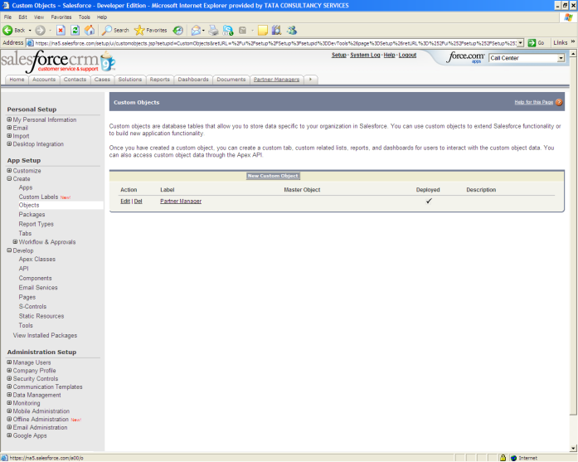
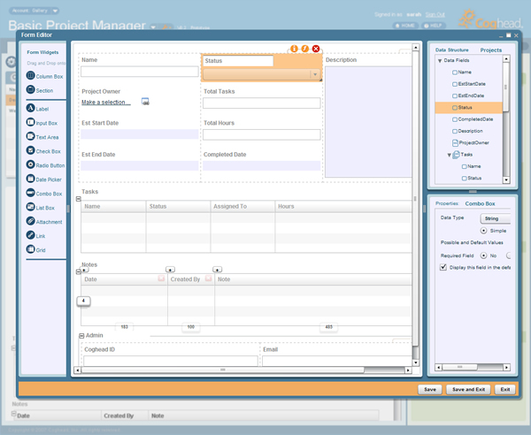
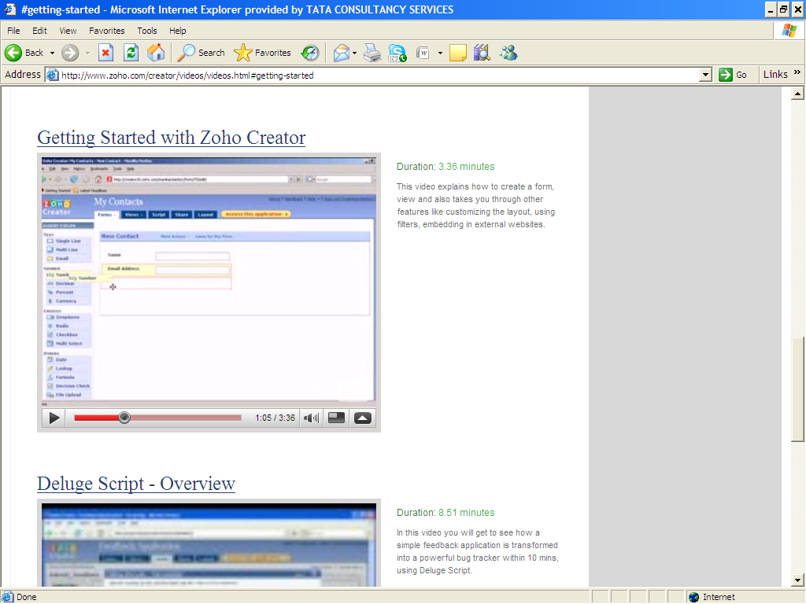
Web 2.0 to Dev 2.0
“Do it yourself” business applications:
Salesforce.com
Coghead
Zoho
Acquired by SAP
Other examples – e.g. a very large F100 enterprise’s in-house platform
Forms driven database oriented workflows without coding or any ‘IDE’

Slide 13
From MDA to MDI
Describes
Model Repository
Attributes
Attribute Name | Object Name | Column Name
PID | PropertyObj | PropertyID
Address | PropertyObj | Address
Owner | PropertyObj | Owner
WYSIWYG “Designer”
Model Interpreter
Class EntObj:
attrs = [(,)]
def _init_(name):
classname=name
lookupMM()
fillAttrs()
InstantApps: J2EE, TCS tool
(early Python prototype
released as open source)
In-memory Model

Slide 14
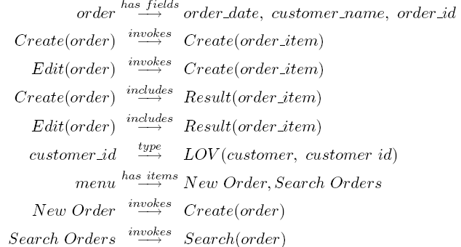
Models = Behavior Patterns: e.g. User-Interfaces
“form” abstraction: e.g. order form
Customer Page

Slide 15
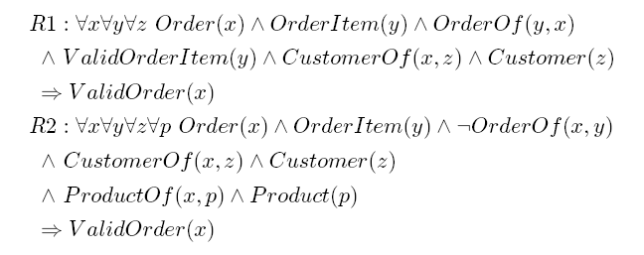
More Patterns: Modeling Validation Rules

Slide 16
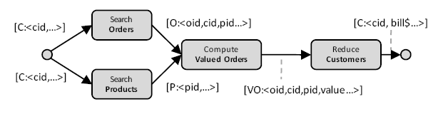
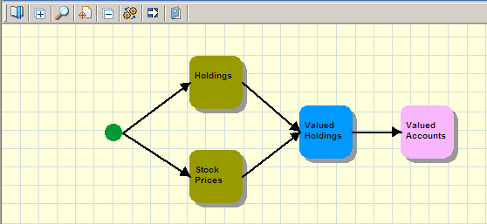
More Patterns: Modeling Computations using MapReduce
Recap MapReduce:
  map (k1,v1) → [(k2,v2)] - key-value pair to list of pairs on new key
  reduce (k2,[v2])→ (k2,v3) – new key, list of values to ‘reduced’ value
  merge (k2,[v3]) I a , (k3,[v4]) I b → [(k4,v5)] two key,list to a list of pairs
Applying this to visually model ‘business logic’ on relational records:

Slide 17
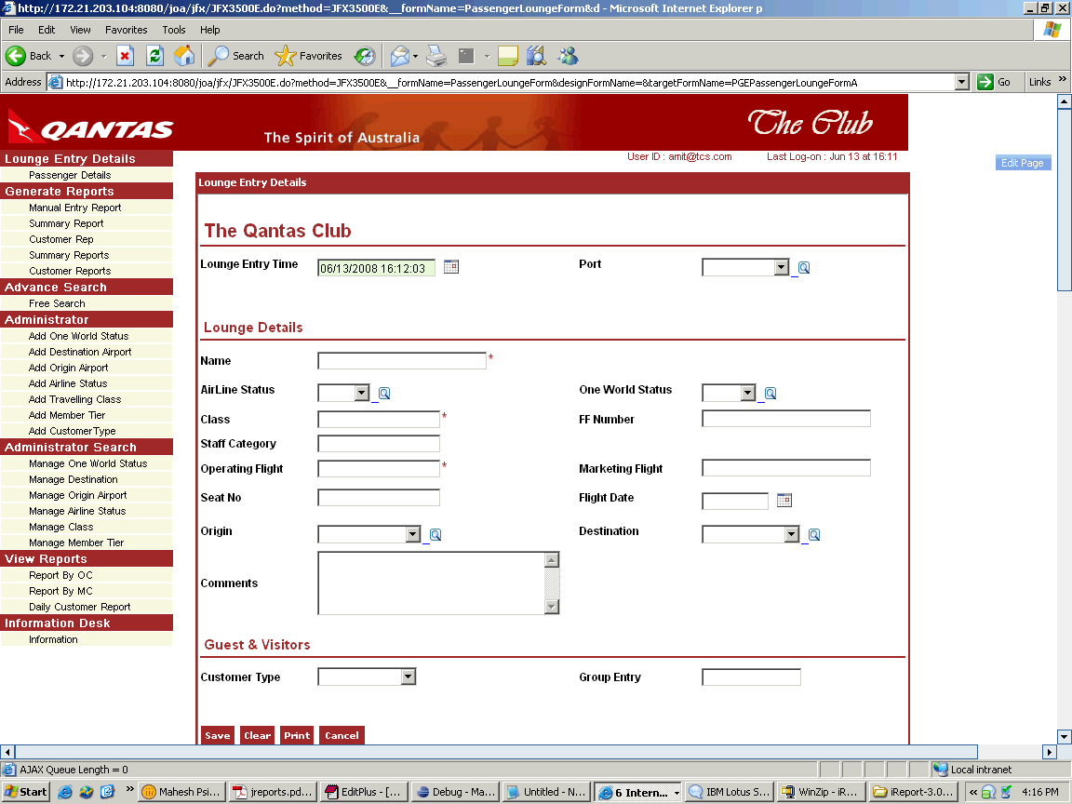
TCS InstantApps: Enterprise-class Dev 2.0
R&D initiative begun in 2004
Goal: “point and click” WYSIWIG development of business applications
Integrated platform for small-medium applications, moderate workloads / data
Proven Rapid time-to-market – significantly faster e.g. 1.5x => business agility
Enterprise class:
  complex forms (multi-table)
  workflow (BPMN in browser, ECA rules)
  business logic (custom code + visual…)
  custom user interfaces
“Instant Multi-Tier Applications without Tears”
ISEC 2009, Pune India
“InstantApps: A WYSIWYG Model-driven Interpreter for Web Applications”
ICSE 2008, Vancouver, Canada (Research Demo)
Notes:
Using InstantApps can significantly accelerate development and improve maintenance SLAs
Development takes place on TCS’s own InstantApps infrastructure – thus also reducing development and testing infrastructure needs for our customers
In production, InstantApps is deployed at premise in our customer’s data centres as an integrated runtime engine
However – equivalent application source code is also provided (by code generation) in case desired for risk mitgation, however TCS maintains applications using the InstantApps runtime engine rather than using the generated code.
InstantApps is not a product –it is TCS’ own unique solution accelerator

Slide 18
Inside InstantApps:
Designer
Users
http
http
Designer
Player
Authoring Tools
Customer Add Screen
‘Customer’ Specs
‘Add’ Pattern
Specifications
Patterns
Application Server
DB
CUST Table
Meta - Model

Slide 19
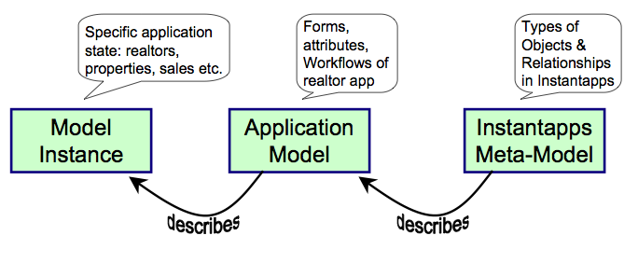
InstantApps Models

Slide 20
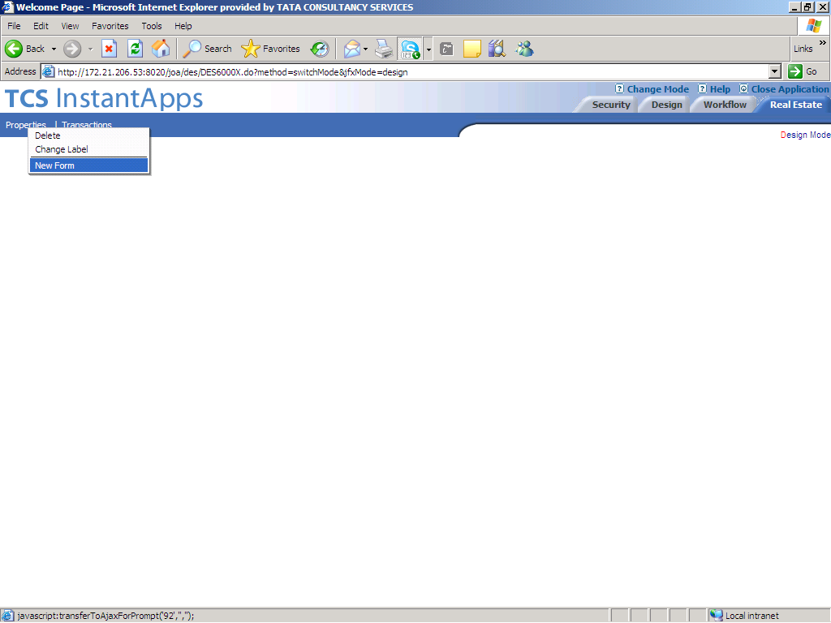
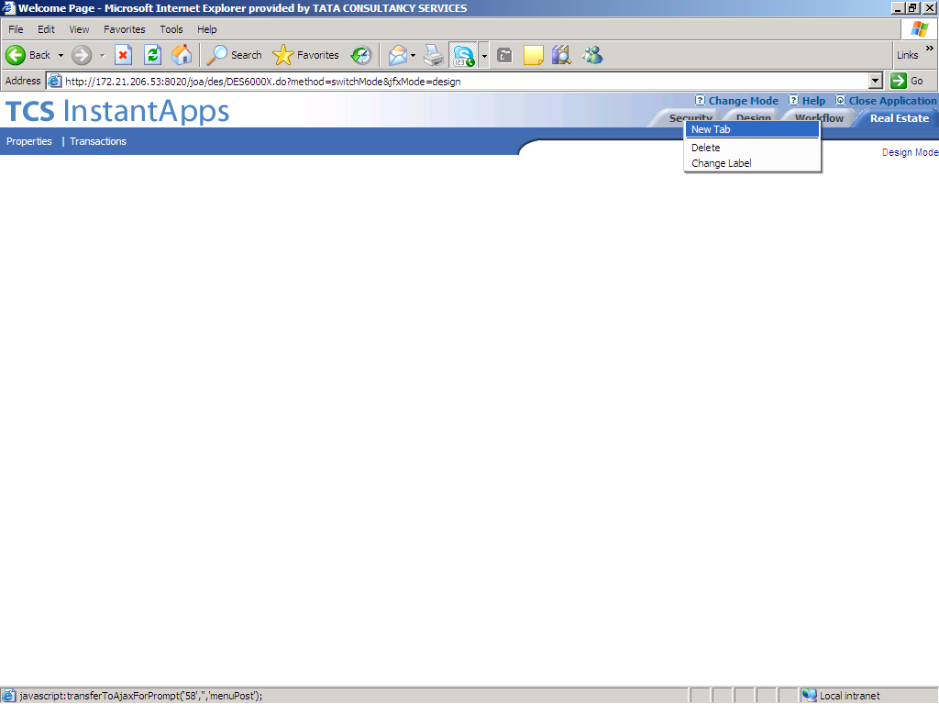
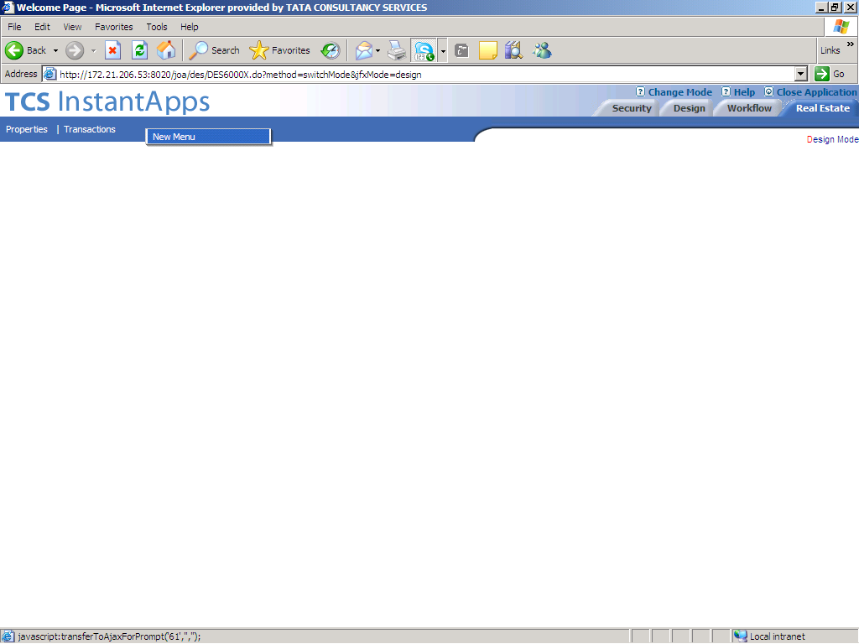
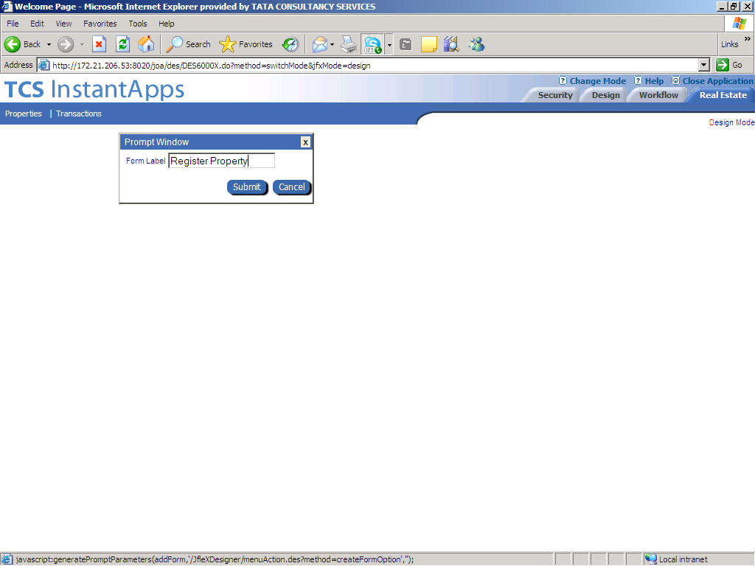
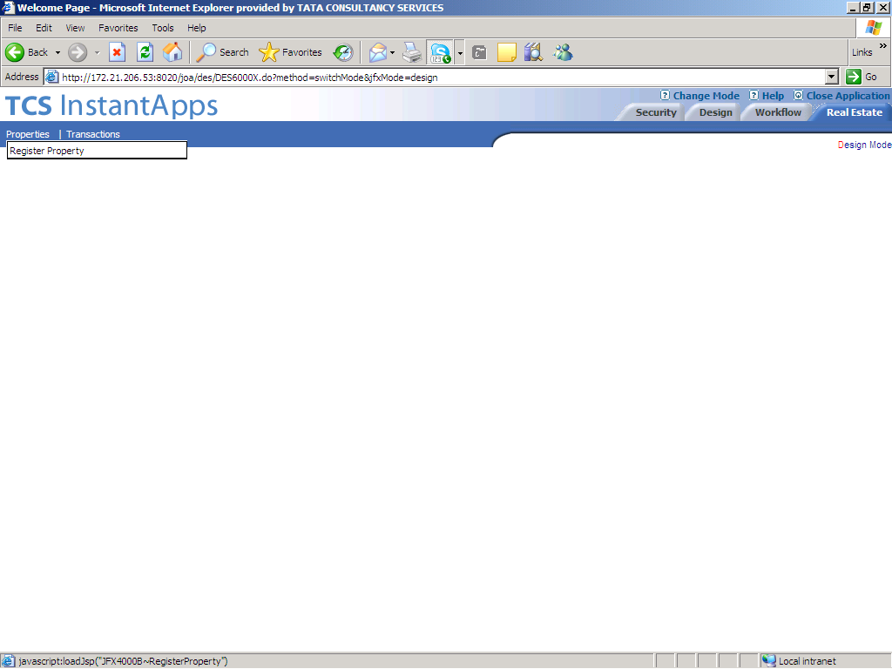
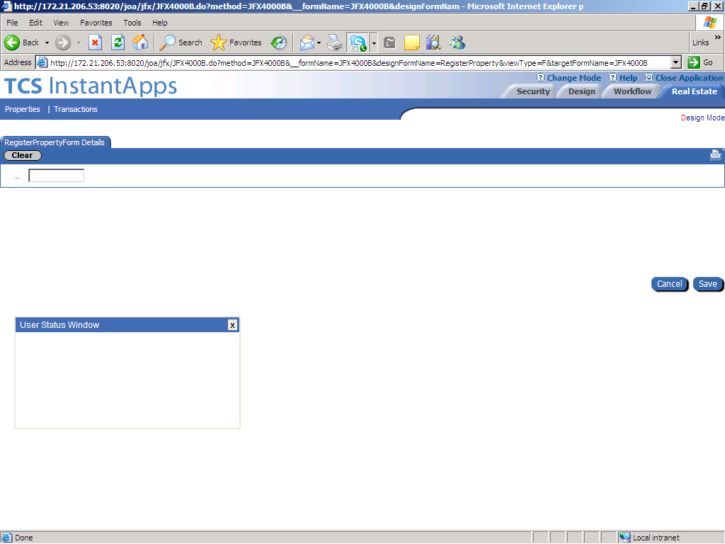
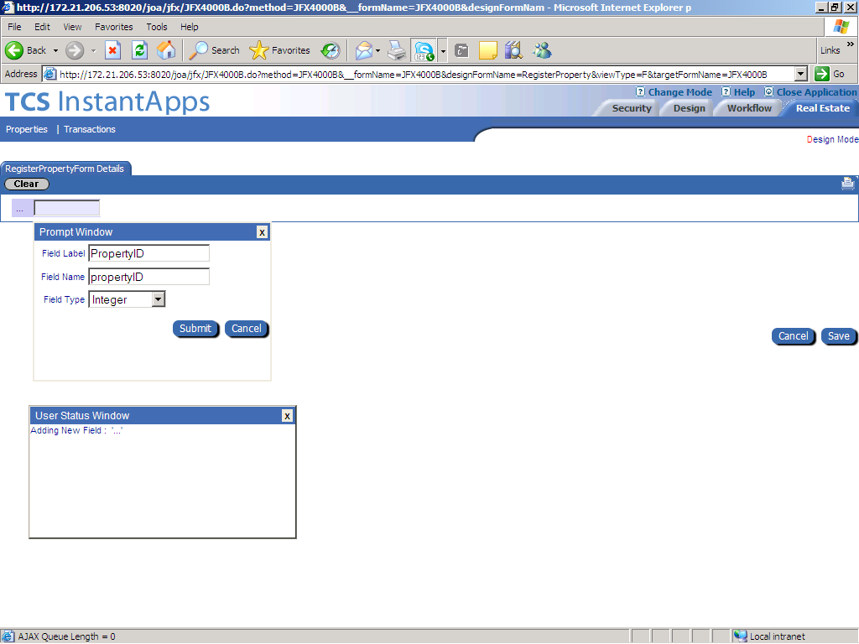
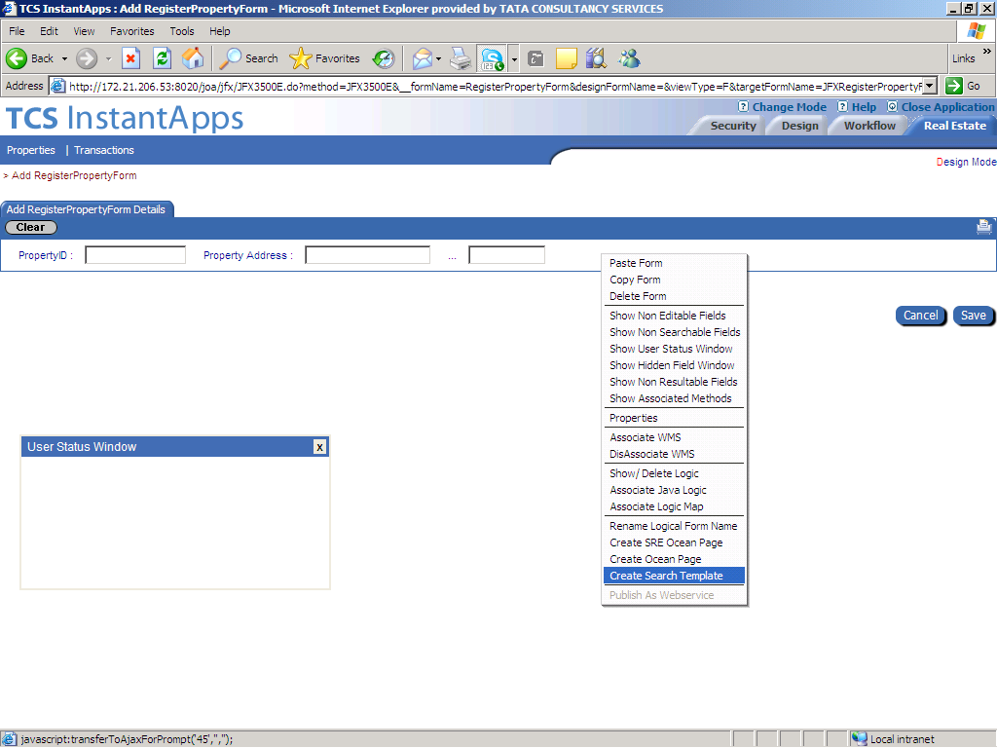
Example
Object
ObjectName | TableName
PropertyObj | Properties
SaleObj | Sales
…... | …
Attributes
Attribute Name | Object Name | Column Name
PID | PropertyObj | PropertyID
Address | PropertyObj | Address
Owner | PropertyObj | Owner
SaleID | SaleObj | SaleID
PID | SaleObj | PropertyID
Buyer | SaleObj | Buyer
Price | SaleObj | Price
Method
Method Name | Called Form | Type
 | Sell Property | PF
sellProp |  | LM
FormDetails
FormName | Attribute | Object
Register Property | PID | PropertyObj
Register Property | Address | PropertyObj
Sell Property | PID | SaleObj
Sell Property | Price | SaleObj
Search Sales | Address | PropertyObj
Form
FormName | ObjectName
Register Property | PropertyObj
Sell Property | SaleObj
Search Sales | SaleObj
Operation
Form | Type
Register Property - Result | Action
Sell Property - Add | After Add

Slide 21
Experience using InstantApps: Time & Cost
Significantly accelerated development
Caveats
  small applications (<2000FP)
Significantly improved productivity
Being used in practice
Deployed in production

Slide 22
MDI Results in a Compressed Development Cycle
Requirements Gathering
and
Rapid Prototyping
Requirements Gathering
and
Rapid Prototyping
Design
Design and Construction
Construction and Unit Testing
System Testing
Integration Testing
X
User Acceptance Testing
System Testing
User Acceptance Testing

Slide 23
Experience using InstantApps: Performance
Performance for moderate workloads similar to non-interpreted application using ‘same’ architecture.
  many100s of concurrent users, millions of records, on single blade
Why?
  computing overhead is not the critical bottleneck – faster CPUs, …
  but also perhaps some losses are made up:
  less code – less memory footprint
  fixed # of classes w.r.t. size of functionality – drives object re-use within JVM

Slide 24
Multi-Tenancy with Model Driven Interpreters
Multi-tenancy comes for free
  – single instance supports multiple applications
Re-use by importing application models
Application Y = Application X
Meta-Data
Repository
Import
Application X
Delta
Application Y
Publish
Application Y after enhancements

Slide 25
Challenges of Software as a Service
“What about my data”
  often an inhibitor to SaaS adoption
SaaS applications could potentially
use a customer’s ‘own’ data in the same
cloud :
InstantApps in the Cloud allows this
‘my’ data
SaaS
application

Slide 26
Dev 2.0 in the Cloud
Web based Dev 2.0 platforms - `SaaS’ model
InstantApps on Amazon EC2 - `PaaS’ model

Slide 27
Cloud Computing and Hosted MDI
Dev 2.0 platforms can potentially access customer’s ‘own’ data
Multiple Dev 2.0 platforms, each appropriate for a particular type of application, can access same data
  forms processing
  transaction processing (batch)
  analytics (OLAP)
  Integration
(this does not happen yet)
‘Forms’ MDI
‘my’ data
meta-data
‘Analytics’ MDI
‘Integration’ MDI

Slide 28
Dev 2.0 Economics
Dev 2.0
Essential aspects of any `cloud’ service:
“pay-per-use” per-user / per CPU-hr / per-FP
rapid end-user provisioning instantly `provision’ a `blank’
application via multi-tenancy
commoditized service common application functionality
available as re-usable `templates’
  Consumer: can avoid provisioning for peak load
  Provider: can amortize load across a larger variability of usage profiles
Cloud platforms offer computing infrastructure at significantly cheaper TCO

Slide 29
Beyond Dev 2.0 in the Cloud: “Cloud Services”?
Can outsourced services (BPO, KPO) share `cloud’ features?
“pay-per-use” outcome based pricing
rapid end-user provisioning customer configurable services
commoditized service “payroll”, “accounting”, “claims”
available as re-usable templates’
Dev 2.0 ideas appear to have some role to play here - `watch this space’

Slide 30
Research Problem: Tools to build MDIs
How did we create a MDI?
Choose application:
  ‘target architecture’
Extract architecture code
  templates
Define equivalent meta-model
Convert templates to interpreters
Create a custom Designer
Q: Can this be automated?
  Partial Evaluation:
  Given an interpreter and a program
  Produce code specific to that program
  (i.e. ‘evaluate out’ the interpreter)
  Given a model-driven interpreter and a model
  Produce code that executes only that model
Reverse of ‘partial evaluation’
  - unsolved!

Slide 31
Summary
Cost and Time are precious
  IT has improved agility, but is IT itself agile?
Cloud Computing achieves efficiencies for IT Infrastructure,
MDI (Dev 2.0) could do the same for Application Development
  maybe even for other areas
Many research problems remain

Slide 32

TCS Research
7 major corporate research locations in India
~ 500 research staff, ~ 75 PhDs
Areas:
  Software Engineering
  AI and NLP
  Multimedia and Graphics
  Analytics and Algorithms
  Large Scale Systems
  Bio & Nano Technology
Please visit us – short term (and long☺)
saabaticals / internships are welcomed!
DELHI
KOLKATTA
MUMBAI
PUNE
HYDERABAD
BANGALORE
CHENNAI

