Slide 1
Graphs
COL 106
Slide Courtesy : http://courses.cs.washington.edu/courses/cse373/
Douglas W. Harder, U Waterloo

Slide 2
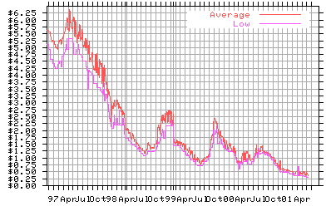
What are graphs?
Yes, this is a graph….
But we are interested in a different kind of “graph”

Slide 3
Graphs
Graphs are composed of
Nodes (vertices)
Edges (arcs)
node
edge

Slide 4
Varieties
Nodes
Labeled or unlabeled
Edges
Directed or undirected
Labeled or unlabeled

Slide 5
Motivation for Graphs
node
node
Consider the data structures we have looked at so far…
Linked list: nodes with 1 incoming edge + 1 outgoing edge
Binary trees/heaps: nodes with 1 incoming edge + 2 outgoing edges
B-trees: nodes with 1 incoming edge + multiple outgoing edges
Value
Next
Value
Next
94
10
97
3 5
96
99

Slide 6
Motivation for Graphs
How can you generalize these data structures?
Consider data structures for representing the following problems…

Slide 7
CSE Course Prerequisites
461
373
322
143
321
142
326
410
415
370
341
413
417
378
Nodes = courses
Directed edge = prerequisite
421
401

Slide 8
Representing a Maze
S
S
B
E
E
Nodes = rooms
Edge = door or passage

Slide 9
Representing Electrical Circuits
Battery
Switch
Nodes = battery, switch, resistor, etc.
Edges = connections
Resistor

Slide 10
Program statements
x1
x2
x1=q+y*z
+
-
x2=y*z-q
Naive:
q
*
*
q
y*z calculated twice
y
z
x1
x2
common
subexpression
+
-
eliminated:
q
*
q
Nodes = symbols/operators
Edges = relationships
y
z

Slide 11
Precedence
S₁ a=0;
S₂ b=1;
S₃ c=a+1
S₄ d=b+a;
S₅ e=d+1;
S₆ e=c+d;
6
5
Which statements must execute before S₆?
S₁, S₂, S₃, S₄
4
3
Nodes = statements
Edges = precedence requirements
1
2

Slide 12
Information Transmission in a Computer Network
56
Tokyo
Seattle
Seoul
128
16
181
New York
30
140
L.A.
Sydney
Nodes = computers
Edges = transmission rates

Slide 13
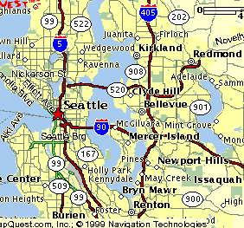
Traffic Flow on Highways
UW
Nodes = cities
Edges = # vehicles on
connecting highway

Slide 14
Graph Definition
A graph is simply a collection of nodes plus edges
Linked lists, trees, and heaps are all special cases of graphs
The nodes are known as vertices (node = “vertex”)
Formal Definition: A graph G is a pair (V, E) where
V is a set of vertices or nodes
E is a set of edges that connect vertices

Slide 15
Graph Example
Here is a directed graph G = (V, E)
Each edge is a pair (v₁, v₂), where v₁, v₂ are vertices in V
V = {A, B, C, D, E, F}
E = {(A,B), (A,D), (B,C), (C,D), (C,E), (D,E)}
B
C
A
F
D
E

Slide 16
Directed vs Undirected Graphs
If the order of edge pairs (v₁, v₂) matters, the graph is directed (also called a digraph): (v₁, v₂) ≠(v₂, v₁)
If the order of edge pairs (v₁, v₂) does not matter, the graph is called an undirected graph: in this case, (v₁, v₂) = (v₂, v₁)
v₁
v₂
v₁
v₂

Slide 17
Undirected Terminology
Two vertices u and v are adjacent in an undirected graph G if {u,v} is an edge in G
edge e = {u,v} is incident with vertex u and vertex v
A graph is connected if given any two vertices u and v, there is a path from u to v
The degree of a vertex in an undirected graph is the number of edges incident with it
a self-loop counts twice (both ends count)
denoted with deg(v)

Slide 18
Undirected Terminology
B is adjacent to C and C is adjacent to B
(A,B) is incident to A and to B
B
C
Self-loop
A
F
D
E
Degree = 0
Degree = 3

Slide 19
Directed Terminology
Vertex u is adjacent to vertex v in a directed graph G if (u,v) is an edge in G
vertex u is the initial vertex of (u,v)
Vertex v is adjacent from vertex u
vertex v is the terminal (or end) vertex of (u,v)
Degree
in-degree is the number of edges with the vertex as the terminal vertex
out-degree is the number of edges with the vertex as the initial vertex

Slide 20
Directed Terminology
B adjacent to C and C adjacent from B
B
C
A
F
D
E
In-degree = 0
Out-degree = 0
In-degree = 2
Out-degree = 1

Slide 21
Handshaking Theorem
Let G=(V,E) be an undirected graph with |E|=e edges. Then
Every edge contributes +1 to the degree of each of the two vertices it is incident with
number of edges is exactly half the sum of deg(v)
the sum of the deg(v) values must be even
Add up the degrees of all vertices.

Slide 22
Graph Representations
Space and time are analyzed in terms of:
Number of vertices = |V| and
Number of edges = |E|
There are at least two ways of representing graphs:
The adjacency matrix representation
The adjacency list representation

Slide 23
Adjacency Matrix
A B C D E F
B
C
A
B
C
D
E
F
0 1 0 1 0 0
A
1 0 1 0 0 0
F
0 1 0 1 1 0
D
E
1 0 1 0 1 0
0 0 1 1 0 0
1 if (v, w) is in E
M(v, w) =
0 0 0 0 0 0
0 otherwise
Space = |V|²

Slide 24
Adjacency Matrix for a Digraph
A B C D E F
B
C
A
B
C
D
E
F
0 1 0 1 0 0
A
0 0 1 0 0 0
F
0 0 0 1 1 0
D
E
0 0 0 0 1 0
0 0 0 0 0 0
1 if (v, w) is in E
M(v, w) =
0 0 0 0 0 0
0 otherwise
Space = |V|²

Slide 25
Adjacency List
For each v in V, L(v) = list of w such that (v, w) is in E
a
b
B
A
B
C
D
E
F
B
D
list of
neighbors
C
A
A
C
F
B
D
E
D
E
A
C
E
C
D
Space = a |V| + 2 b |E|

Slide 26
Adjacency List for a Digraph
For each v in V, L(v) = list of w such that (v, w) is in E
a
b
B
A
B
C
D
E
F
B
D
C
A
C
F
D
E
D
E
E
Space = a |V| + b |E|

Slide 27
Searching in graphs
Find Properties of Graphs
Spanning trees
Connected components
Bipartite structure
Biconnected components
Applications
Finding the web graph – used by Google and others
Garbage collection – used in Java run time system

Slide 28
Graph Searching Methodology Depth-First Search (DFS)
Depth-First Search (DFS)
Searches down one path as deep as possible
When no nodes available, it backtracks
When backtracking, it explores side-paths that were not taken
Uses a stack (instead of a queue in BFS)
Allows an easy recursive implementation

Slide 29
Depth First Search Algorithm
Recursive marking algorithm
Initially every vertex is unmarked
DFS(i)
i
DFS(i: vertex)
mark i;
for each j adjacent to i do
if j is unmarked then DFS(j)
end{DFS}
DFS(j)
j
k
Marks all vertices reachable from i

Slide 30
DFS Application: Spanning Tree
Given a (undirected) connected graph G(V,E) a spanning tree of G is a graph G’(V’,E’)
V’ = V, the tree touches all vertices (spans) the graph
E’ is a subset of E such that G’ is connected and there is no cycle in G’

Slide 31
Example of DFS: Graph connectivity and spanning tree
2
DFS(1)
1
7
3
5
6
4

Slide 32
Example Step 2
2
DFS(1)
DFS(2)
1
7
3
5
6
4
Red links will define the spanning tree if the graph is connected

Slide 33
Example Step 5
2
DFS(1)
DFS(2)
DFS(3)
DFS(4)
DFS(5)
1
7
3
5
6
4

Slide 34
Example Steps 6 and 7
2
DFS(1)
DFS(2)
DFS(3)
DFS(4)
DFS(5)
DFS(3)
DFS(7)
1
7
3
5
6
4

Slide 35
Example Steps 8 and 9
2
DFS(1)
DFS(2)
DFS(3)
DFS(4)
DFS(5)
DFS(7)
1
7
3
5
6
Now back up.
4

Slide 36
Example Step 10 (backtrack)
2
DFS(1)
DFS(2)
DFS(3)
DFS(4)
DFS(5)
1
7
3
5
6
Back to 5,
but it has no
more neighbors.
4

Slide 37
Example Step 12
2
DFS(1)
DFS(2)
DFS(3)
DFS(4)
DFS(6)
1
7
3
5
6
Back up to 4.
From 4 we can
get to 6.
4

Slide 38
Example Step 13
2
DFS(1)
DFS(2)
DFS(3)
DFS(4)
DFS(6)
1
7
3
5
6
From 6 there is
nowhere new
to go. Back up.
4

Slide 39
Example Step 14
2
DFS(1)
DFS(2)
DFS(3)
DFS(4)
1
7
3
5
Back to 4.
Keep backing up.
6
4

Slide 40
Example Step 17
2
DFS(1)
1
7
All the way
back to 1.
Done.
3
5
6
4
All nodes are marked so graph is connected; red links define a spanning tree

Slide 41
Finding Connected Components using DFS
2
1
3
7
10
4
9
5
6
8
11
3 connected components

Slide 42
Connected Components
2
1
3
7
10
4
9
5
6
8
11
3 connected components are labeled

Slide 43
Performance DFS
n vertices and m edges
Storage complexity O(n + m)
Time complexity O(n + m)
Linear Time!

Slide 44
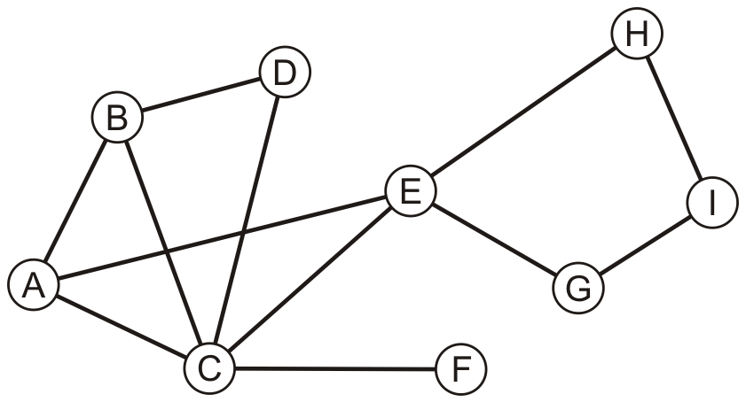
Another Example
Perform a recursive depth-first traversal on this graph

Slide 45
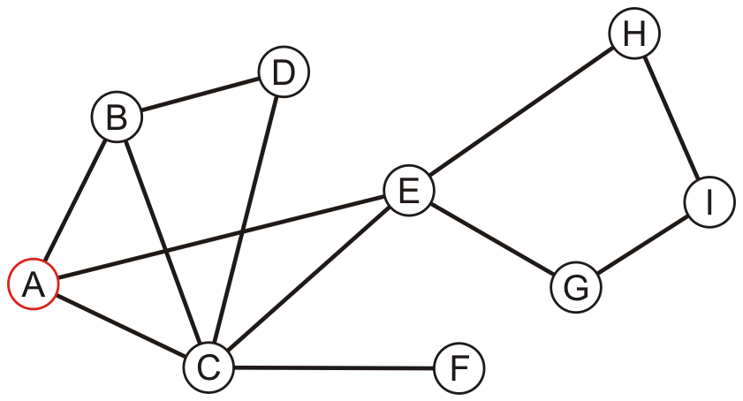
Another Example
Visit the first node
A

Slide 46
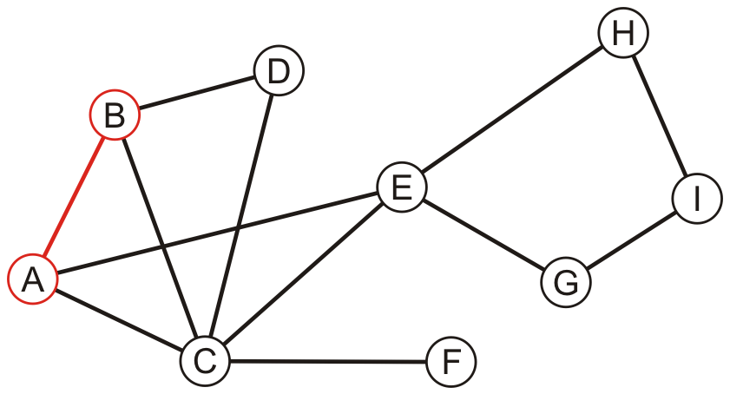
Another Example
A has an unvisited neighbor
A, B

Slide 47
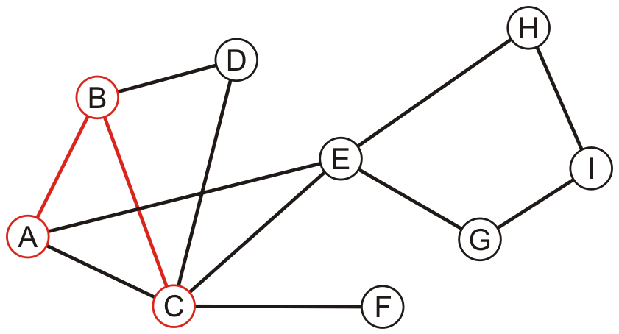
Another Example
B has an unvisited neighbor
A, B, C

Slide 48
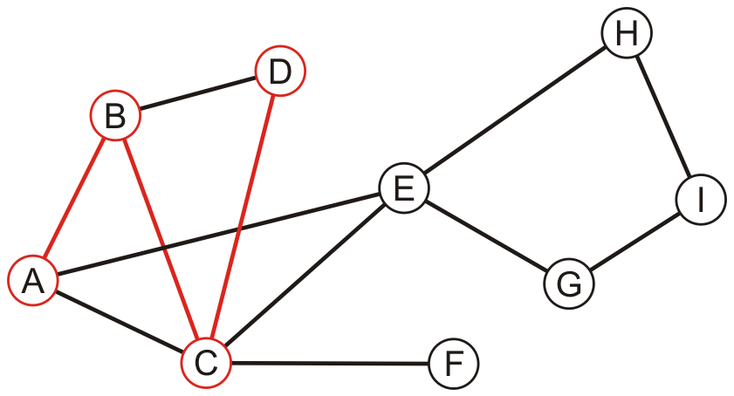
Another Example
C has an unvisited neighbor
A, B, C, D

Slide 49
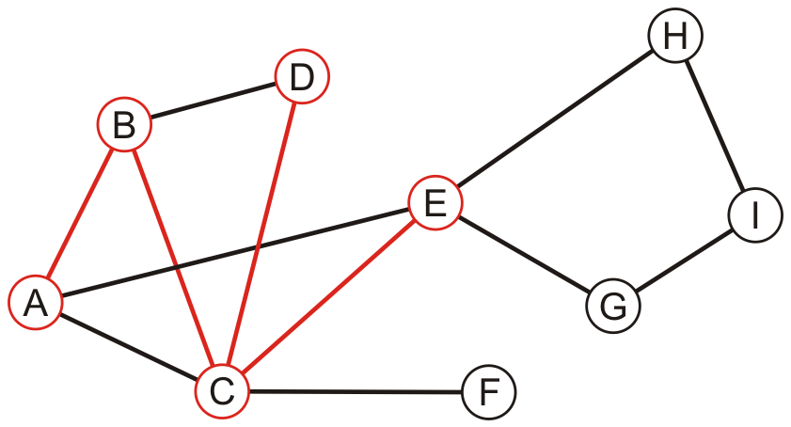
Another Example
D has no unvisited neighbors, so we return to C
A, B, C, D, E

Slide 50
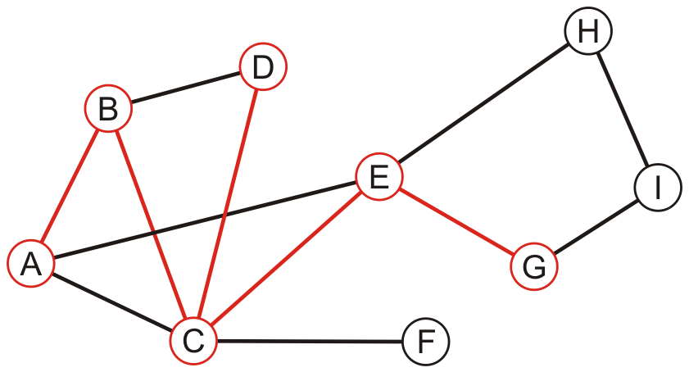
Another Example
E has an unvisited neighbor
A, B, C, D, E, G

Slide 51
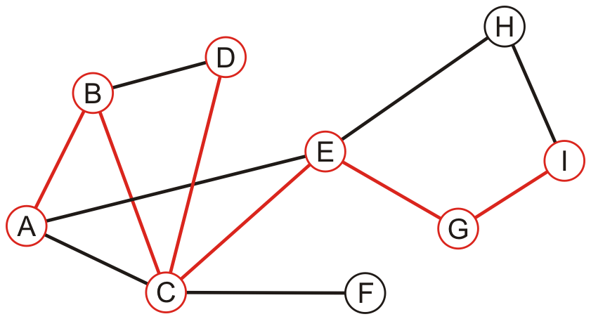
Another Example
F has an unvisited neighbor
A, B, C, D, E, G, I

Slide 52
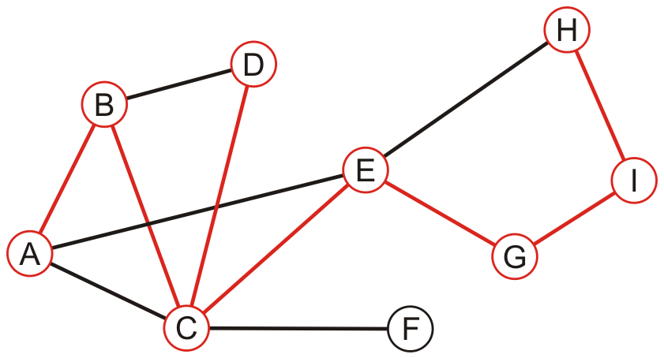
Another Example
H has an unvisited neighbor
A, B, C, D, E, G, I, H

Slide 53
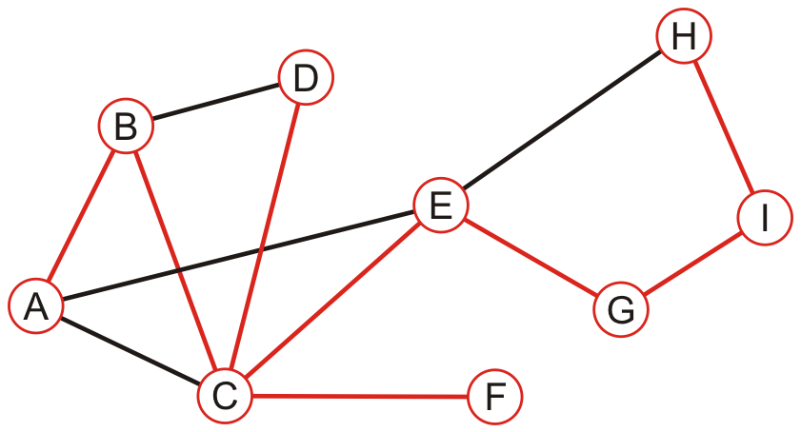
Another Example
We recurse back to C which has an unvisited neighbour
A, B, C, D, E, G, I, H, F

Slide 54
Another Example
We recurse finding that no nodes have unvisited neighbours
A, B, C, D, E, G, I, H, F

Slide 55
Graph Searching Methodology Breadth-First Search (BFS)
Breadth-First Search (BFS)
Use a queue to explore neighbors of source vertex, then neighbors of neighbors etc.
All nodes at a given distance (in number of edges) are explored before we go further

Slide 56
Example
Consider the graph from previous example

Slide 57
Example
Performing a breadth-first traversal
Push the first vertex onto the queue
A

Slide 58
Example
Performing a breadth-first traversal
Pop A and push B, C and E
A
B | C | E

Slide 59
Example
Performing a breadth-first traversal:
Pop B and push D
A, B
C | E | D

Slide 60
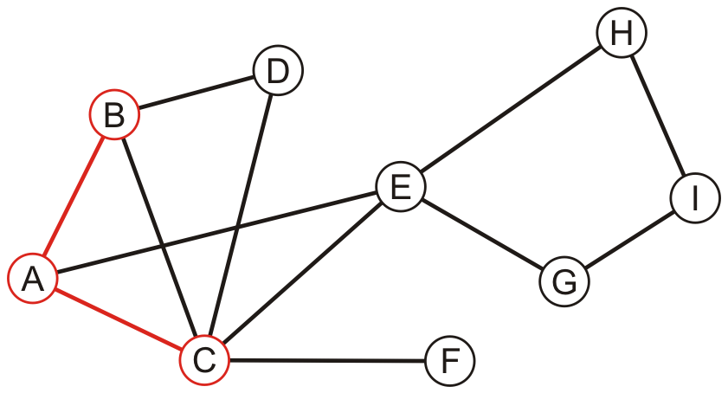
Example
Performing a breadth-first traversal:
Pop C and push F
A, B, C
E | D | F

Slide 61
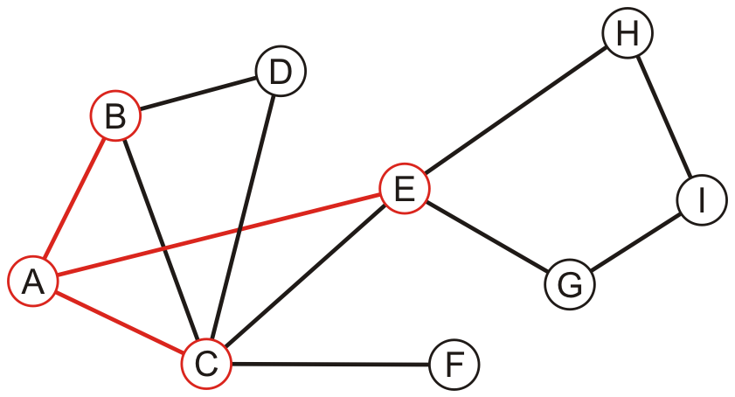
Example
Performing a breadth-first traversal:
Pop E and push G and H
A, B, C, E
D | F | G | H

Slide 62
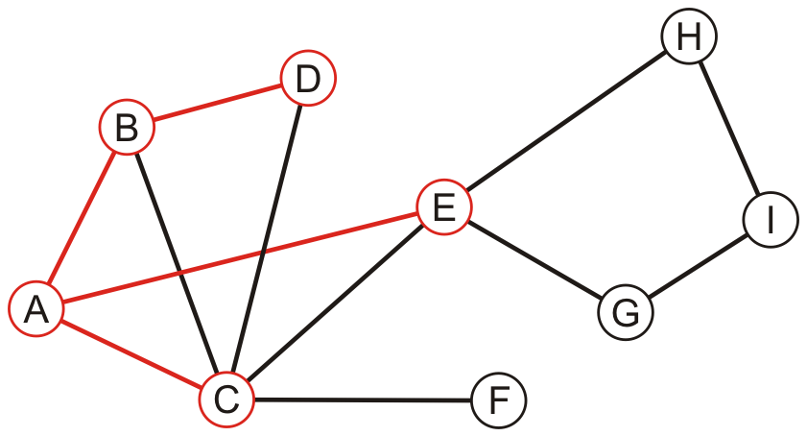
Example
Performing a breadth-first traversal:
Pop D
A, B, C, E, D
F | G | H

Slide 63
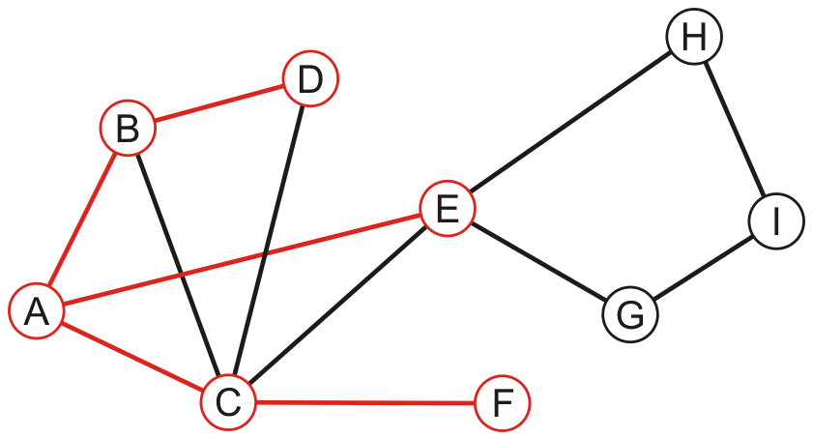
Example
Performing a breadth-first traversal:
Pop F
A, B, C, E, D, F
G | H

Slide 64
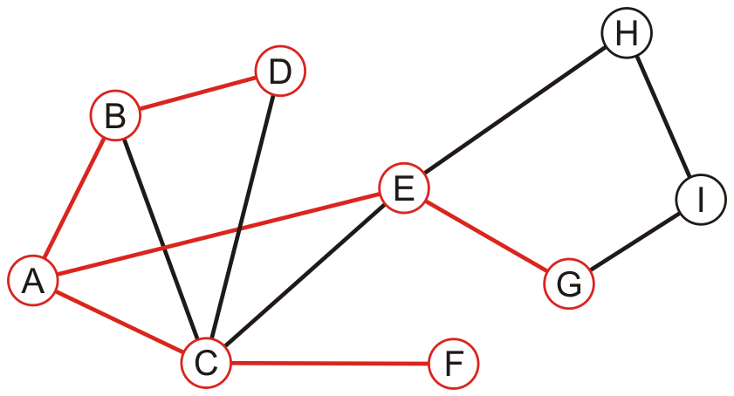
Example
Performing a breadth-first traversal:
Pop G and push I
A, B, C, E, D, F, G
H | I

Slide 65
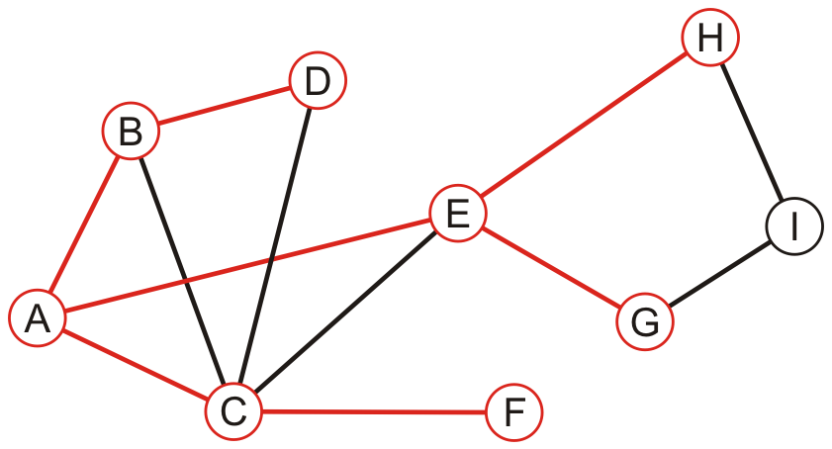
Example
Performing a breadth-first traversal:
Pop H
A, B, C, E, D, F, G, H
I

Slide 66
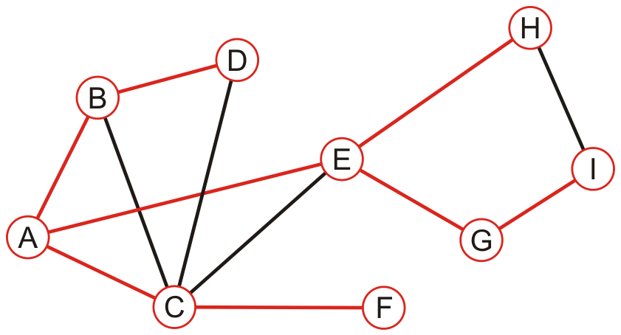
Example
Performing a breadth-first traversal:
Pop I
A, B, C, E, D, F, G, H, I

Slide 67
Example
Performing a breadth-first traversal:
The queue is empty: we are finished
A, B, C, E, D, F, G, H, I

Slide 68
Breadth-First Search
BFS
Initialize Q to be empty;
Enqueue(Q,1) and mark 1;
while Q is not empty do
i := Dequeue(Q);
for each j adjacent to i do
if j is not marked then
Enqueue(Q,j) and mark j;
end{BFS}

Slide 69
Comparison
The order in which vertices can differ greatly
An iterative depth-first traversal may also be different again
A, B, C, E, D, F, G, H, I
A, B, C, D, E, G, I, H, F

Slide 70
Depth-First vs Breadth-First
Depth-First
Stack or recursion
Many applications
Breadth-First
Queue (recursion no help)
Can be used to find shortest paths from the start vertex

Slide 71
Topological Sort

Slide 72
Topological Sort
142
322
143
321
Problem: Find an order in
which all these courses can
be taken.
Example: 142 → 143 → 378
370 → 321 → 341 → 322
326 → 421 → 401
326
370
341
378
421
In order to take a course, you must
take all of its prerequisites first
401

Slide 73
Topological Sort
Given a digraph G = (V, E), find a linear ordering of
its vertices such that:
for any edge (v, w) in E, v precedes w in the ordering
B
C
A
F
D
E

Slide 74
Topo sort - good example
B
C
Any linear ordering in which
all the arrows go to the right
is a valid solution
A
F
D
E
A
B
F
C
D
E
Note that F can go anywhere in this list because it is not connected.
Also the solution is not unique.

Slide 75
Topo sort - bad example
B
C
A
Any linear ordering in which
an arrow goes to the left
is not a valid solution
F
D
E
A
B
F
C
E
D
NO!

Slide 76
Paths and Cycles
Given a digraph G = (V,E), a path is a sequence of vertices v₁,v₂, …,v_{k} such that:
(v_{i},v_{i+1}) in E for 1 < i < k
path length = number of edges in the path
path cost = sum of costs of each edge
A path is a cycle if :
k > 1; v₁ = v_{k}
G is acyclic if it has no cycles.

Slide 77
Only acyclic graphs can be topo. sorted
A directed graph with a cycle cannot be topologically sorted.
B
C
A
F
D
E

Slide 78
Topo sort algorithm - 1
Step 1: Identify vertices that have no incoming edges
The “in-degree” of these vertices is zero
B
C
A
F
D
E

Slide 79
Topo sort algorithm - 1a
Step 1: Identify vertices that have no incoming edges
If no such vertices, graph has only cycle(s) (cyclic graph)
Topological sort not possible – Halt.
B
C
A
Example of a cyclic graph
D

Slide 80
Topo sort algorithm - 1b
Step 1: Identify vertices that have no incoming edges
Select one such vertex
Select
B
C
A
F
D
E

Slide 81
Topo sort algorithm - 2
Step 2: Delete this vertex of in-degree 0 and all its outgoing edges from the graph. Place it in the output.
B
C
A
F
A
D
E

Slide 82
Continue until done
Repeat Step 1 and Step 2 until graph is empty
Select
B
C
F
A
D
E

Slide 83
B
Select B. Copy to sorted list. Delete B and its edges.
B
C
F
A
B
D
E

Slide 84
C
Select C. Copy to sorted list. Delete C and its edges.
C
F
A
B
C
D
E

Slide 85
D
Select D. Copy to sorted list. Delete D and its edges.
F
A
B
C
D
D
E

Slide 86
E, F
Select E. Copy to sorted list. Delete E and its edges.
Select F. Copy to sorted list. Delete F and its edges.
F
A
B
C
D
E
F
E

Slide 87
Done
B
C
A
F
D
E
A
B
C
D
E
F

Slide 88
Implementation
Assume adjacency list
representation
B
C
1
2
3
4
5
6
2
4
A
3
F
4
5
D
5
E
Translation
array
1 2 3 4 5 6
value next
A
B
C
D
E
F

Slide 89
Calculate In-degrees
D
A
0
1
2
3
4
5
6
2
4
1
3
1
4
5
In-Degree array; or add a field to array A
2
5
2
0

Slide 90
Calculate In-degrees
for i = 1 to n do D[i] := 0; endfor
for i = 1 to n do
x := A[i];
while x ≠ null do
D[x.value] := D[x.value] + 1;
x := x.next;
endwhile
endfor

Slide 91
Maintaining Degree 0 Vertices
Key idea: Initialize and maintain a queue (or stack)
of vertices with In-Degree 0
D
A
0
1
2
3
4
5
6
2
4
Queue
1
6
1
3
1
4
5
2
3
6
2
5
1
2
4
5
0

Slide 92
Topo Sort using a Queue (breadth-first)
After each vertex is output, when updating In-Degree array, enqueue any vertex whose In-Degree becomes zero
Queue
6
2
D
A
dequeue
0
1
2
3
4
5
6
2
4
enqueue
Output
1
0
3
1
4
5
2
3
6
1
5
1
2
4
5
0

Slide 93
Topological Sort Algorithm
Store each vertex’s In-Degree in an array D
Initialize queue with all “in-degree=0” vertices
While there are vertices remaining in the queue:
(a) Dequeue and output a vertex
(b) Reduce In-Degree of all vertices adjacent to it by 1
(c) Enqueue any of these vertices whose In-Degree became zero
If all vertices are output then success, otherwise there is a cycle.
Notes:
Why use a queue?

