Slide 1
AVL Trees
COL 106
Amit Kumar
Shweta Agrawal
Slide Courtesy : Douglas Wilhelm Harder, MMath, UWaterloo
dwharder@alumni.uwaterloo.ca

Slide 2
Background
So far …
Binary search trees store linearly ordered data
Best case height: Θ(ln(n))
Worst case height: O(n)
Requirement:
Define and maintain a balance to ensure Θ(ln(n)) height

Slide 3
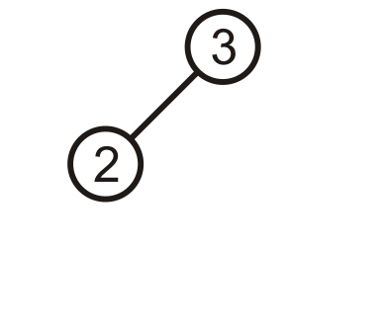
Prototypical Examples
These two examples demonstrate how we can correct for imbalances: starting with this tree, add 1:

Slide 4
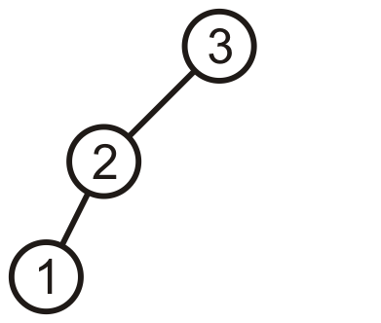
Prototypical Examples
This is more like a linked list; however, we can fix this…

Slide 5
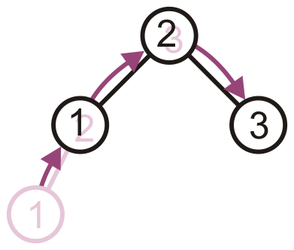
Prototypical Examples
Promote 2 to the root, demote 3 to be 2’s right child, and 1 remains the left child of 2

Slide 6
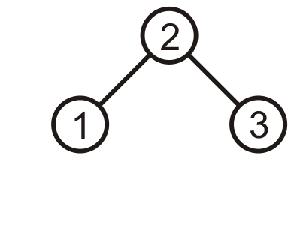
Prototypical Examples
The result is a perfect, though trivial tree

Slide 7
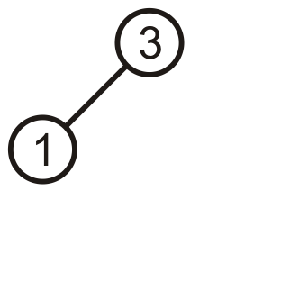
Prototypical Examples
Alternatively, given this tree, insert 2

Slide 8
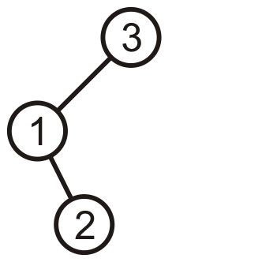
Prototypical Examples
Again, the product is a linked list; however, we can fix this, too

Slide 9
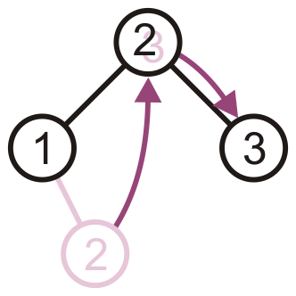
Prototypical Examples
Promote 2 to the root, and assign 1 and 3 to be its children

Slide 10
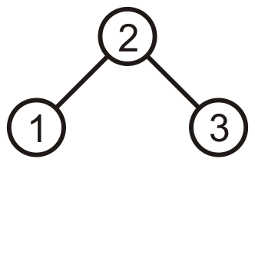
Prototypical Examples
The result is, again, a perfect tree
These examples may seem trivial, but they are the basis for the corrections in the next data structure we will see: AVL trees

Slide 11
AVL Trees
We will focus on the first strategy: AVL trees
Named after Adelson-Velskii and Landis
Balance is defined by comparing the height of the two sub-trees
Recall:
An empty tree has height –1
A tree with a single node has height 0

Slide 12
AVL Trees
A binary search tree is said to be AVL balanced if:
The difference in the heights between the left and right sub-trees is at most 1, and
Both sub-trees are themselves AVL trees

Slide 13
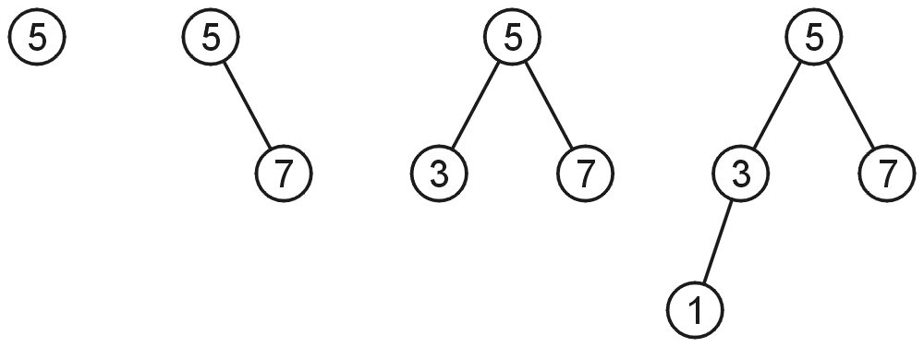
AVL Trees
AVL trees with 1, 2, 3, and 4 nodes:

Slide 14
AVL Trees
Here is a larger AVL tree (42 nodes):

Slide 15
AVL Trees
The root node is AVL-balanced:
Both sub-trees are of height 4:

Slide 16
AVL Trees
All other nodes are AVL balanced
The sub-trees differ in height by at most one

Slide 17
Height of an AVL Tree
By the definition of complete trees, any complete binary search tree is an AVL tree
Thus an upper bound on the number of nodes in an AVL tree of height h a perfect binary tree with 2^{h + 1} – 1 nodes
What is an lower bound?

Slide 18
Height of an AVL Tree
Let F(h) be the fewest number of nodes in a tree of height h
From a previous slide:
F(0) = 1
F(1) = 2
F(2) = 4
Can we find F(h)?

Slide 19
Height of an AVL Tree
The worst-case AVL tree of height h would have:
A worst-case AVL tree of height h – 1 on one side,
A worst-case AVL tree of height h – 2 on the other, and
The root node
We get: F(h) = F(h – 1) + 1 + F(h – 2)

Slide 20
Height of an AVL Tree
This is a recurrence relation:
The solution?

Slide 21
Height of an AVL Tree
In this example, n = 88, the worst- and best-case scenarios differ in height by only 2

Slide 22
Height of an AVL Tree
Fact: The height of an AVL tree storing n keys is O(log n).
Proof: Let us bound n(h): the minimum number of internal nodes of an AVL tree of height h.
We easily see that n(1) = 1 and n(2) = 2
For n > 2, an AVL tree of height h contains the root node, one AVL subtree of height h-1 and another of height h-2.
That is, n(h) = 1 + n(h-1) + n(h-2)
Knowing n(h-1) > n(h-2), we get n(h) > 2n(h-2). So
n(h) > 2n(h-2), n(h) > 4n(h-4), n(h) > 8n(n-6), … (by induction),
n(h) > 2^{i}n(h-2i)
Solving the base case we get: n(h) > 2 ^{h/2-1}
Taking logarithms: h < 2log n(h) +2
Thus the height of an AVL tree is O(log n)
n(2)
3
4
n(1)

Slide 23
Maintaining Balance
To maintain AVL balance, observe that:
Inserting a node can increase the height of a tree by at most 1
Removing a node can decrease the height of a tree by at most 1

Slide 24
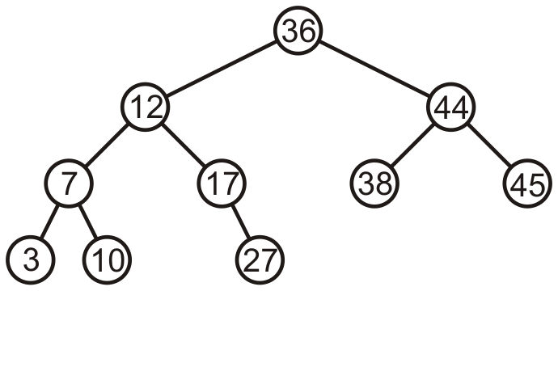
Maintaining Balance
Consider this AVL tree

Slide 25
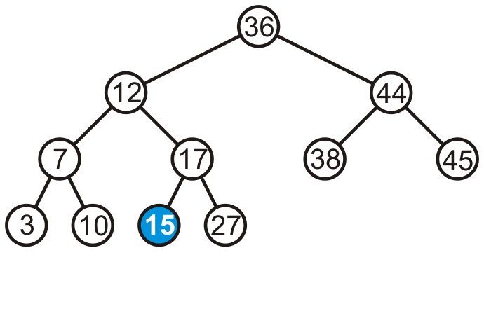
Maintaining Balance
Consider inserting 15 into this tree
In this case, the heights of none of the trees change

Slide 26
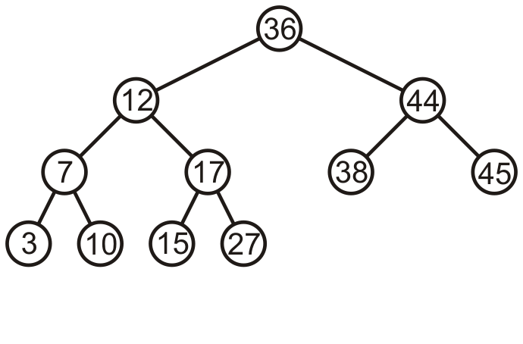
Maintaining Balance
The tree remains balanced

Slide 27
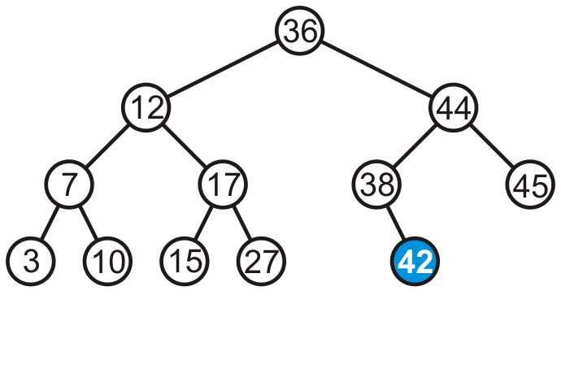
Maintaining Balance
Consider inserting 42 into this tree
In this case, the heights of none of the trees change

Slide 28
Maintaining Balance
If a tree is AVL balanced, for an insertion to cause an imbalance:
The heights of the sub-trees must differ by 1
The insertion must increase the height of the deeper sub-tree by 1

Slide 29
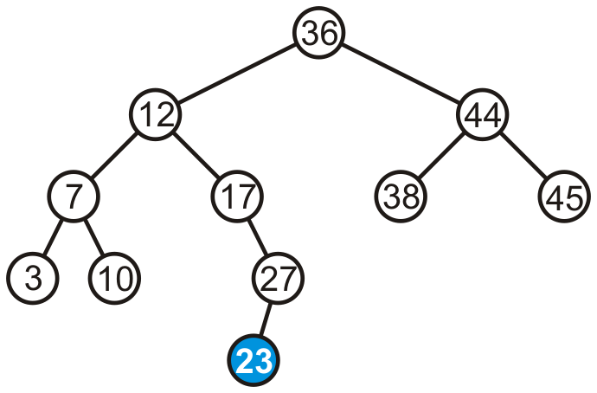
Maintaining Balance
Suppose we insert 23 into our initial tree

Slide 30
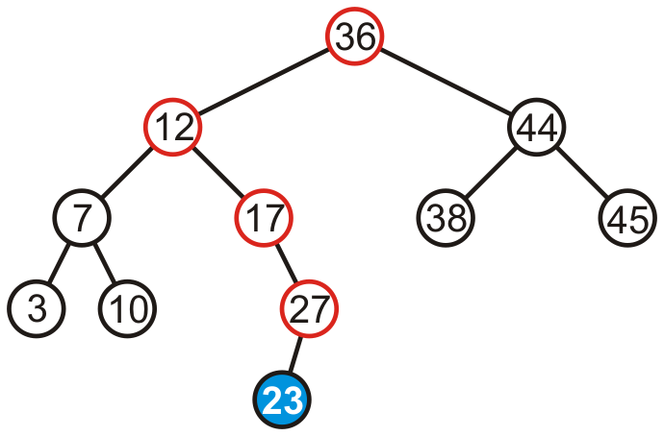
Maintaining Balance
The heights of each of the sub-trees from here to the root are increased by one

Slide 31
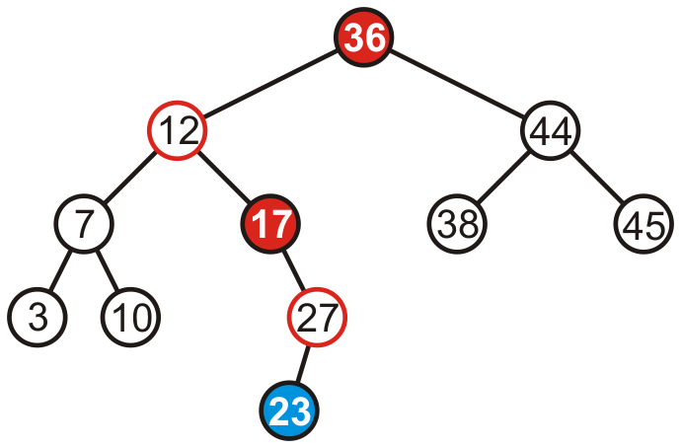
Maintaining Balance
However, only two of the nodes are unbalanced: 17 and 36

Slide 32
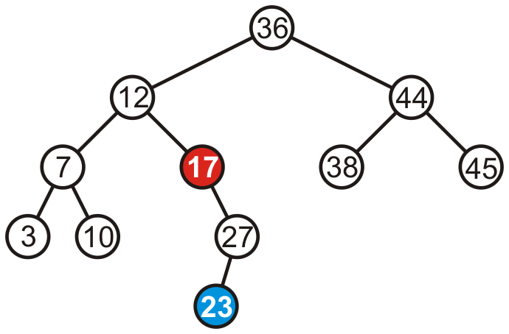
Maintaining Balance
However, only two of the nodes are unbalanced: 17 and 36
We only have to fix the imbalance at the lowest node

Slide 33
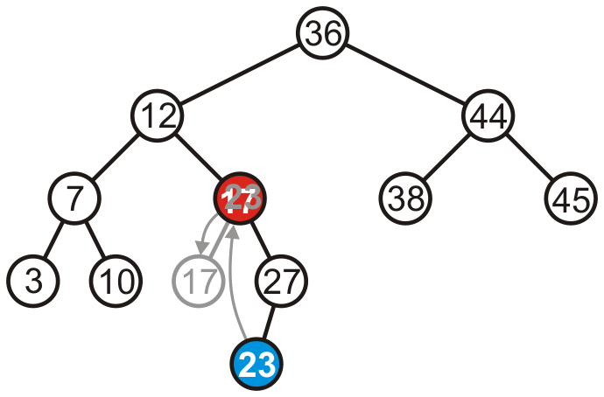
Maintaining Balance
We can promote 23 to where 17 is, and make 17 the left child of 23

Slide 34
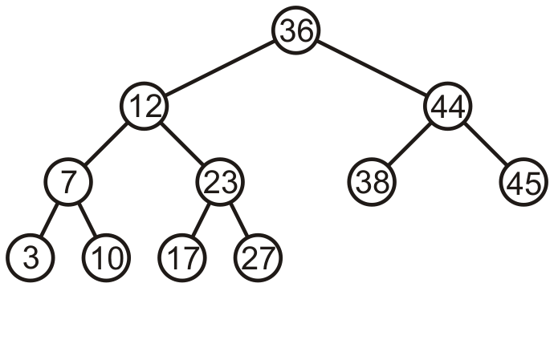
Maintaining Balance
Thus, that node is no longer unbalanced
Incidentally, neither is the root now balanced again, too

Slide 35
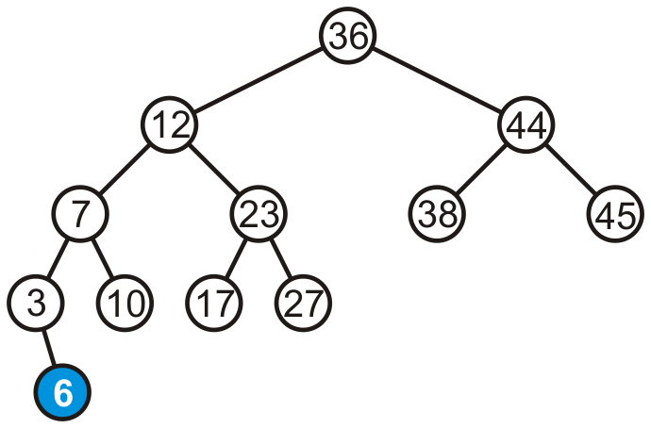
Maintaining Balance
Consider adding 6:

Slide 36
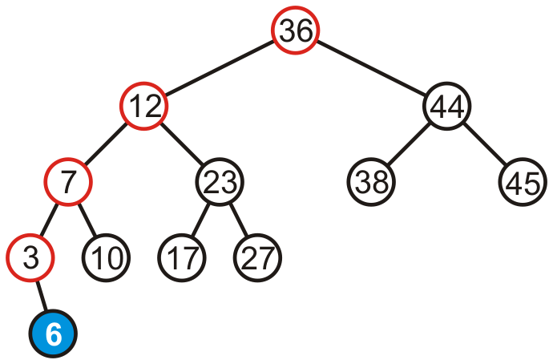
Maintaining Balance
The height of each of the trees in the path back to the root are increased by one

Slide 37
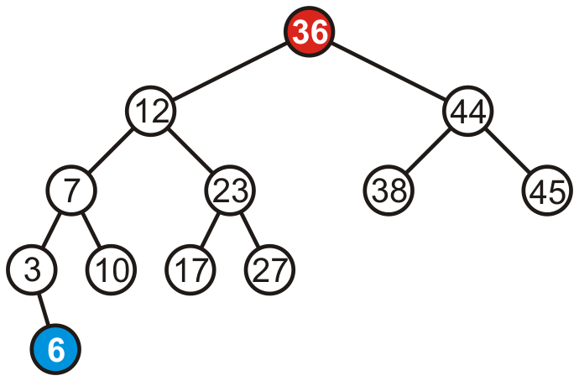
Maintaining Balance
The height of each of the trees in the path back to the root are increased by one
However, only the root node is now unbalanced

Slide 38
Maintaining Balance
We may fix this by rotating the root to the right
Note: the right subtree of 12 became the left subtree of 36

Slide 39
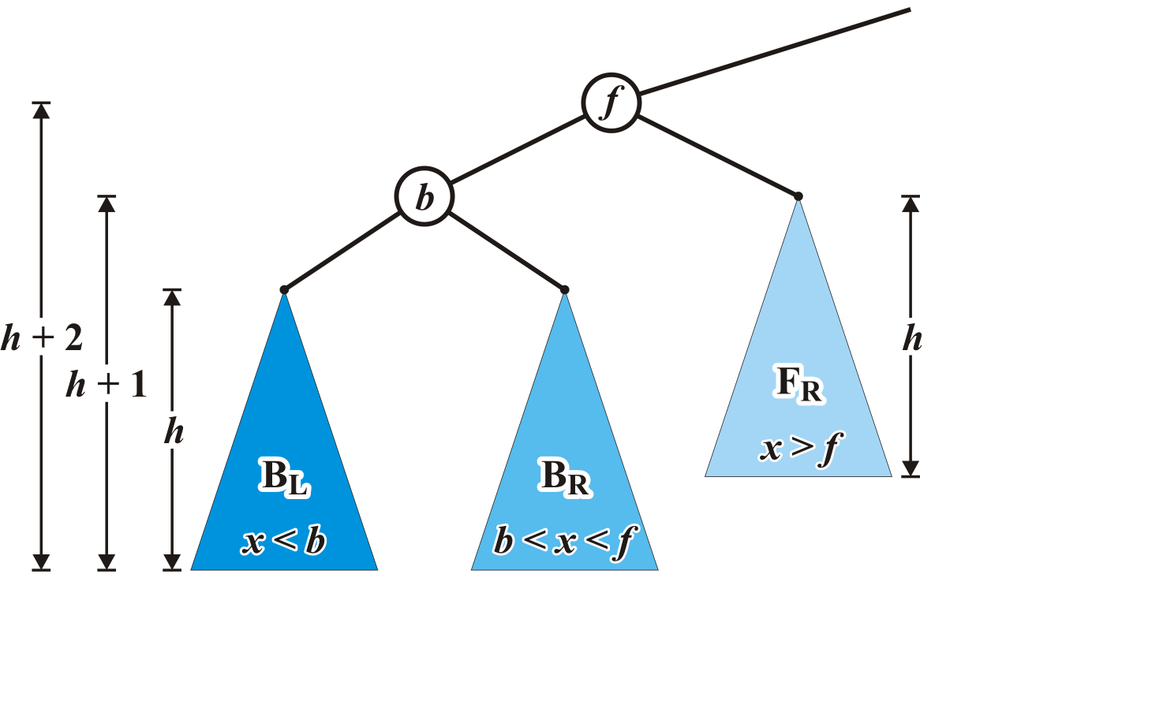
Case 1 setup
Consider the following setup
Each blue triangle represents a tree of height h

Slide 40
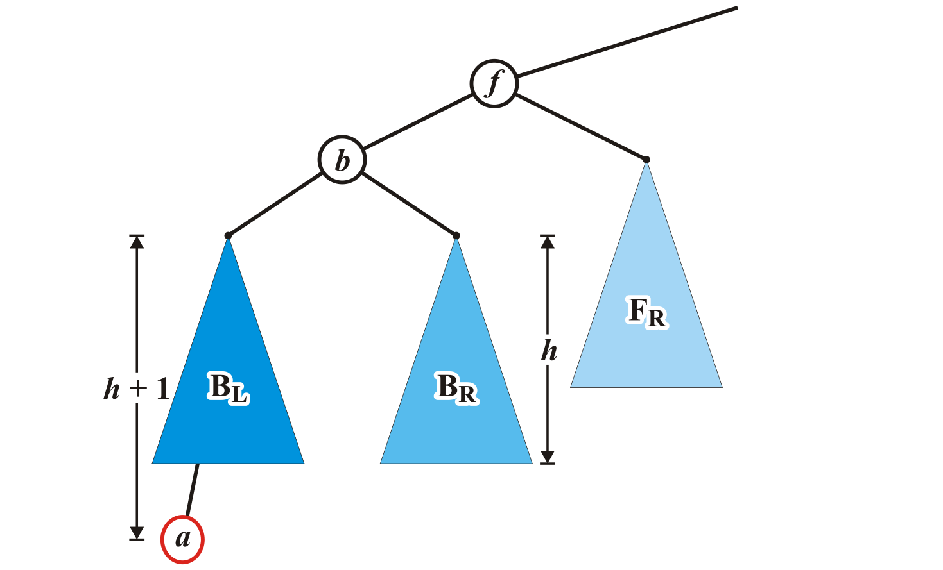
Maintaining Balance: Case 1
Insert a into this tree: it falls into the left subtree B_{L} of b
Assume B_{L} remains balanced
Thus, the tree rooted at b is also balanced
Left subtree of left child

Slide 41
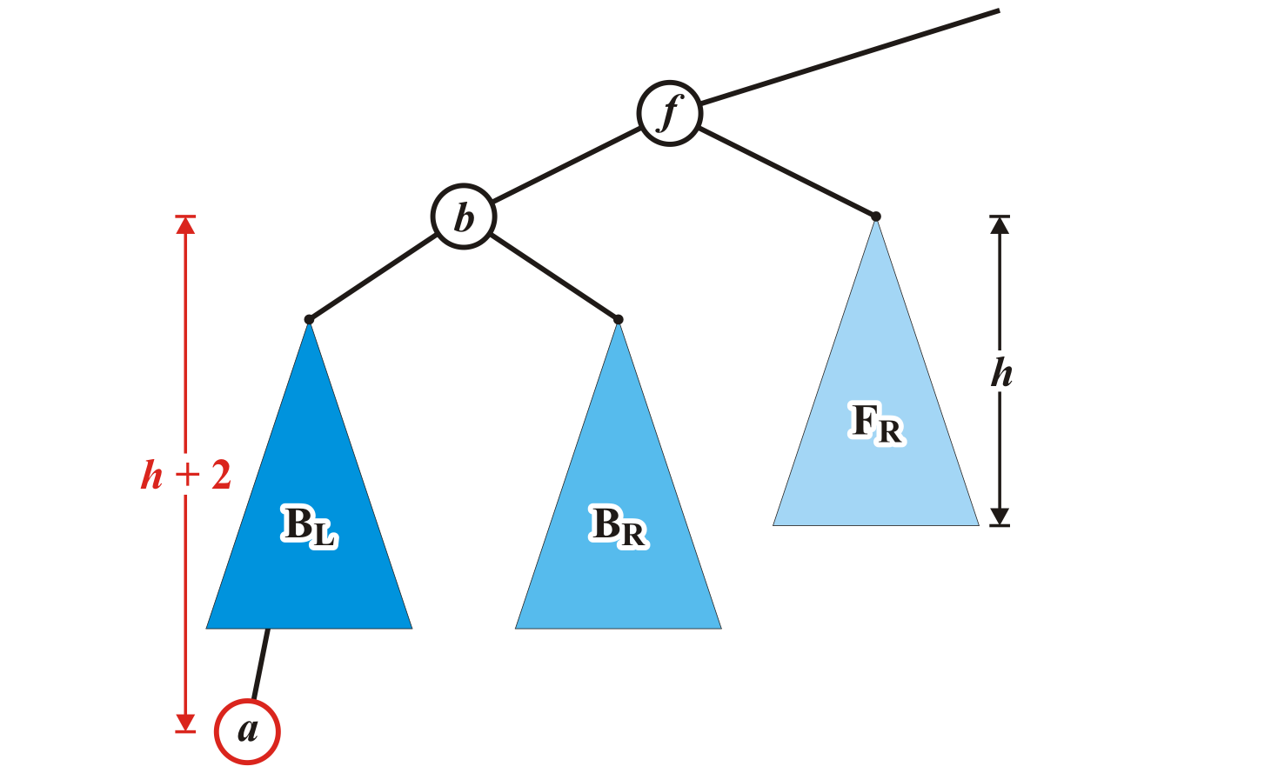
Maintaining Balance: Case 1
The tree rooted at node f is now unbalanced
We will correct the imbalance at this node

Slide 42
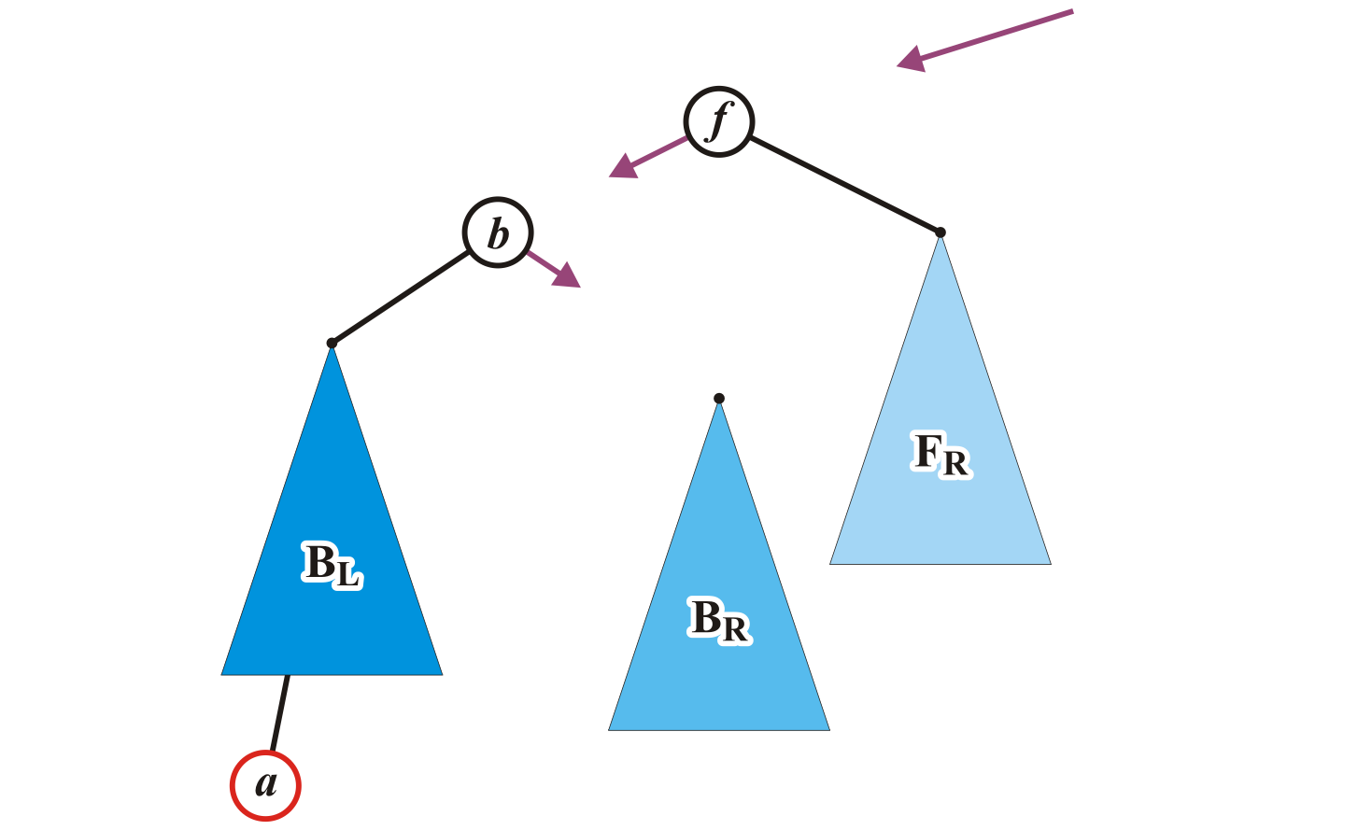
Maintaining Balance: Case 1
We will modify these three pointers:

Slide 43
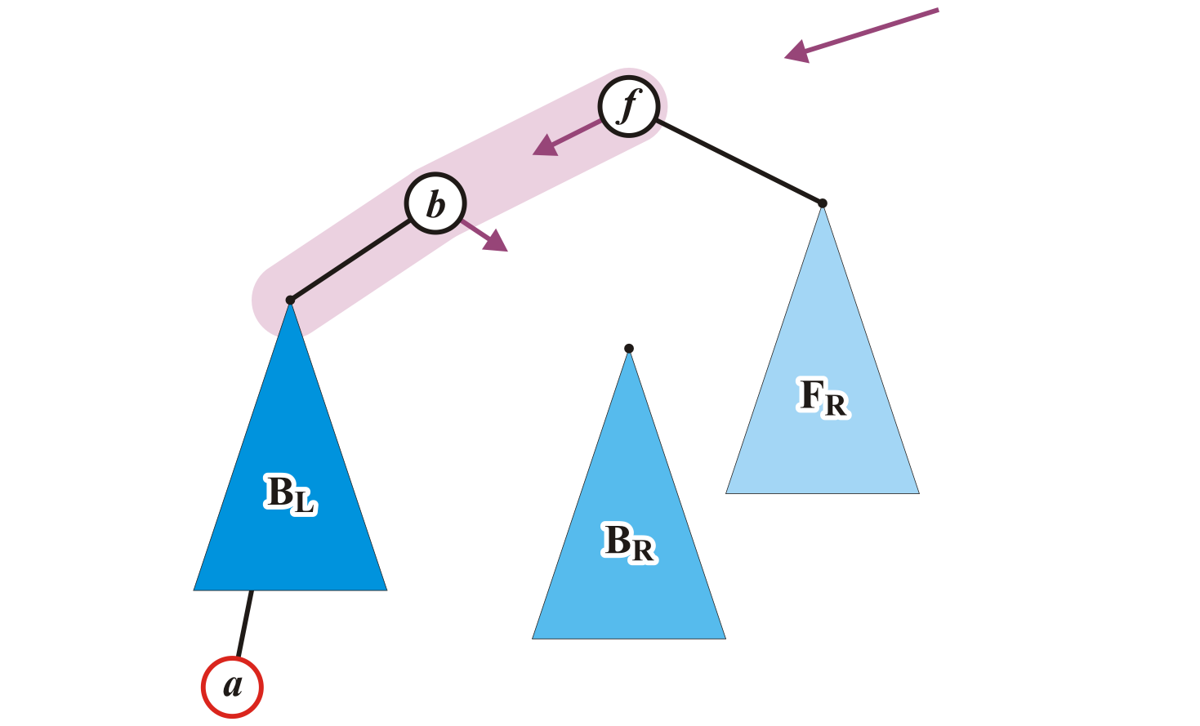
Maintaining Balance: Case 1
Specifically, we will rotate these two nodes around the root:
Recall the first prototypical example
Promote node b to the root and demote node f to be the right child of b

Slide 44
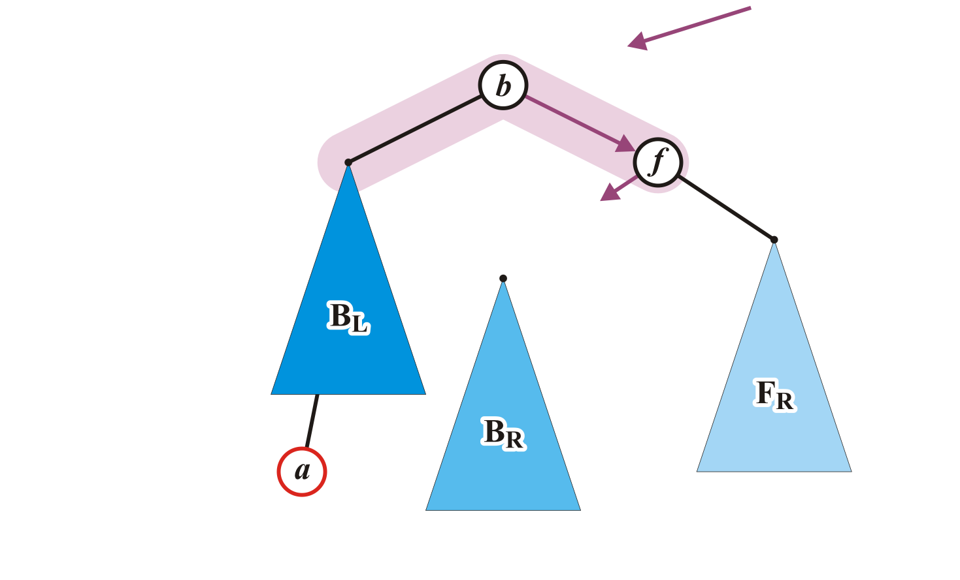
Maintaining Balance: Case 1
Make f the right child of b

Slide 45
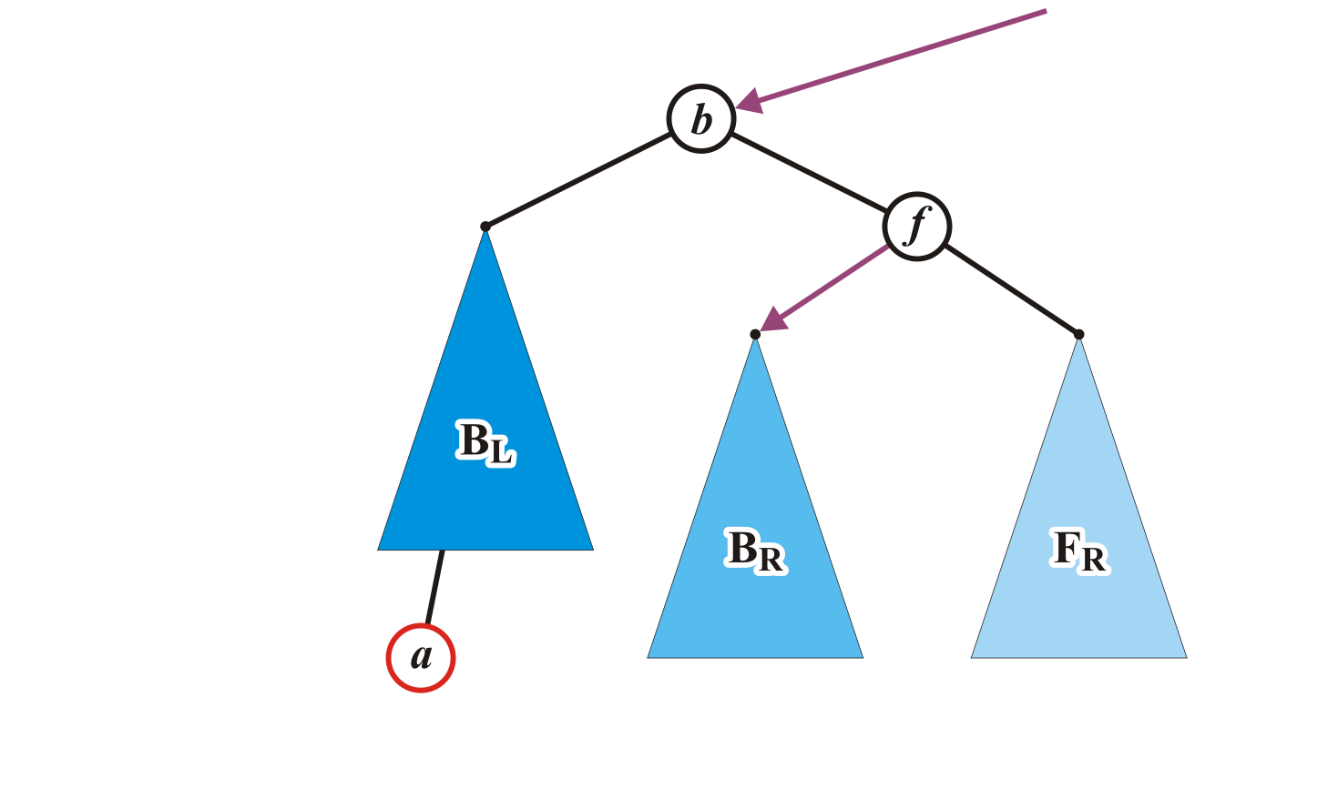
Maintaining Balance: Case 1
Assign former parent of node f to point to node b
Make B_{R} left child of node f

Slide 46
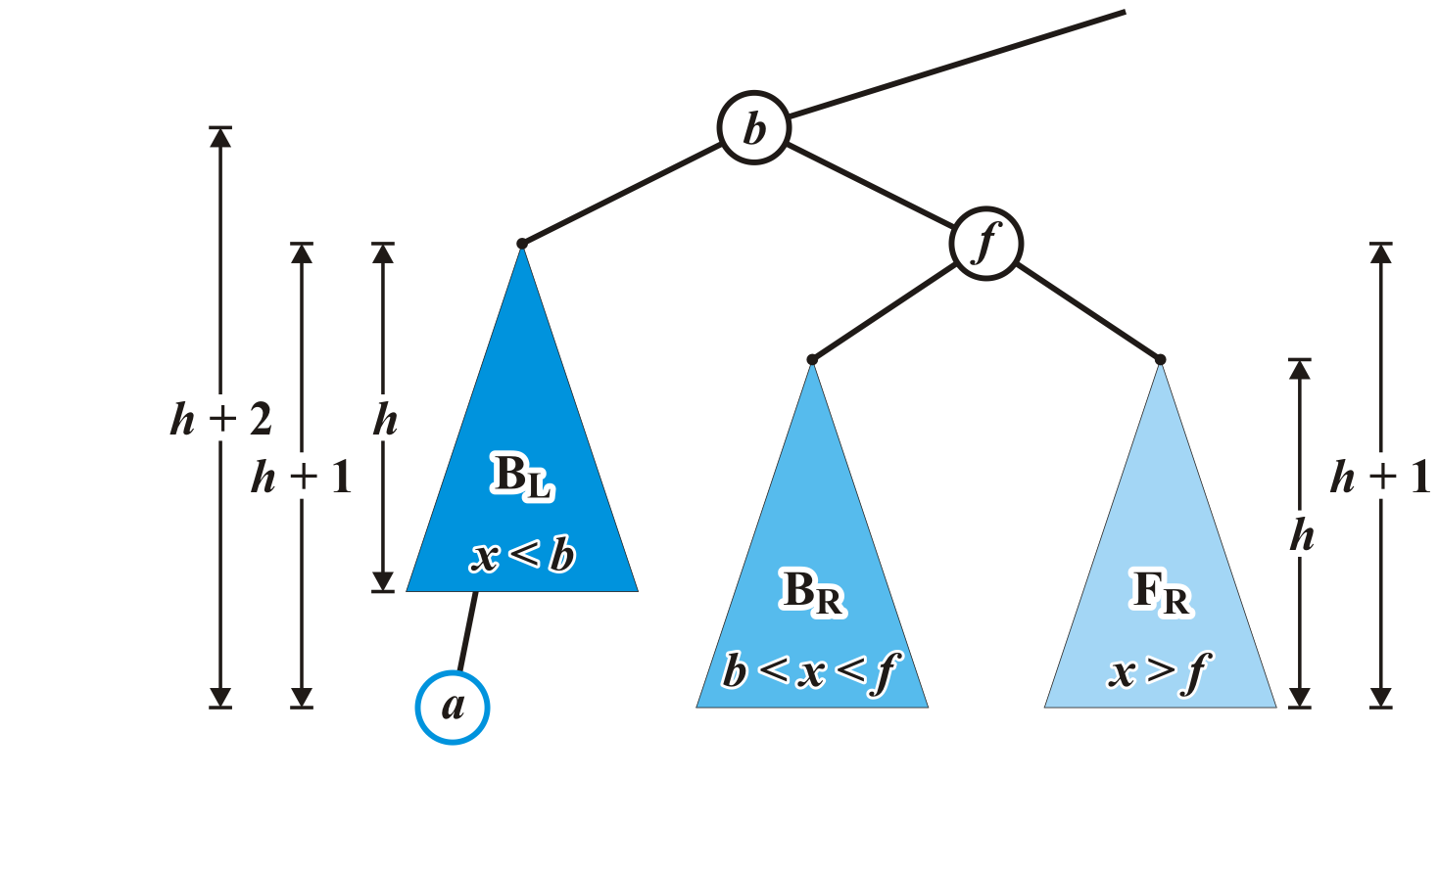
Maintaining Balance: Case 1
The nodes b and f are now balanced and all remaining nodes of the subtrees are in their correct positions

Slide 47
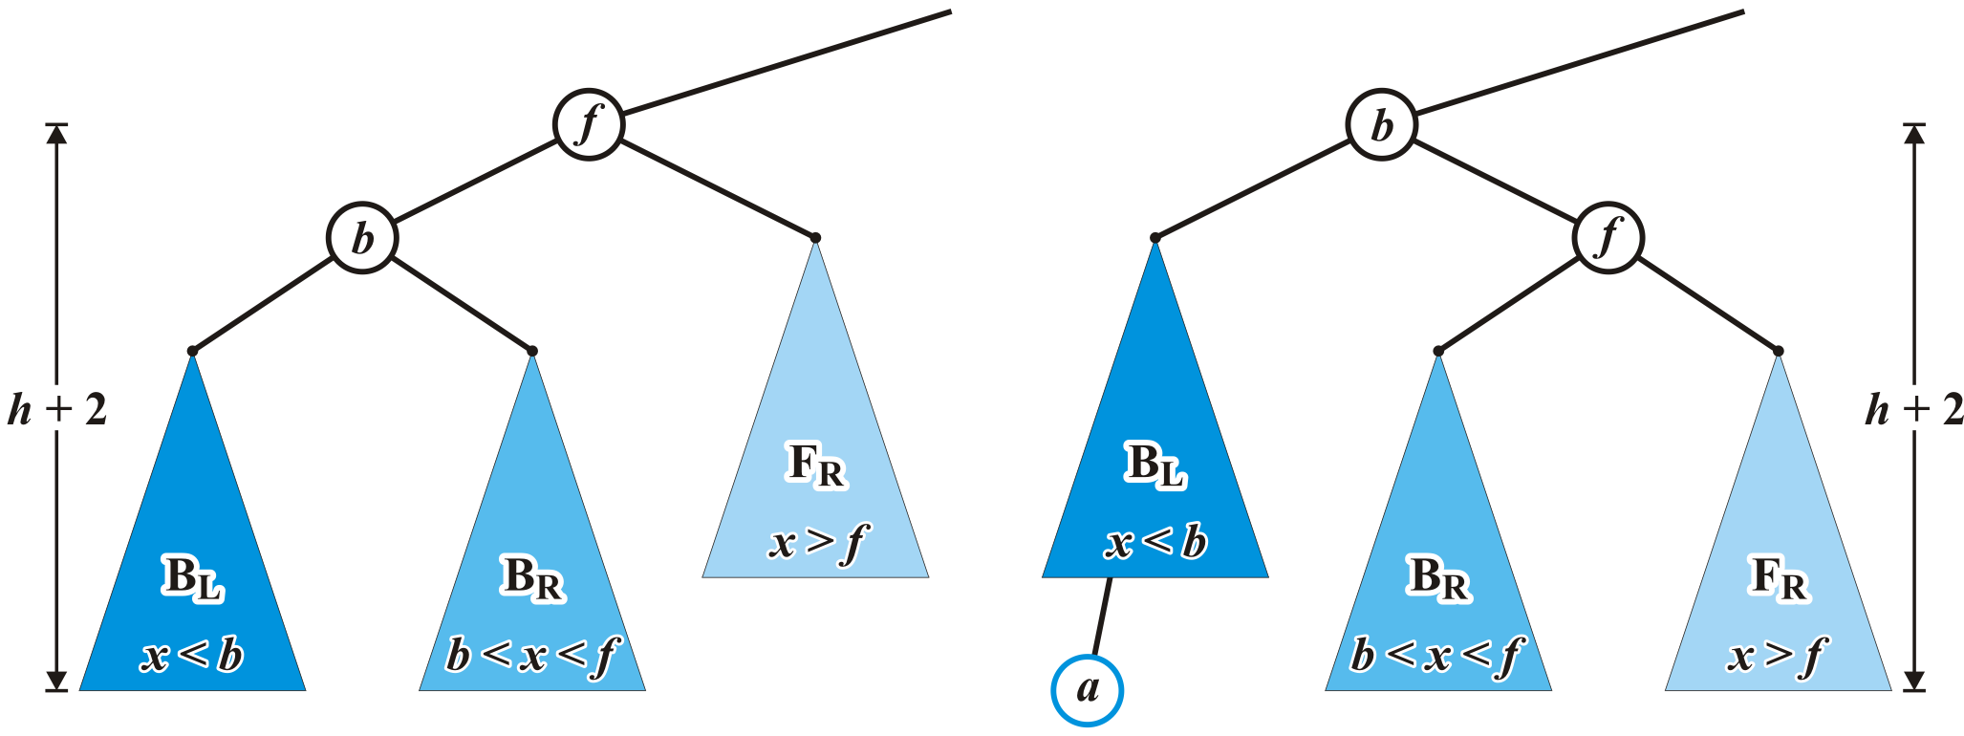
Maintaining Balance: Case 1
Additionally, height of the tree rooted at b equals the original height of the tree rooted at f
Thus, this insertion will no longer affect the balance of any ancestors all the way back to the root

Slide 48
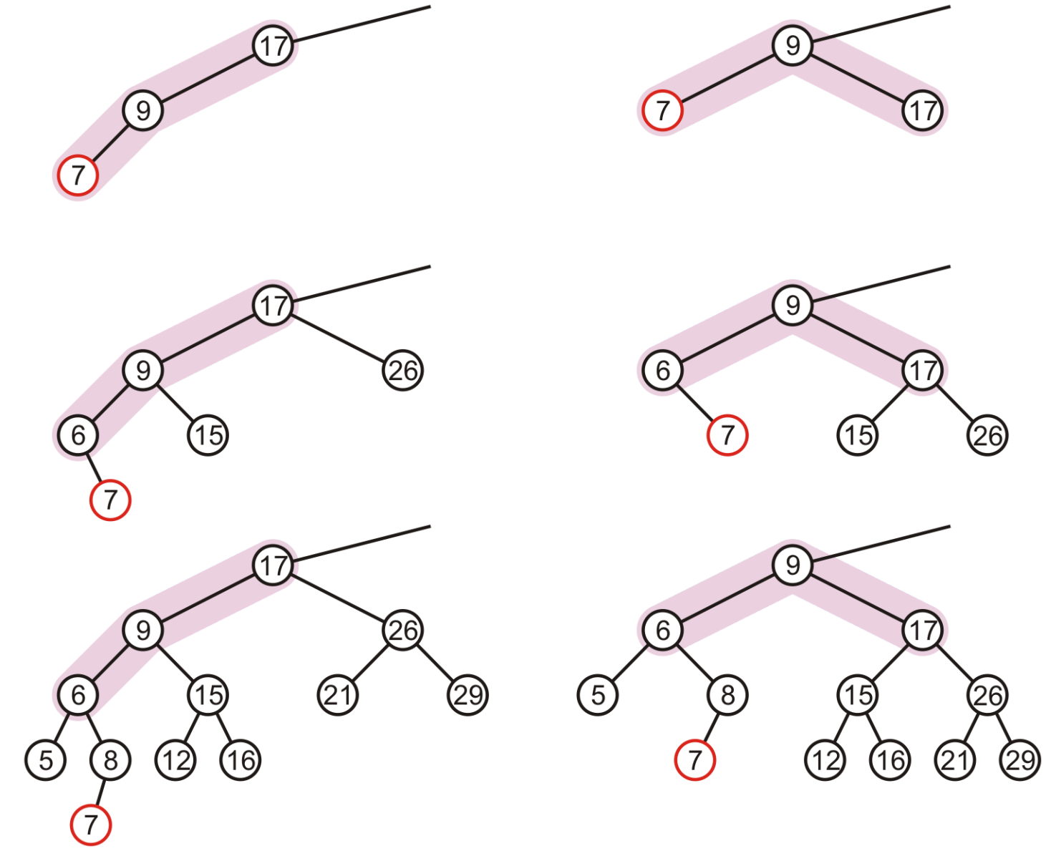
More Examples

Slide 49
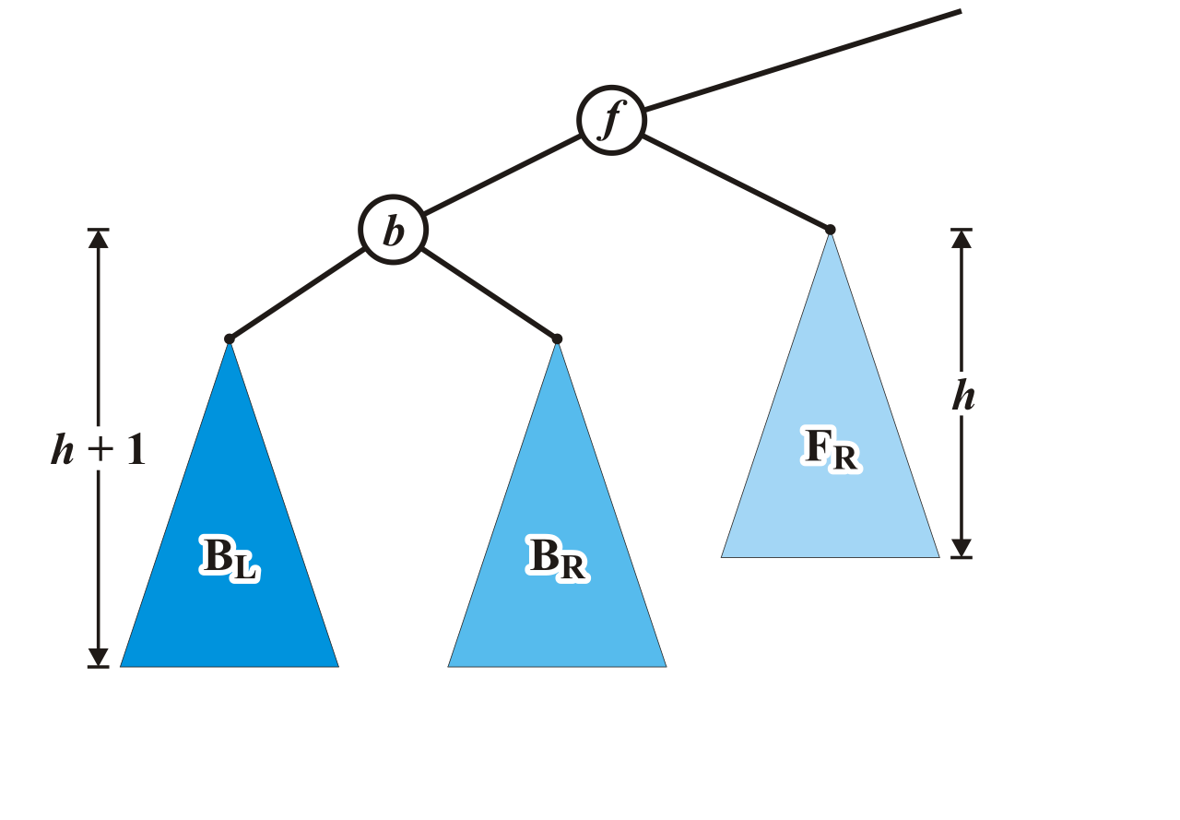
Maintaining Balance: Case 2
Alternatively, consider the insertion of c where b < c < f into our original tree

Slide 50
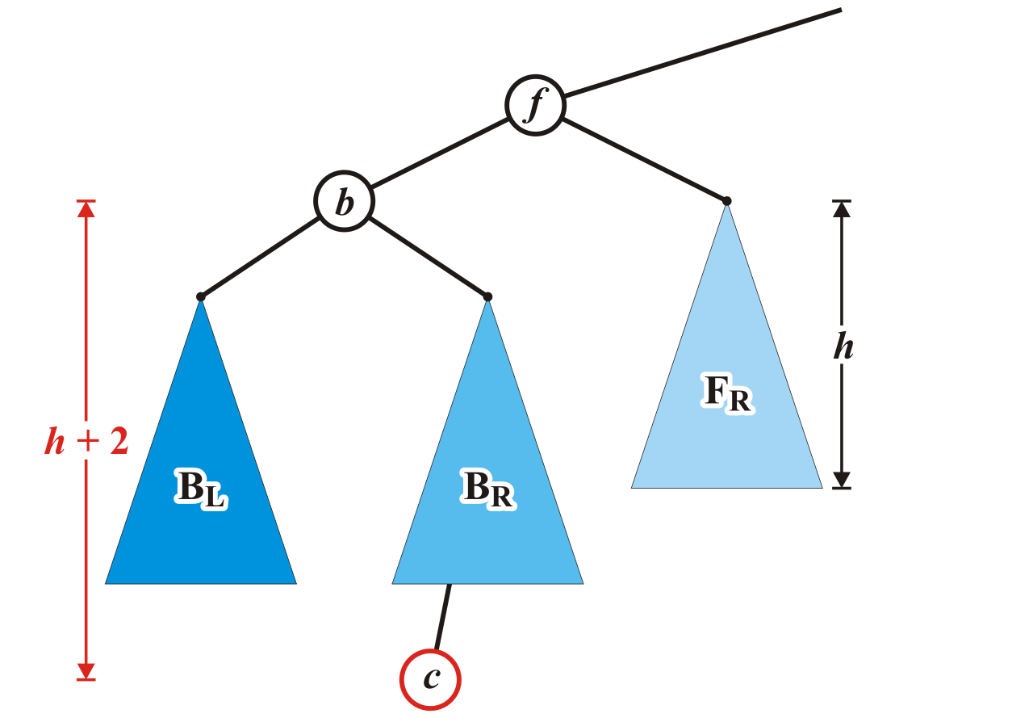
Maintaining Balance: Case 2
Assume that the insertion of c increases the height of B_{R}
Once again, f becomes unbalanced
Right subtree of left child

Slide 51
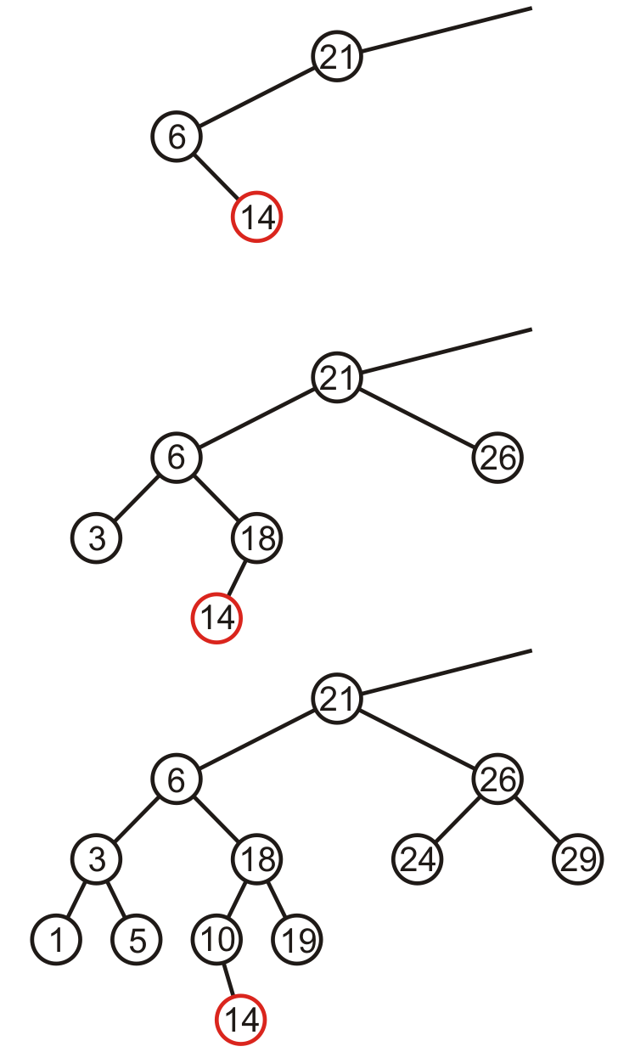
Maintaining Balance: Case 2
Here are examples of when the insertion of 14 may cause this situation when h = –1, 0, and 1

Slide 52
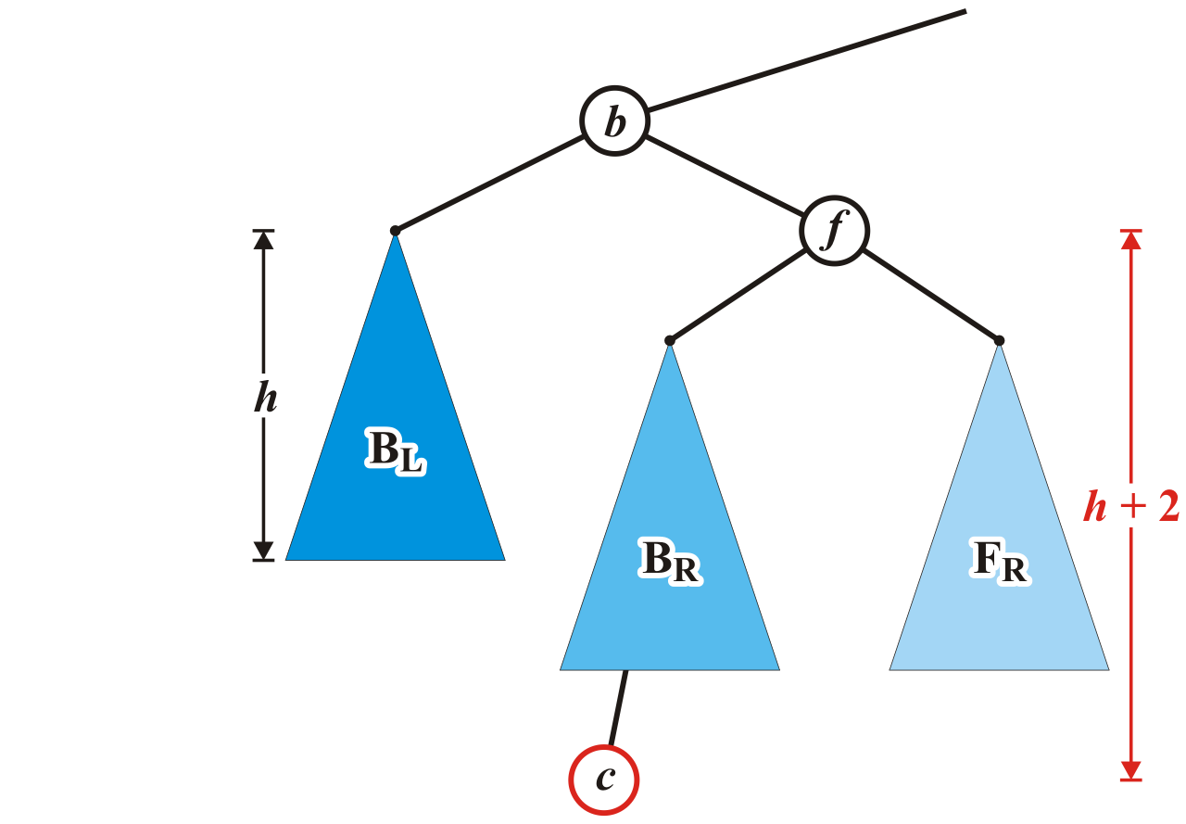
Maintaining Balance: Case 2
Unfortunately, the previous correction does not fix the imbalance at the root of this sub-tree: the new root, b, remains unbalanced

Slide 53
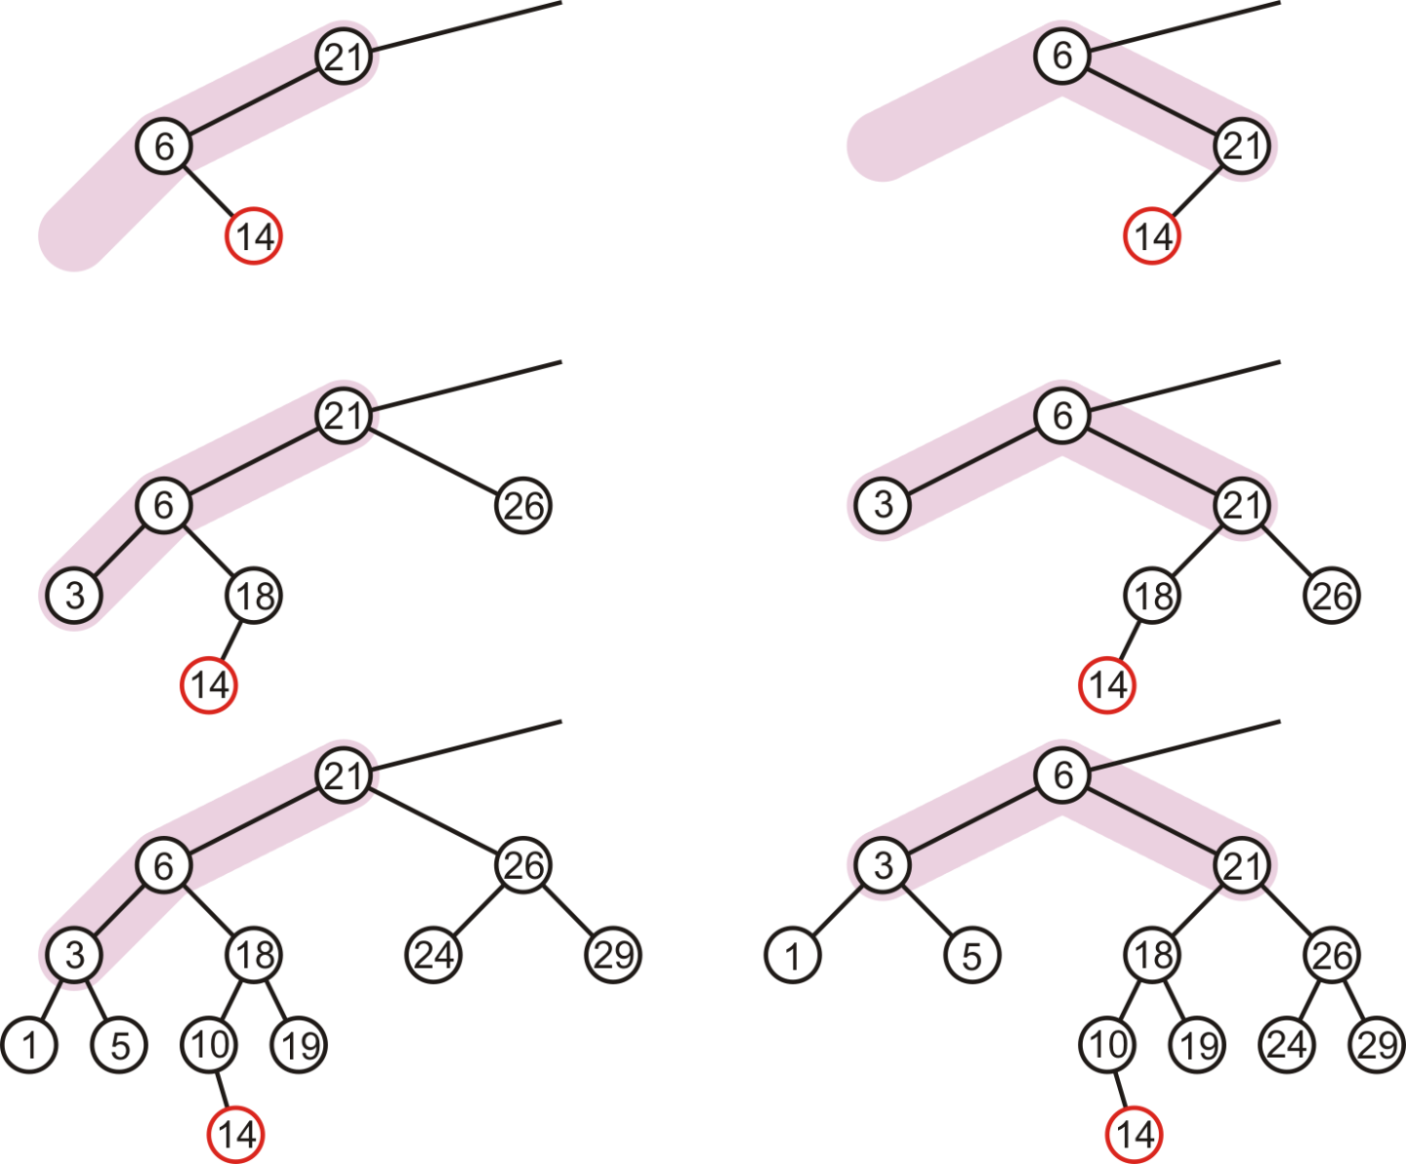
Maintaining Balance: Case 2
In our three sample cases with h = –1, 0, and 1, doing the same thing as before results in a tree that is still unbalanced…
The imbalance is just shifted to the other side

Slide 54
Maintaining Balance: Case 2
Lets start over …

Slide 55
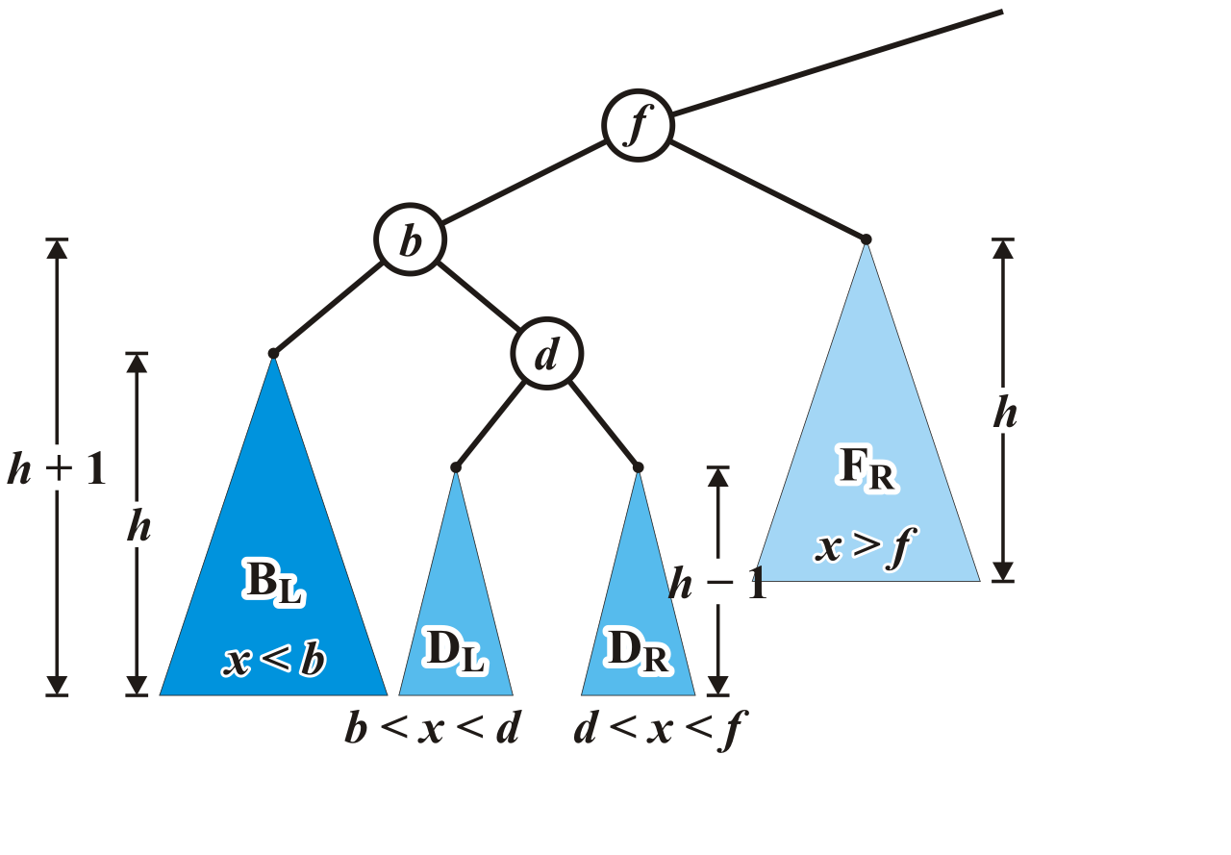
Maintaining Balance: Case 2
Re-label the tree by dividing the left subtree of f into a tree rooted at d with two subtrees of height h – 1

Slide 56
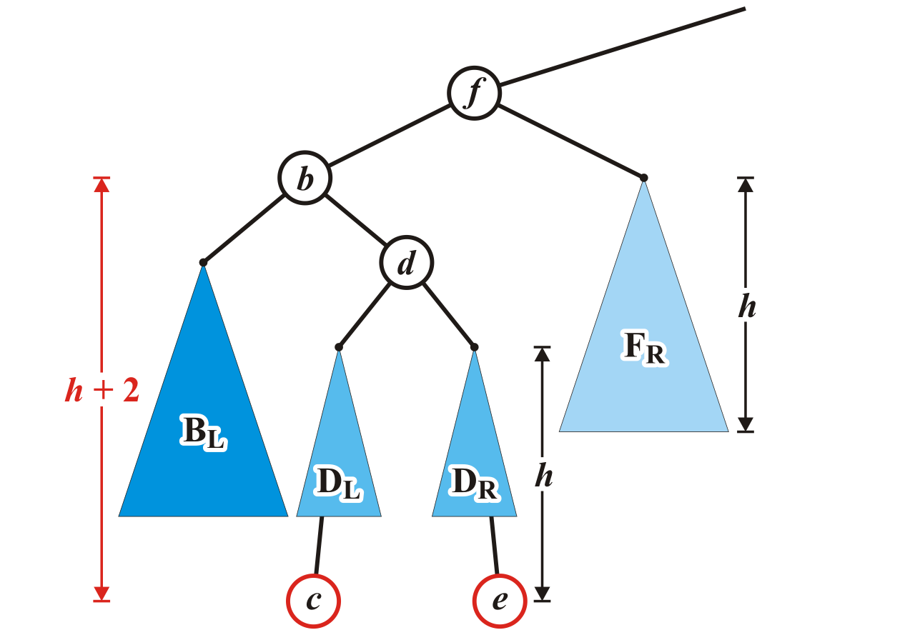
Maintaining Balance: Case 2
Now an insertion causes an imbalance at f
The addition of either c or e will cause this

Slide 57
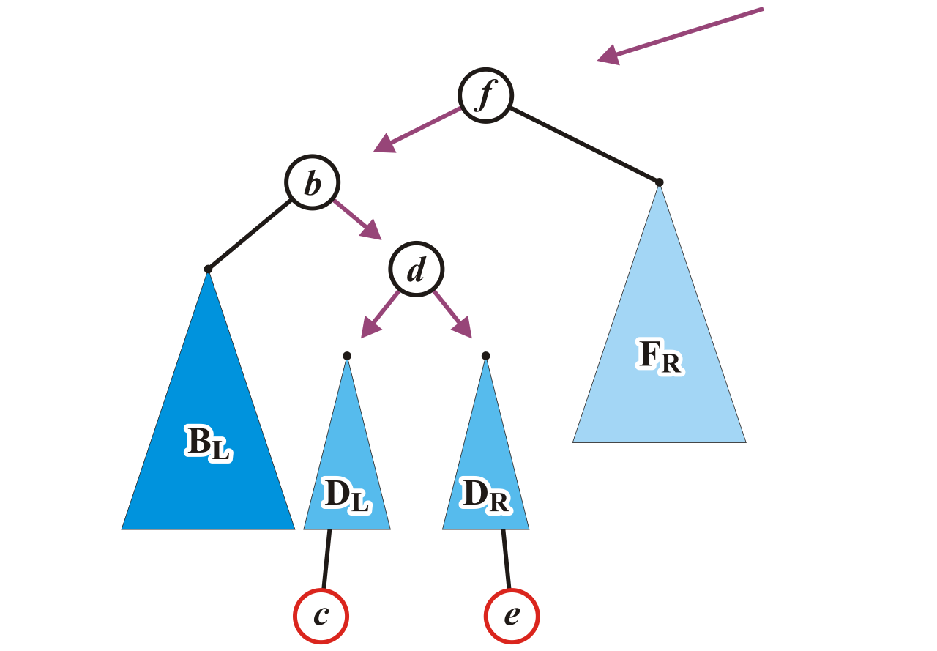
Maintaining Balance: Case 2
We will reassign the following pointers

Slide 58
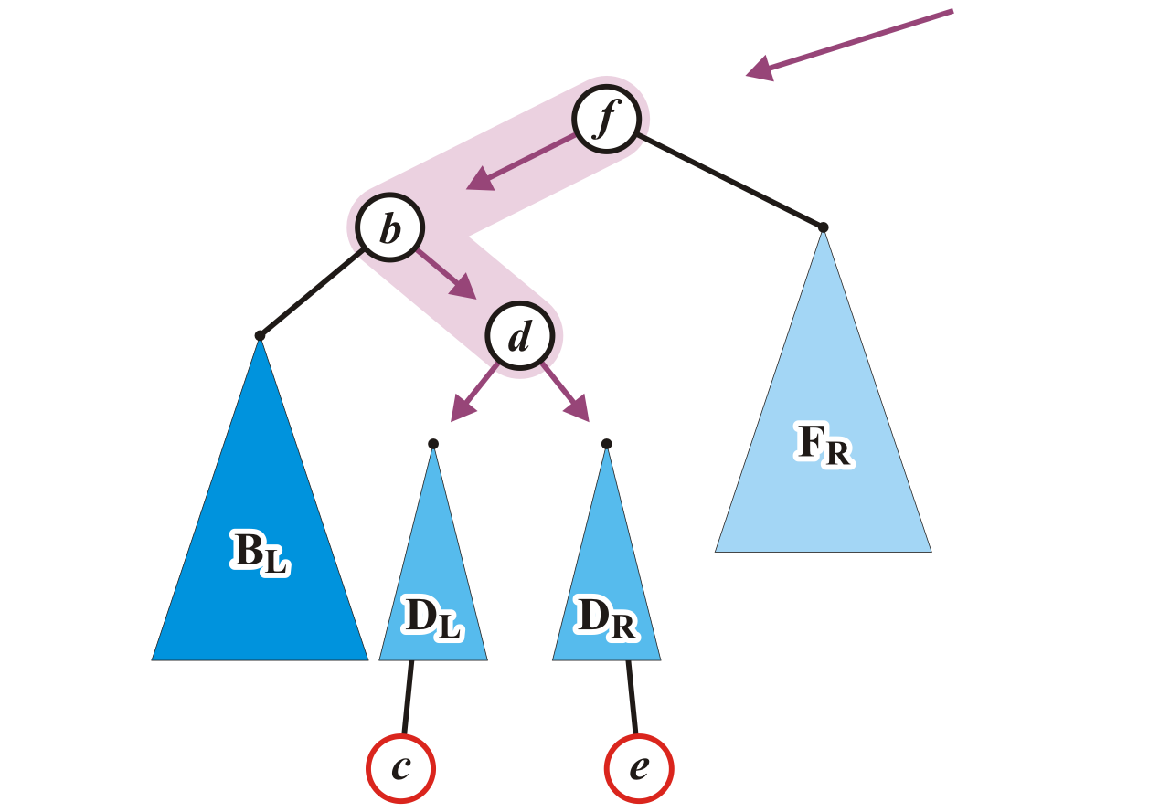
Maintaining Balance: Case 2
Specifically, we will order these three nodes as a perfect tree
Recall the second prototypical example

Slide 59
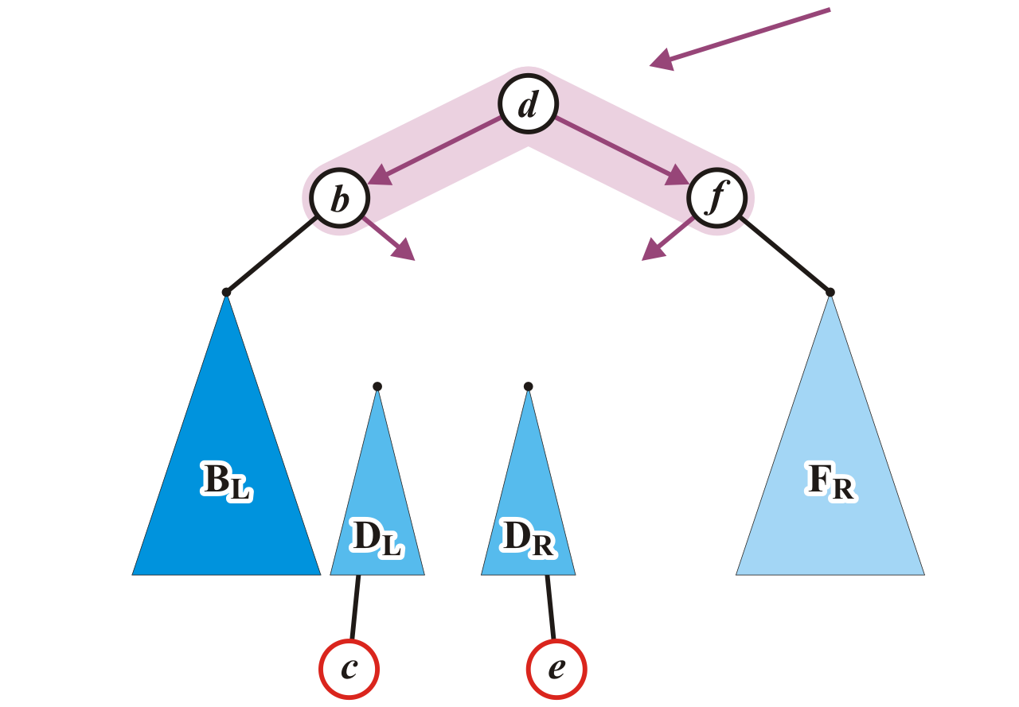
Maintaining Balance: Case 2
To achieve this, b and f will be assigned as children of the new root d

Slide 60
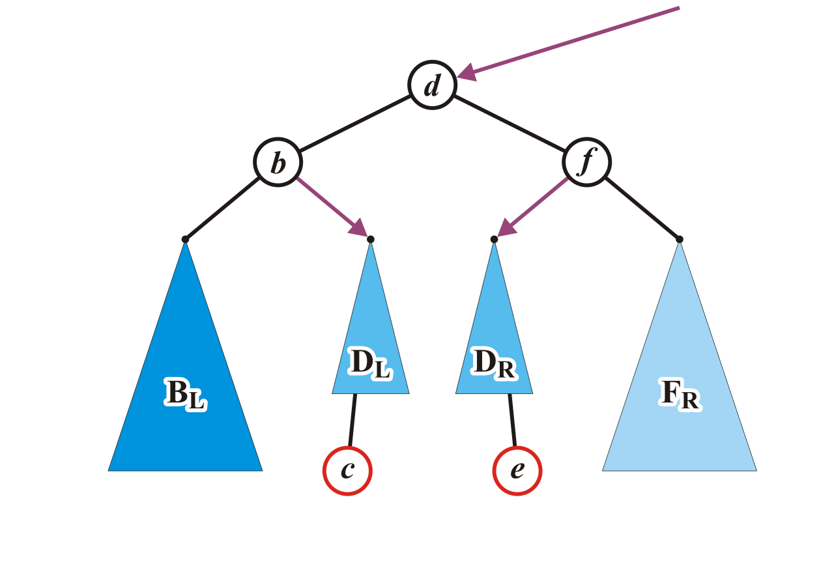
Maintaining Balance: Case 2
We also have to connect the two subtrees and original parent of f

Slide 61
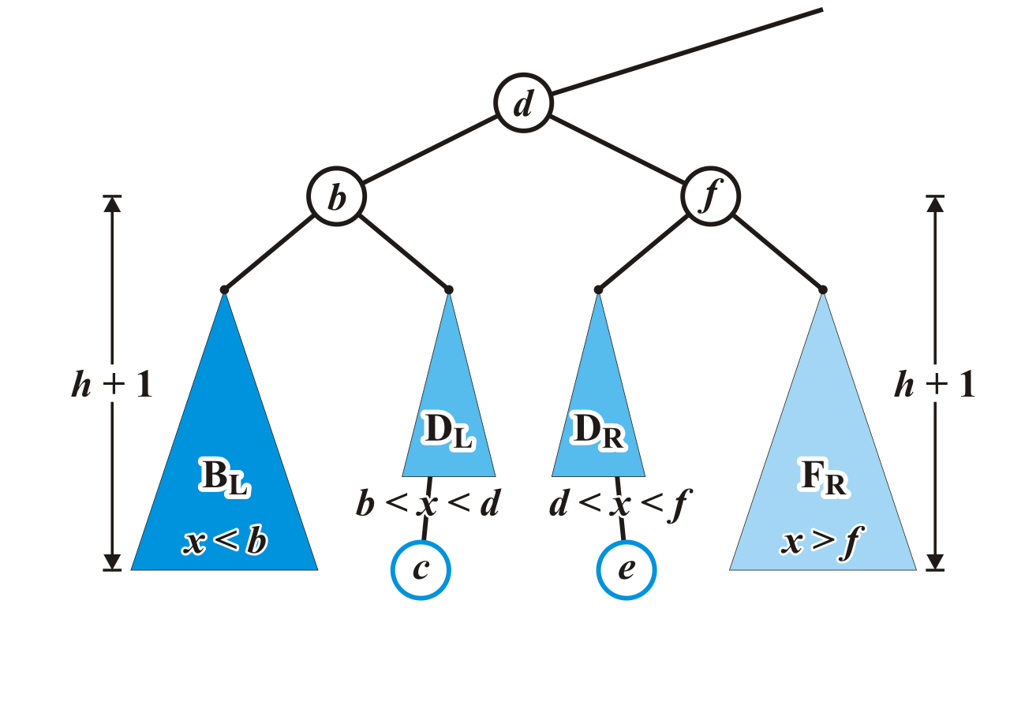
Maintaining Balance: Case 2
Now the tree rooted at d is balanced

Slide 62
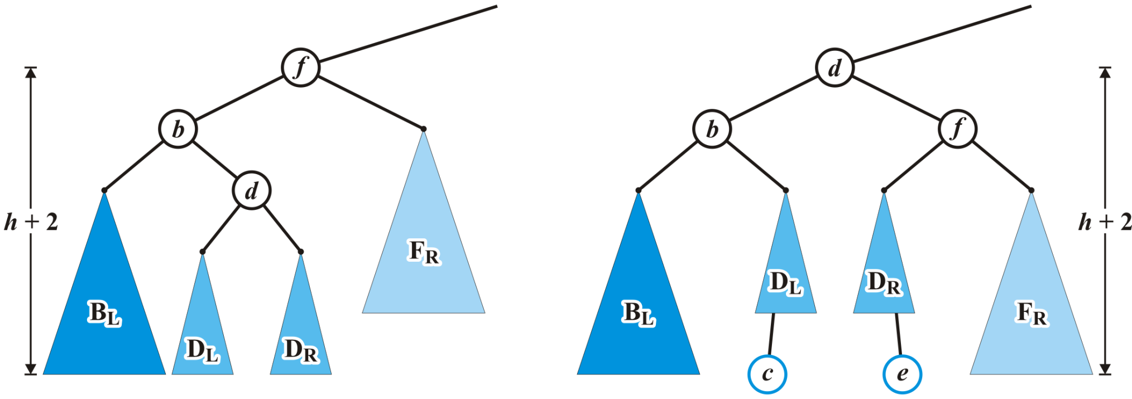
Maintaining Balance: Case 2
Again, the height of the root did not change

Slide 63
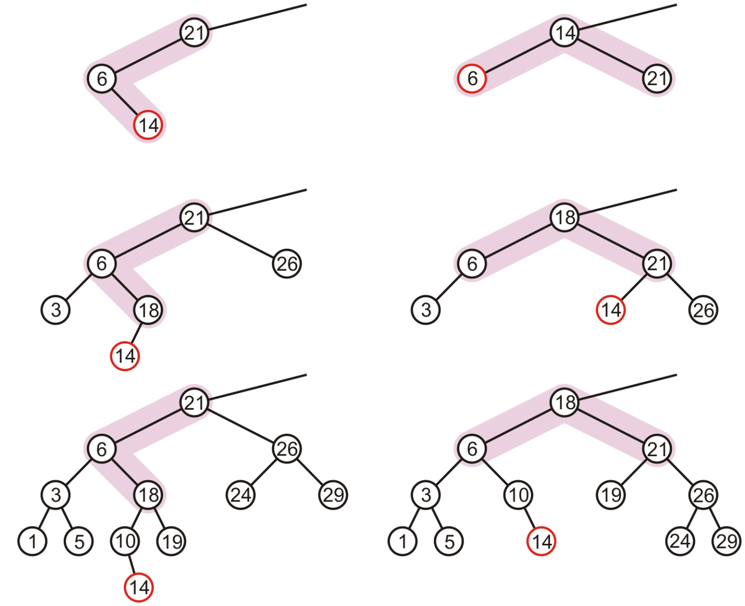
Maintaining Balance: Case 2
In our three sample cases with h = –1, 0, and 1, the node is now balanced and the same height as the tree before the insertion
14

Slide 64
Maintaining balance: Summary
There are two symmetric cases to those we have examined:
Insertions into the right-right sub-tree
-- Insertions into either the right-left sub-tree

Slide 65
More examples : Insertion
Consider this AVL tree

Slide 66
Insertion
Insert 73

Slide 67
Insertion
The node 81 is unbalanced
A left-left imbalance

Slide 68
Insertion
The node 81 is unbalanced
A left-left imbalance

Slide 69
Insertion
The node 81 is unbalanced
A left-left imbalance
Promote the intermediate node to the imbalanced node

Slide 70
Insertion
The node 81 is unbalanced
A left-left imbalance
Promote the intermediate node to the imbalanced node
75 is that node

Slide 71
Insertion
The node 81 is unbalanced
A left-left imbalance
Promote the intermediate node to the imbalanced node
75 is that node

Slide 72
Insertion
The tree is AVL balanced

Slide 73
Insertion
Insert 77

Slide 74
Insertion
The node 87 is unbalanced
A left-right imbalance

Slide 75
Insertion
The node 87 is unbalanced
A left-right imbalance

Slide 76
Insertion
The node 87 is unbalanced
A left-right imbalance
Promote the intermediate node to the imbalanced node

Slide 77
Insertion
The node 87 is unbalanced
A left-right imbalance
Promote the intermediate node to the imbalanced node
81 is that value

Slide 78
Insertion
The node 87 is unbalanced
A left-right imbalance
Promote the intermediate node to the imbalanced node
81 is that value

Slide 79
Insertion
The tree is balanced

Slide 80
Insertion
Insert 76

Slide 81
Insertion
The node 78 is unbalanced
A left-left imbalance

Slide 82
Insertion
The node 78 is unbalanced
Promote 77

Slide 83
Insertion
Again, balanced

Slide 84
Insertion
Insert 80

Slide 85
Insertion
The node 69 is unbalanced
A right-left imbalance
Promote the intermediate node to the imbalanced node

Slide 86
Insertion
The node 69 is unbalanced
A left-right imbalance
Promote the intermediate node to the imbalanced node
75 is that value

Slide 87
Insertion
Again, balanced

Slide 88
Insertion
Insert 74

Slide 89
Insertion
The node 72 is unbalanced
A right-right imbalance
Promote the intermediate node to the imbalanced node
75 is that value

Slide 90
Insertion
The node 72 is unbalanced
A right-right imbalance
Promote the intermediate node to the imbalanced node

Slide 91
Insertion
Again, balanced

Slide 92
Insertion
Insert 55

Slide 93
Insertion
The node 69 is imbalanced
A left-left imbalance
Promote the intermediate node to the imbalanced node

Slide 94
Insertion
The node 69 is imbalanced
A left-left imbalance
Promote the intermediate node to the imbalanced node
63 is that value

Slide 95
Insertion
Insert 55
No imbalances

Slide 96
Insertion
Again, balanced

Slide 97
Insertion
Again, balanced

Slide 98
Insertion
Insert 70

Slide 99
Insertion
The root node is now imbalanced
A right-left imbalance
Promote the intermediate node to the root
75 is that value

Slide 100
Insertion
The root node is imbalanced
A right-left imbalance
Promote the intermediate node to the root
63 is that node

Slide 101
Insertion
The result is balanced

Slide 102
Summary : Insertions
Let the node that needs rebalancing be j.
There are 4 cases:
Outside Cases (require single rotation) :
1. Insertion into left subtree of left child of j.
2. Insertion into right subtree of right child of j.
Inside Cases (require double rotation) :
3. Insertion into right subtree of left child of j.
4. Insertion into left subtree of right child of j.
The rebalancing is performed through four separate rotation algorithms.

Slide 103
Outside Case
Left subtree of left child
Inside Case
Right subtree of left child
Single “right” Rotation
“left-right” Double Rotation

Slide 104
Inside Case Recap
j
k
h
Z
h
h
X
Y

Slide 105
AVL Insertion: Inside Case
Consider the structure
of subtree Y…
j
k
h
Z
h
h+1
X
Y

Slide 106
AVL Insertion: Inside Case
j
k
h
Z
i
h
h+1
X
h or h-1
V
W

Slide 107
AVL Insertion: Inside Case
j
We will do a left-right
“double rotation” . . .
k
Z
i
X
V
W

Slide 108
Double rotation : first rotation
j
left rotation complete
i
Z
k
W
V
X

Slide 109
Double rotation : second rotation
j
Now do a right rotation
i
Z
k
W
V
X

Slide 110
Double rotation : second rotation
right rotation complete
Balance has been
restored
i
k
j
h
h
h or h-1
V
X
W
Z

Slide 111
Implementation
balance (1,0,-1)
key
left
right
No need to keep the height; just the difference in height, i.e. the balance factor; this has to be modified on the path of insertion even if you don’t perform rotations
Once you have performed a rotation (single or double) you won’t need to go back up the tree

Slide 112
Insertion in AVL Trees
Insert at the leaf (as for all BST)
only nodes on the path from insertion point to root node have possibly changed in height
So after the Insert, go back up to the root node by node, updating heights
If a new balance factor (the difference h_{left}-h_{right}) is 2 or –2, adjust tree by rotation around the node
Correctness: Rotations preserve inorder traversal ordering

Slide 113
Erase
Removing a node from an AVL tree may cause more than one AVL imbalance
Like insert, erase must check after it has been successfully called on a child to see if it caused an imbalance
Unfortunately, it may cause multiple imbalances that must be corrected
Insertions will only cause one imbalance that must be fixed

Slide 114
Erase
Consider the following AVL tree

Slide 115
Erase
Suppose we erase the front node: 1

Slide 116
Erase
While its previous parent, 2, is not unbalanced, its grandparent 3 is
The imbalance is in the right-right subtree

Slide 117
Erase
We can correct this with a simple balance

Slide 118
Erase
The node of that subtree, 5, is now balanced

Slide 119
Erase
Recursing to the root, however, 8 is also unbalanced
This is a right-left imbalance

Slide 120
Erase
Promoting 11 to the root corrects the imbalance

Slide 121
Erase
At this point, the node 11 is balanced

Slide 122
Erase
Still, the root node is unbalanced
This is a right-right imbalance

Slide 123
Erase
Again, a simple balance fixes the imbalance

Slide 124
Erase
The resulting tree is now AVL balanced

Slide 125
Pros and Cons of AVL Trees
Arguments for AVL trees:
Search is O(log N) since AVL trees are always balanced.
Insertion and deletions are also O(logn)
The height balancing adds no more than a constant factor to the speed of insertion.
Arguments against using AVL trees:
Difficult to program & debug; more space for balance factor.
Asymptotically faster but rebalancing costs time.
Most large searches are done in database systems on disk and use other structures (e.g. B-trees).
May be OK to have O(N) for a single operation if total run time for many consecutive operations is fast (e.g. Splay trees).

