Slide 1
Presentation On: A combinatorial approach to detect buffer overflow vulnerabilites
Abhinn Kothari,
2009CS10172
Parth Jaiswal
2009CS10205
Group: 3
Supervisor : Huzur Saran

Slide 2
Outline
Introduction
Approach – Combinatorial Testing
Algorithm – Buffer Overflow Vulnerability Test
Tance – A prototype testing tool
Threats to Validity
Conclusion and Future Work

Slide 3
Introduction
Buffer Overflow Vulnerabilities – Program Defects that can cause buffer to overflow at runtime
Security attacks on BOV can compromise critical data structures
Presents a black box testing approach to detect BOV’s
Target system attacked by controlling the values of external parameters.

Slide 4
Attack Payload Parameter
Attack Payload Parameter - whose value is likely to be copied into a buffer vulnerable to overflow, located close to critical data structure.
Example – Return Address on the call stack
There exists a single attack payload parameter in many buffer overflow attacks.
Allows attacker to gain control over program execution

Slide 5
Attack Control Parameters
Attack Control Parameters – external parameters which steer program execution to reach a vulnerable point.
Example – A statement that copies the value of attack payload parameter P into Buffer B.
As critical as choosing attack payload parameter, so as to reach the vulnerable point and carry out a successful attack.
Aim – Use combinatorial testing to generate a group of tests for each value identified for each attack payload parameter, s.t. one of these is likely to steer program execution to reach a vulnerable point.

Slide 6
Approach- Combinatorial Testing
Combinatorial testing, which is also referred to as t-way testing, requires that, for any t (out of n) parameters of M, every combination of values of these t parameters be covered at least once
t – refers to strength of combinatorial testing
Empirical results suggest high correlation between combinatorial coverage and code coverage.
Significantly reduces the number of tests.
Example: A pairwise test set for 10 boolean parameters as few as 13 tests, while exhaustive tests may require1024.

Slide 7
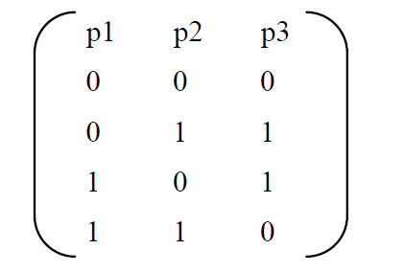
Approach- Combinatorial Testing
Example – Program with 3 parameters, each taking values 0 or 1. Shows 2-way test set for these 3 parameters.

Slide 8
Vulnerability Detection
Consider, a statement L, copying a string variable into buffer B, without checking buffer has enough space to hold. A test case can detect this vulnerability if:
C1: L must be executed during the execution of test
C2: When L is executed, buffer must overflow.
Our approach centered on how to generate tests such that C1 and C2 are satisfied simultaneously
Notes:
Buffer Small or String very large or both

Slide 9
Hypothesis
Hypothesis H1: It is often the case that a buffer is overrun by an extreme value (of an internal variable) that is derived from a single extreme value taken by an external parameter.
Hypothesis validated using BOV reports in 3 public databases
Hypothesis allows to generate tests s.t. each test needs only single attack payload parameter

Slide 10
Main Idea
Identify a group of potential attack payload parameters
A set of extreme values for each of these payload parameters
For each attack payload parameter, identify a set of attack control parameters
A set of control values for each of these attack control parameters.
Notes:
For each extreme value of each attack payload parameter, we generate a combinatorial test set such that P takes value v in each test T and T covers all t-way combination of attack control parameters , where t shouldn’t be greater than 6.

Slide 11
Algorithm- BOV Test
Algorithm BOVTest
Input: A program specification M, and an integer t
Output: A test set T for detecting buffer overflow vulnerabilities in an implementation of M
1. let P be the set of all the external parameters of M
2. identify a set Px ⊆ P of attack-payload parameters and a set of extreme values for each parameter p in Px
3. initialize T to be an empty test set
4. for each attack-payload parameter px in Px {
5. identify a set Pc ⊆ P of attack-control parameters for px and a set of control values for each parameter pin Pc
6. let Pd = P – Pc, and identify a default value d(p) foreach parameter p in Pd
7. for each extreme value v of px {
8. build a t-way test set T′ for parameters in Pc using their control values
9. for each test τ′ in T′ {
10. create a complete test τ such that for each parameter p, τ(p) = v if p = px, τ(p) = τ′(p) if p ∈ Pc, and τ(p) = d(p) otherwise, where τ(p) (or τ′(p)) is the value of parameter p in test τ (or τ′)
11. T = T ∪ τ }}}
15. return T

Slide 12
Parameter Identification
Identification of set Px of attack payload parameters and their values.
Identification of the set P_{c} of attack control parameters and their values for each attack payload parameter in P_{x} .
Identification of the set P_{d} of non attack control parameters and their values.
Basically, P_{d} is complement of P_{c} .
Notes:
Specific values are not important |||||| Network Protocol – User Payload - Attack Payload Parameter and Message Type - ACP

Slide 13
Security Test Generation
Generate a t-way test set T’ for all the parameters in P_{c} using their control values
Each test in T’ is then used as a base test to create a complete test by:
Adding v as a value of P_{x}
Adding the default value of each parameter in P_{d}

Slide 14
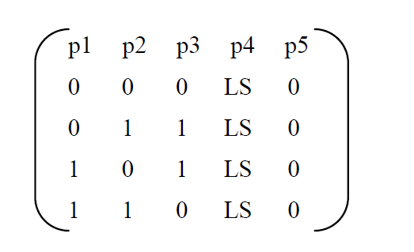
Example
p1, p2 , p3 – attack control parameters , p4 – attack payload parameters , p5 – non-attack control parameters.
LS indicates a very long string
p1, p2 and p3 take control values 0 & 1
p5 has default value 0.
2-way test set

Slide 15
Discussion
Extreme values matter because of their extreme properties instead of their specific values.
Approach effective when attack payload and control parameters identified properly, otherwise will miss
Nonetheless, the approach ensures t-way coverage of each attack payload parameter and its control parameters, thus no vulnerable point will be missed in most cases.
Notes:
Since combinatorial coverage is shown to directly correlate with code coverage

Slide 16
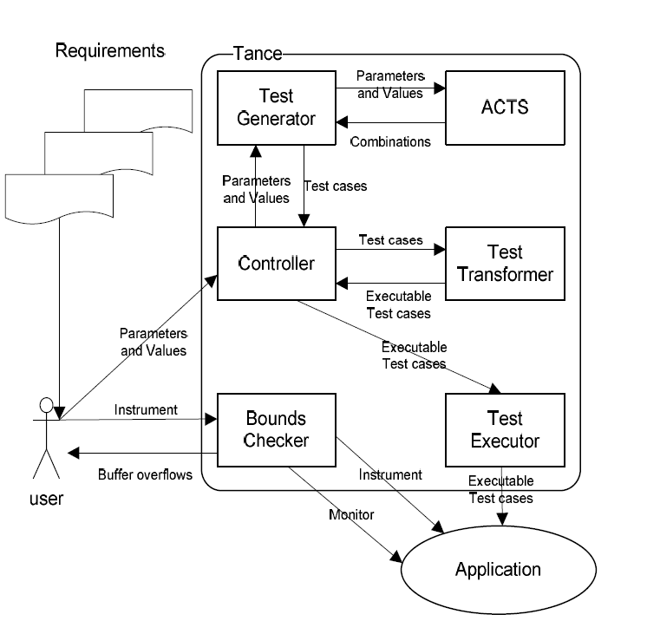
TANCE – A prototype tool

Slide 17
Controller
Core component of TANCE, drives the entire testing process
Receives from user the external parameter model of the subject application
Calls Test Generator to generate combinatorial test based on the given parameter model.
For each test uses Test Transformer to transform into an executable format.
Calls Test Executor to execute each test automatically.

Slide 18
Test Generator
Implements the algorithm BOV test.
Uses a combinatorial test generation tool called ACTS to generate a base combinatorial test set.

Slide 19
Test Transformer
Transforms each combinatorial test into a format acceptable by the subject program
Example: a web server requires each test to be presented as an http request

Slide 20
Test Executor
Carries out the actual test execution process
Example: Send test requests automatically to http servers. In addition test executors will restart http servers before running the next test so that there is no interference between different tests.
Needs to be customized for different programs

Slide 21
Bounds Checker
Detects actual occurrence of a buffer overflow
Instruments the source code
Source level information helps analysis of test results for evaluation purpose.

Slide 22
Threats to validity
Effectiveness of the approach depends on proper identification of attack payload and attack control parameters.
Validity of results are jeopardized if knowledge of known vulnerabilities were used to identify these parameters

Slide 23
Conclusions & Future Work
Discussed black-box testing approach to detect buffer overflow vulnerabilities.
The approach exploits the fact that combinatorial testing achieves high degree of code coverage.
Future plan is to develop static analysis techniques for identifying attack payload and attack control parameters

