Slide 1
Defenses

Slide 2
Preventing hijacking attacks
Fix bugs:
Audit software
Automated tools: Coverity, Prefast/Prefix.
Rewrite software in a type safe languange (Java, ML)
Difficult for existing (legacy) code …
Concede overflow, but prevent code execution
Add runtime code to detect overflows exploits
Halt process when overflow exploit detected
StackGuard, LibSafe, …

Slide 3
Marking memory as non-execute (W^X)
Prevent overflow code execution by marking stack and heap segments as non-executable
NX-bit on AMD Athlon 64, XD-bit on Intel P4 Prescott
NX bit in every Page Table Entry (PTE)
Deployment:
Linux (via PaX project); OpenBSD
Windows since XP SP2 (DEP)
Boot.ini : /noexecute=OptIn or AlwaysOn
Limitations:
Some apps need executable heap (e.g. JITs).
Does not defend against `return-to-libc’ exploit
Notes:
OptIn: Windows processes are protected. Other apps must OptIn for protection using sysdm.cpl program.
DEP: data execute prevention

Slide 4
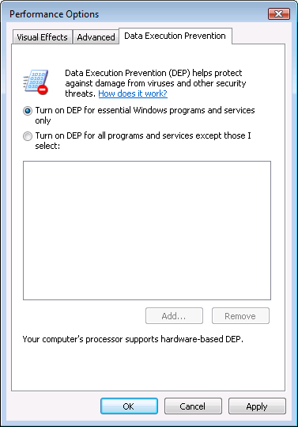
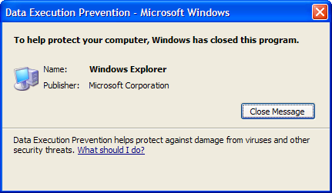
Examples: DEP controls in Vista
DEP terminating a program

Slide 5
Return to libc
Control hijacking without executing code
stack
libc.so
args
ret-addr
exec()
sfp
printf()
local buf
“/bin/sh”
Notes:
NX wasted effort?

Slide 6
Response: randomization
ASLR: (Address Space Layout Randomization)
Map shared libraries to rand location in process memory
⇒ Attacker cannot jump directly to exec function
Deployment:
Windows Vista: 8 bits of randomness for DLLs
aligned to 64K page in a 16MB region ⇒ 256 choices
Linux (via PaX): 16 bits of randomness for libraries
More effective on 64-bit architectures
Other randomization methods:
Sys-call randomization: randomize sys-call id’s
Instruction Set Randomization (ISR)
Notes:
Combination of NX and ASLR is effective.

Slide 7
ASLR Example
Booting Vista twice loads libraries into different locations:
Note: ASLR is only applied to images for which the dynamic-relocation flag is set

Slide 8
Run time checking

Slide 9
Run time checking: StackGuard
Many many run-time checking techniques …
we only discuss methods relevant to overflow protection
Solution 1: StackGuard
Run time tests for stack integrity.
Embed “canaries” in stack frames and verify their integrity prior to function return.
Frame 2
Frame 1
top of stack
local
canary
sfp
ret
str
local
canary
sfp
ret
str

Slide 10
Canary Types
Random canary:
Choose random string at program startup.
Insert canary string into every stack frame.
Verify canary before returning from function.
To corrupt random canary, attacker must learn current random string.
Terminator canary: Canary = 0, newline, linefeed, EOF
String functions will not copy beyond terminator.
Attacker cannot use string functions to corrupt stack.

Slide 11
StackGuard (Cont.)
StackGuard implemented as a GCC patch.
Program must be recompiled.
Minimal performance effects: 8% for Apache.
Note: Canaries don’t offer fullproof protection.
Some stack smashing attacks leave canaries unchanged
Heap protection: PointGuard.
Protects function pointers and setjmp buffers by encrypting them: XOR with random cookie
More noticeable performance effects

Slide 12
StackGuard variants - ProPolice
ProPolice (IBM) - gcc 3.4.1. (-fstack-protector)
Rearrange stack layout to prevent ptr overflow.
String Growth
args
No arrays or pointers
ret addr
SFP
CANARY
Stack Growth
arrays
local variables
Ptrs, but no arrays
Notes:
ProPolice: replicates pointers in arguments to bottom of local vars area.
/GS: Arguments, return address, cookie, arrays, local variables, copies of some pointer arguments, alloca

Slide 13
MS Visual Studio /GS [2003]
Compiler /GS option:
Combination of ProPolice and Random canary.
Triggers UnHandledException in case of Canary mismatch to shutdown process.
Litchfield vulnerability report
Overflow overwrites exception handler
Redirects exception to attack code

Slide 14
Run time checking: Libsafe
Solution 2: Libsafe (Avaya Labs)
Dynamically loaded library (no need to recompile app.)
Intercepts calls to strcpy (dest, src)
Validates sufficient space in current stack frame: |frame-pointer – dest| > strlen(src)
If so, does strcpy, otherwise, terminates application
top of stack
sfp
ret-addr
dest
src
buf
sfp
ret-addr
libsafe
main

Slide 15
More methods …
StackShield
At function prologue, copy return address RET and SFP to “safe” location (beginning of data segment)
Upon return, check that RET and SFP is equal to copy.
Implemented as assembler file processor (GCC)
Control Flow Integrity (CFI)
A combination of static and dynamic checking
Statically determine program control flow
Dynamically enforce control flow integrity

